Slide 1
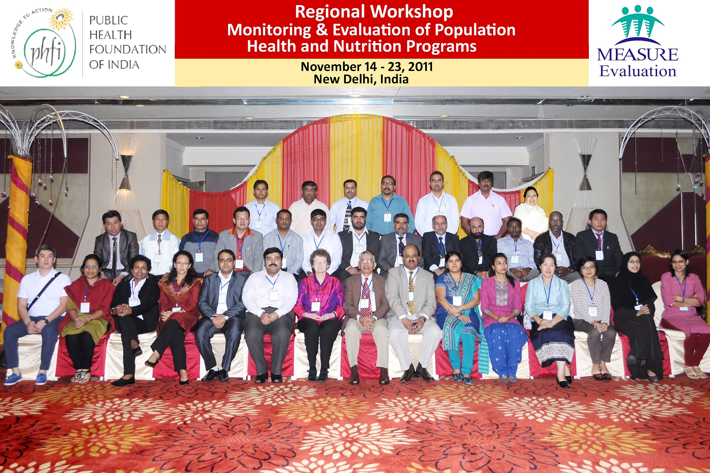
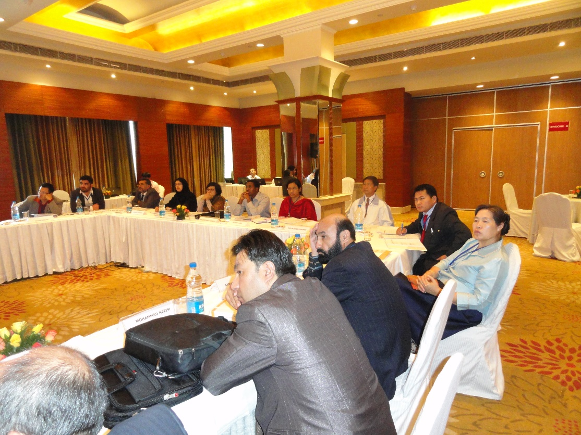
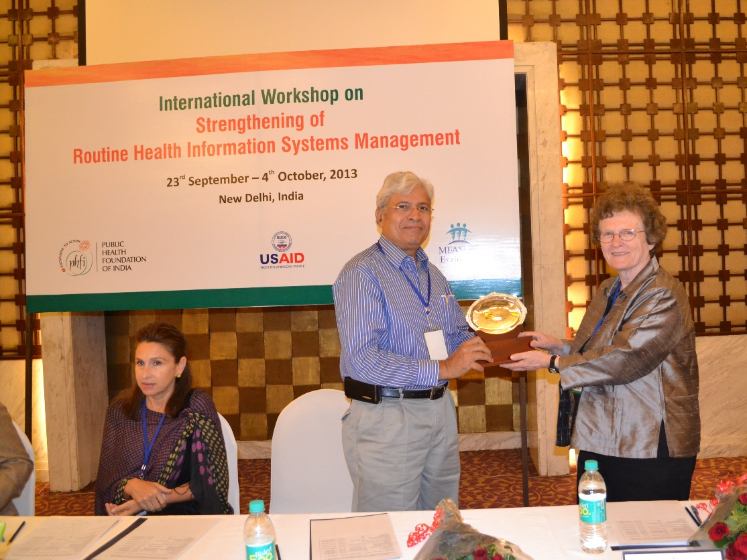
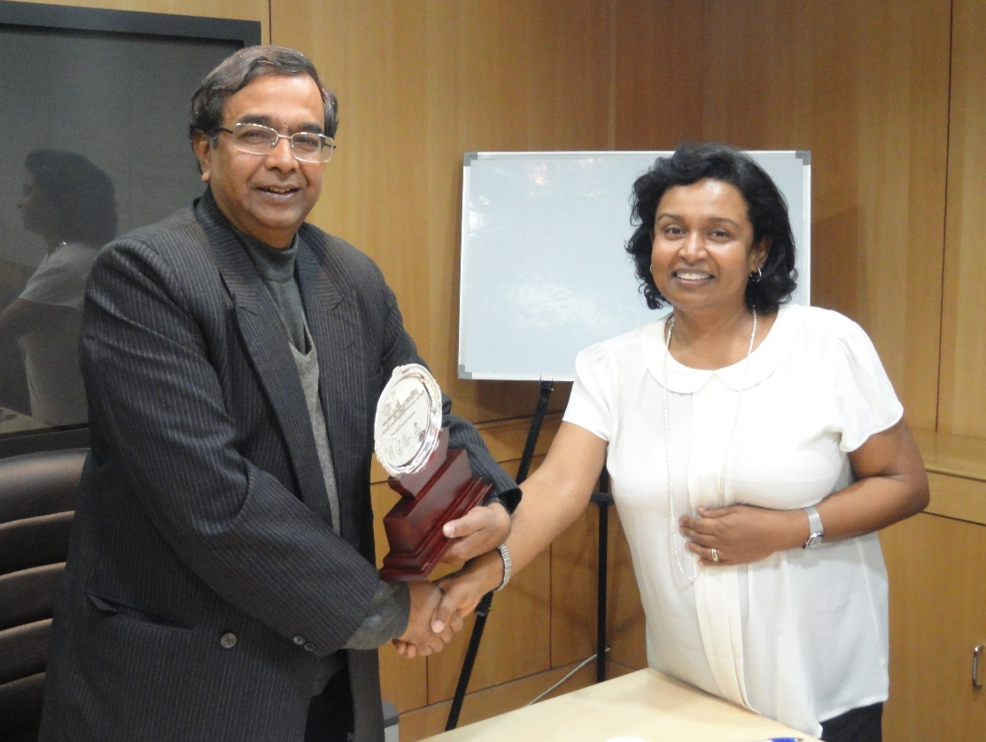
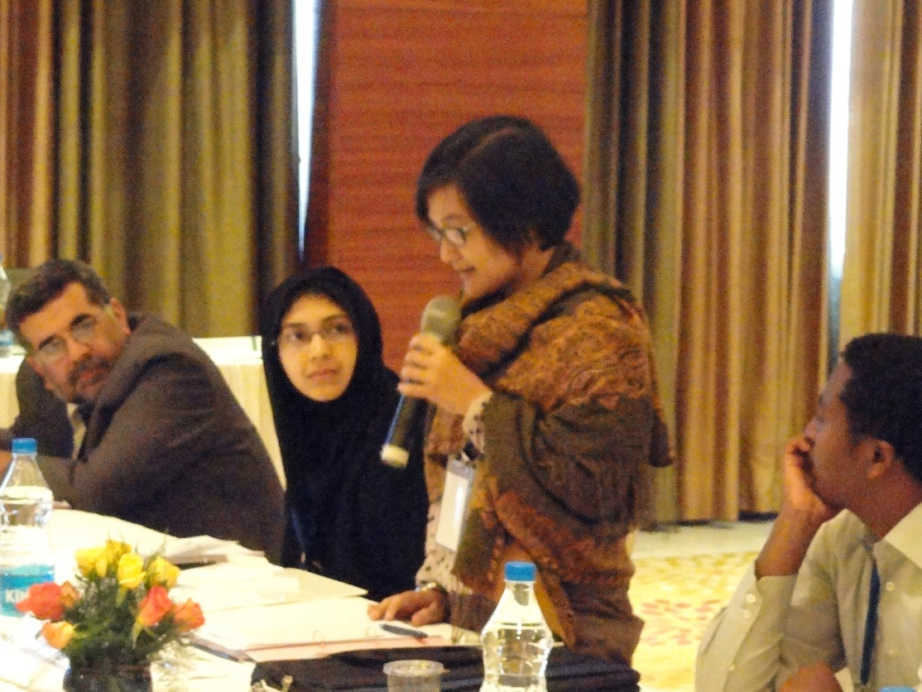
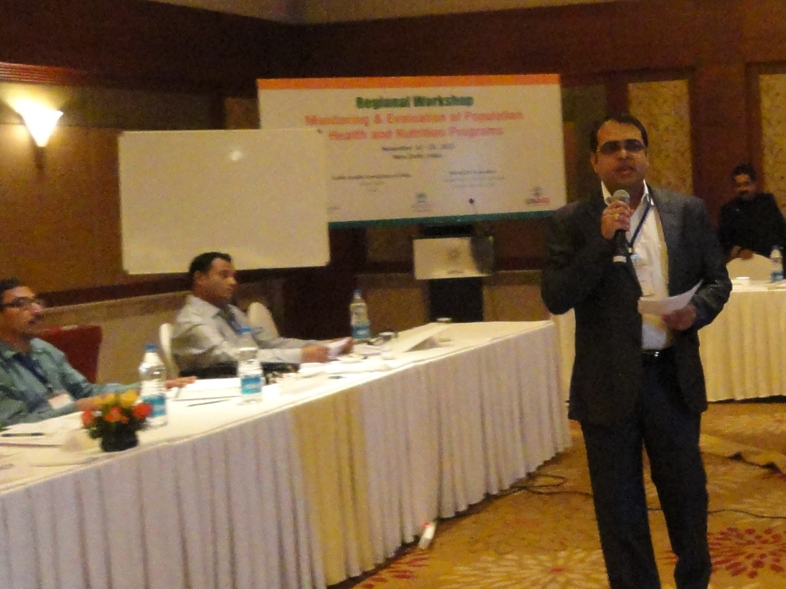
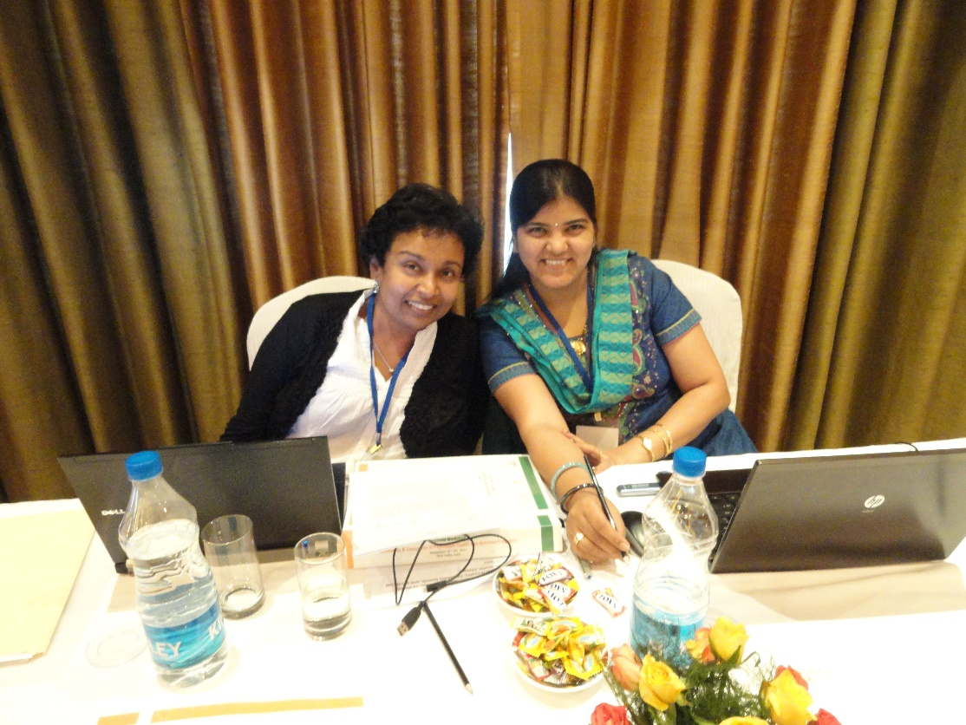



Building a Center of Reference for
M&E of Health Programs:
A Partnership Between MEASURE Evaluation & Public Health Foundation of India
Hemali Kulatilaka and Jason B. Smith (MEASURE Evaluation, Carolina Population Center, University of North Carolina at Chapel Hill)
Sangeeta Tikyani Singh, and Sanjay Zodpey (Public Health Foundation of India)
The Partnership
The Public Health Foundation of India (PHFI) and MEASURE Evaluation established a capacity building partnership in July 2008. The overarching goal of the partnership is to establish PHFI as a regional Center of Reference in M&E by strengthening its institutional capacity in a sustainable way.
Lessons Learned
Importance of Relationship Building
Institutionalization of M&E through creation of organizational unit dedicated to M&E activities
Importance of M&E champion(s)
Sustained commitment to M&E as a strategic organizational priority
Shared Responsibility for Ensuring Adequate Funding
Core Team of trained, high performing staff
Well Developed Training Management System
Importance of Regional and Global Networks and Linkages
Capacity Building Interventions
Capacity building of faculty members and trainers in M&E topics,
Designing and delivering joint training programs,
Developing and adapting M&E curricula and training materials,
Engaging faculty and trainers in regional M&E technical assistance activities, and
Promoting sustainability through the establishment of networks of M&E centers of reference.
Partnership Milestones
Rapid Expansion of M&E Training Portfolio at PHFI
Curriculum Development and Adaptation by PHFI for national and regional training programs
Provision of M&E Technical Assistance and Conducting M&E Research Studies
Organization Development by Developing a Business Plan for Creating a Regional Center of Reference for Public Health M&E in Southeast Asia and establishing a new M&E Unit at PHFI.
Networking with Other Regional M&E Centers as a Founding Member of the Global Evaluation and Monitoring Network for Health (GEMNET – Health)
Monitoring and
Evaluation Unit-
South East Asia
Region
The Monitoring and Evaluation Unit at PHFI functions as a coordinating unit across the other functional groups, tapping into M&E expertise and bringing together those interested in M&E throughout the organization.
The Future
We see PHFI being well positioned to further develop the role of providing training and technical assistance both domestically and regionally, and also become a leader and collaborator in evaluation research efforts. We believe that being connected to other M&E centers through GEMNet-Health will also be a vital element for continued development and expansion of the scope of M&E activities at PHFI.
m
o
c
.
3000
km
(equat.)
s
p
a
m
-
d
2000
mi
(equat.)
©
To date, a total of 698 M&E professionals have attended the 11 regional/ international and 20 national M&E workshops conducted by PHFI
Public Health Foundation of India (PHFI)
The Public Health Foundation of India (PHFI) is a public private initiative that has collaboratively evolved through consultations with multiple constituencies including Indian and international academia, state and central governments, multi & bi-lateral agencies and civil society groups. PHFI is a response to redress the limited institutional capacity in India for strengthening training, research and policy development in the area of Public Health.
MEASURE Evaluation
MEASURE Evaluation works with USAID and its country missions and collaborating agencies, as well as governmental and non-governmental organizations worldwide, to help countries measure their progress in confronting disease, population issues and poverty. Our technical leadership and training programs build the capacity of policy makers and public health leaders to use their knowledge of that progress to improve public policy and health programs. MEASURE Evaluation is supported by the USAID under terms of Cooperative Agreement GHA-A-00-08-00003-00.
Learn more about MEASURE Evaluation
Learn more about PHFI

