Slide 1


Module 2
Household Vulnerability Prioritization Tool Database

Slide 2

Training Agenda
Notes:
Review the day ahead.

Slide 3
Objectives
Become familiar with the Household Vulnerability Prioritization Tool (HVPT) database
Practice using the HVPT database
Use advanced functions of HVPT database
Prioritize households for enrollment
Generate a list of households needing referrals
Know how to use the database for future rounds of enrollment

Slide 4
HVPT Database’s Purpose
Collects data on households assessed
Prioritizes households based on predetermined criteria
Creates list of qualified households
Creates list of households requiring referrals

Slide 5

2A. What Is the HVPT Database?
Upload the file onto your computer.
Open the database file.
Enter the password for the database (OVC_Developer).
Click through the tabs. What do you see?
Source: http://www.123rf.com/photo_29117927_stock-vector-cartoon-illustration-of-a-african-boy-dressed-as-an-explorer.html

Slide 6
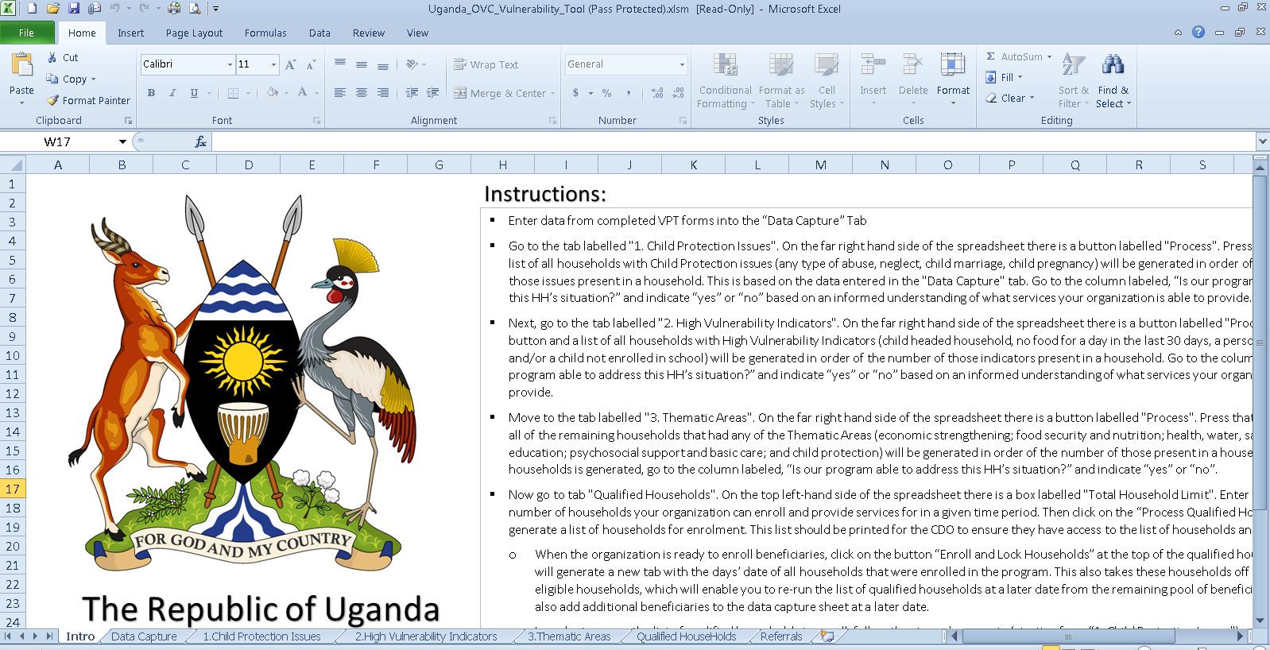
Tabs in Database

Slide 7
“Intro” Tab
Gives instructions on how to use the database
Note: It is important that you use the databases in the order of the tabs in the spreadsheet.
Notes:
Now ask participants to go to this tab and ask them what they see. Then click to get the answer on the slide.

Slide 8
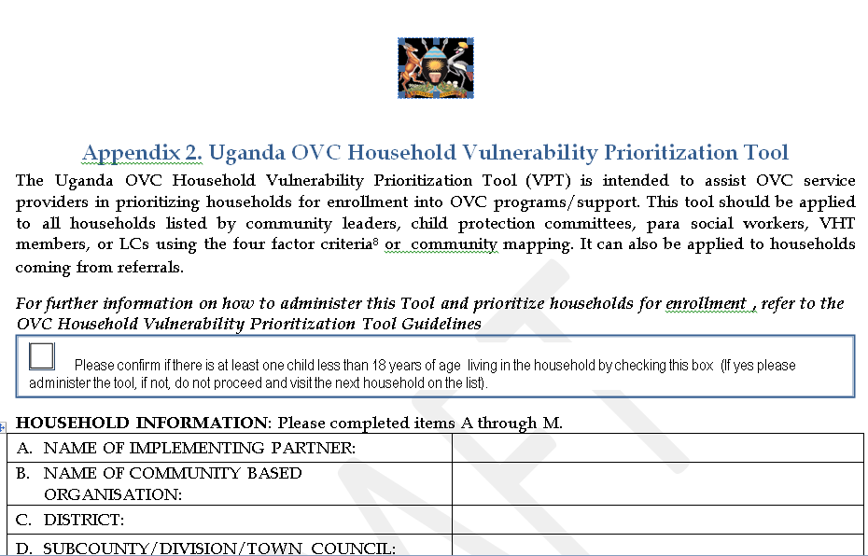
“Data Capture”
Completed HVPT forms are entered here.
There is one column for each question on the HVPT.
Manually enter data from forms here.

Slide 9

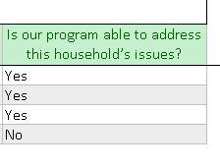
1. “Child Protection Issues”
No data are entered here except under column “M” (“Is our program able to address this household’s issues”).
There is a “process” button you can use to pull households based on the data entry tab.
** Households with child protection issues are considered highest priority by the HVPT.
Notes:
Here it will be important to explain that this was deemed the number one priority area for support to children and families. That’s why households with these characteristics are selected first.
Background: Question 14 refers to several different types of child protection situations. A household experiencing any of these will be prioritized first, and households will be listed in the order of the number of child protection issues to which they responded “yes.”

Slide 10
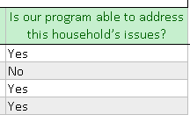
2. “High Vulnerability Indicators”
No data are entered here except under column “L” (“Is our program able to address this household’s issues”).
There is a “process” button you can use to pull households based on the data entry tab
** Households with these characteristics are
prioritized second.
Notes:
Background: Child-headed households (“yes” response to question 1); households where any child went a whole day in the past month without eating anything, because there wasn’t enough to eat (“yes” response to question 6); households that have someone living there who is HIV+ (“yes” response to question 9); and households that have any children ages 5 to 17 years not enrolled in school (“yes” response to question 11) indicate a “highly vulnerable” situation and will be prioritized next.

Slide 11
3. “Thematic Areas”
No data are entered here except under column “J” (“Is our program able to address this household’s issues”).
There is a “process” button you can use to pull households based on the data entry tab.
**The remaining households are prioritized based on the number of core program areas for which a household has vulnerability.
Notes:
Background: After prioritizing the households with child protection issues (a response of “yes” to any of the items in question 14) and high vulnerability indicators, the remaining households will be prioritized based on the number of core program areas for which a household has vulnerability. For example, if economic strengthening; health, water, shelter, and sanitation; and child protection are identified as “yes” (indicating vulnerability), then that indicates three vulnerability areas as “yes.” If another household has economic strengthening and psychosocial support as “yes,” then that indicates two vulnerability thematic areas as “yes.” Households with three vulnerabilities would be prioritized over households with two vulnerability areas. A program will also have to keep in mind what it is able to address with its program services.

Slide 12
“Qualified Households”
The final list of qualified households is generated here.
You have to specify how many households you can enroll by entering a number.
“Process Qualified HHs” will generate a list based on the data capture tab.
“Enroll & Lock HH’s” will move the qualified households list to a separate tab.
  → These households will not appear on future lists.
Notes:
We will practice all of this functionality shortly.

Slide 13
“Referrals”
This will present a list of ALL households referred for services during the VPT administration process (regardless of enrollment).
Click “Process ” button to generate the list.
This can be printed and provided to a district officer for follow-up.
“Enroll & Lock HHs” will move referred households list to a separate tab.
  → These households will not appear on future referral lists.

Slide 14

Notes:
Allow time at the end of the session to discuss challenges encountered during the practice session with demonstrations walking through how to solve them. You can also solicit demonstrations from participants to show the group what they did in specific instances.

Slide 15
2B. Practice Using the HVPT Database
Enter in the HVPT forms (generated for this activity).
Practice following the instructions provided on the “Intro” sheet.
Start with the data capture sheet and data entry.
Then move tab by tab based on the instructions.
Assume you can address the following issues: child protection, economic strengthening, and education.
Assume you can enroll 5 households.
What households do you have in the “qualified households tab”?
What households are in the referrals tab?
Notes:
Ask several participants to report back on the exercise and write down the qualified households on the flip chart. Ask other participants to note if they had the same response or not. If not, discuss with the group what went wrong and which version is correct and why.

Slide 16
Practice Using the HVPT Database
How did it go?
Notes:
To problem-solve and discuss feedback from the practice

Slide 17
2C. Advanced Functions of the HVPT Database
“Is our program able to address this household’s issue?”
“Total Households Limit”
“Enroll & Lock HHs”
Data Storage and Security
Important Notes

Slide 18
“Is Our Program Able to Address the Household’s Issue?”
Based on what services are provided by your organization
Important to be honest and realistic

Slide 19
“Total Households Limit”
Based on the capacity of your organization
Important to be honest and realistic

Slide 20
“Enroll and Lock Households”
Write date on enrollment.
Clicking the button will remove households from all future processing of households.
It is important to confirm that households will be enrolled before clicking this button.

Slide 21
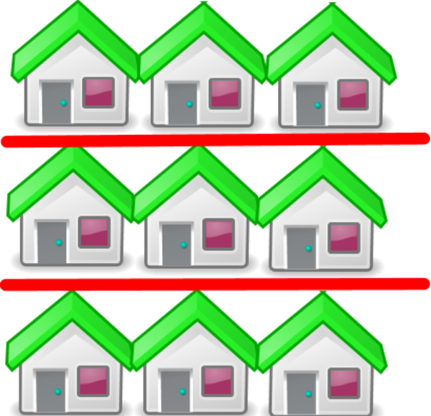
Adding New Households
Add to the original Data Capture Tab.
Follow the same steps.
Recognize that original households not enrolled (and locked) will be included in analysis.

Slide 22
Data Storage and Security
All HVPT forms must be stored in a locked cabinet and protected according to the National Data Protection Act.
The database storing this information should be password-protected and access allowed only by designated officers.

Slide 23
Important Notes
Do not change the naming schema of the spreadsheets.
Do not change the layout of the columns on any of the spreadsheets.
Households that do not have a Household Number do not get processed.
  If there is no household number scheme, insert another way to identify a unique household.
Notes:
Do not change the layout of the columns on any of the spreadsheets. (Removing, adding, or editing column layouts will cause the tool to relay incorrectly filtered information.)

Slide 24
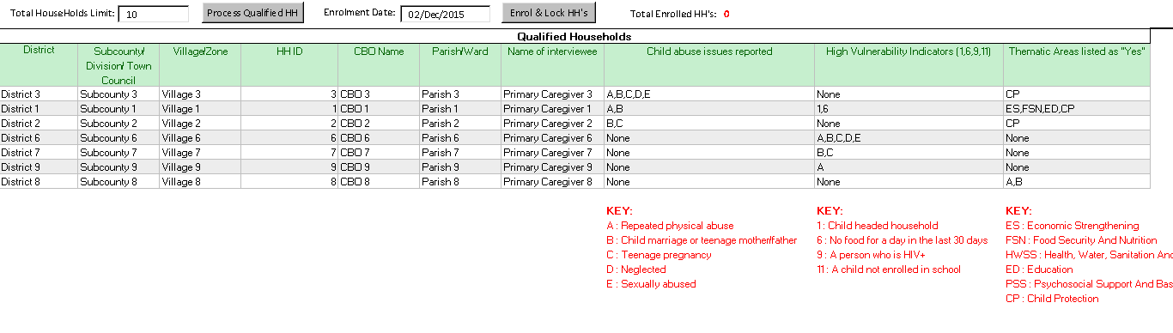
2D. Prioritizing Households
Can you explain how the households were prioritized?
Notes:
Refer back to the exercise done in Session 2B (slide 12). From this exercise participants should have generated a list of prioritized households. Divide participants into groups of three and have them work together for 10 minutes to understand how the households were prioritized for enrollment. Tell them they can refer to the Guidelines for Administering the HVPT and the slide deck.
Ask a group to volunteer to explain the three-step process for prioritizing households. Refer to the “Prioritization Process” on pages 4-7 of the guidelines to make sure it is clear to all participants.

Slide 25

Prioritizing Households
Prioritize Households with Any Child Protection Issue
Prioritize Households with High Vulnerability Indicators
Prioritize Number of Thematic Areas
Numbers enrolled depend on organizational capacity
Depends on what services an organization can provide
Notes:
Show this slide after conducting the exercise below:
Ask a group to volunteer to explain the three-step process for prioritizing households. Refer to the “Prioritization Process” on pages 4-7 of the guidelines to make sure it is clear to all participants. Emphasize that in addition to the three-step process (prioritization by any child protection issue, by high vulnerability indicators, and by number of thematic areas), prioritization occurs based on the services an organization can provide and the numbers of households they can enroll at a given time.

Slide 26
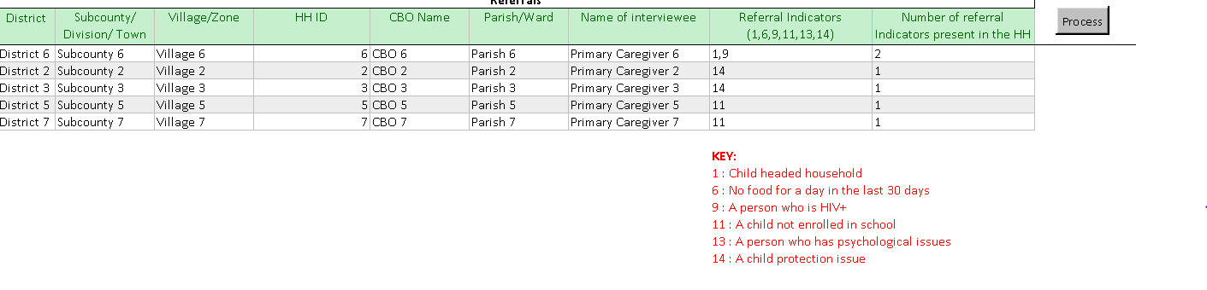
2E. Referrals
What does the referrals tab tell us?
Notes:
Discussion

Slide 27
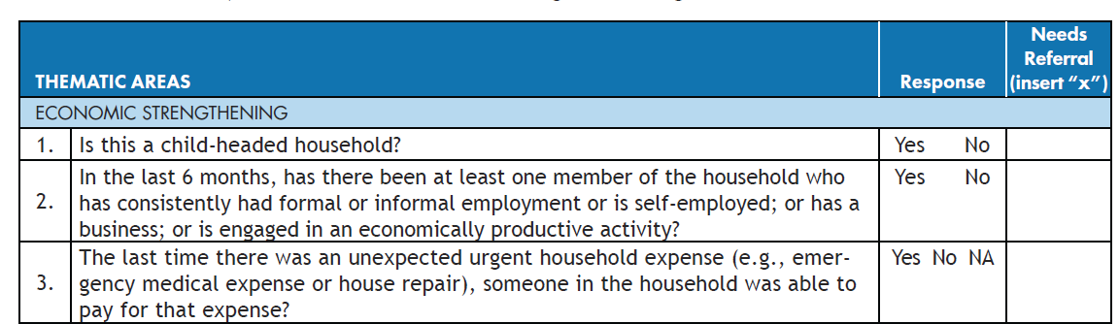
Referrals
This is a reminder of where the referrals come from.

Slide 28
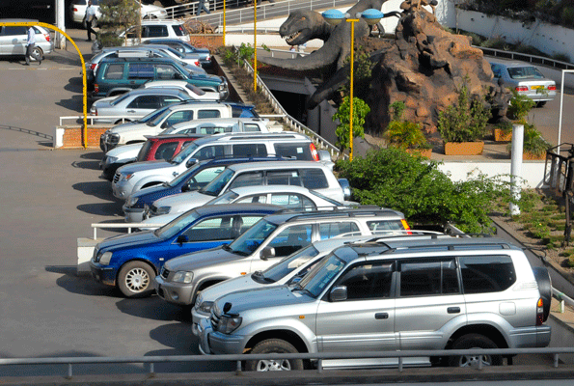
Parking Lot
Image from: http://www.monitor.co.ug/Business/Prosper/Used-vehicles--age-limit-the-only-reliable-criterion/-/688616/1461230/-/qqqugfz/-/index.html
Notes:
(This slide is reserved for time for any questions that might have come up during the training but were “parked” for responses later on, either to allow time for facilitators to gather more information, or because it diverged from the content of a particular session.)

Slide 29
Acknowledgments
The Government of Uganda wishes to thank the USAID- and PEPFAR-funded MEASURE Evaluation project for leading the development of this work.

Slide 30



This presentation was produced with the support of the United States Agency for International Development (USAID) under the terms of MEASURE Evaluation cooperative agreement AID-OAA-L-14-00004. MEASURE Evaluation is implemented by the Carolina Population Center, University of North Carolina at Chapel Hill in partnership with ICF International; John Snow, Inc.; Management Sciences for Health; Palladium; and Tulane University. Views expressed are not necessarily those of USAID or the United States government.
www.measureevaluation.org

