Slide 1


Module 1
Training on the OVC Household Vulnerability Prioritization Tool

Slide 2

Introductions
Notes:
Facilitators introduce themselves, their expertise, and how they became involved in the workshop.
Then ask participants to introduce themselves through icebreakers. Here are a few examples:
Introduce name, title, and favorite food
Introduce name, title, organization, and the three things you would want on a deserted island
Instead of introducing themselves to the whole class, ask participants to introduce themselves to the person next to them and have their partner introduce them
(If you would like to, now is a good to time to also set the rules of the workshop: for example, no talking on cell phones, arriving on time.)

Slide 3

Training Agenda
Notes:
Insert and/or review paper version of agenda for full training

Slide 4
Objectives: Module 1
Articulate the purpose of the orphans and vulnerable children (OVC) Household Vulnerability Prioritization Tool (HVPT)
Understand the pre-identification process
Effectively administer the HVPT
Administer the tool in an ethical manner

Slide 5
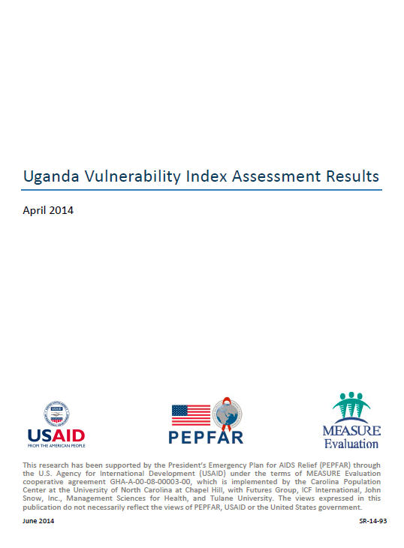
1A. Introducing the HVPT
Vulnerability Index (VI) created in 2012
2013-2014 MEASURE Evaluation assessment of VI
Technical Working Group redesigned the tool and its purpose
Notes:
Ask participants: Is anyone familiar with the vulnerability index, or VI? Has anyone ever seen it used in the program? A MEASURE Evaluation assessment of the tool in 2013-2014 documented shortcomings, including concerns that the tool was not reliably capturing the most vulnerable. In addition, the tool took a long time to administer and asked dozens of detailed personal questions, even though the answers were no guarantee that families would receive services.
Based on that report, the Ministry of Gender, Labour, and Social Development (MGLSD) convened a VI technical working group meeting in June 2015 in Kampala to clarify the purpose of the VI and the most critical types of household vulnerability that would lead a program to enroll a household. From this meeting, the tool has been revised and renamed the OVC Vulnerability Identification and Prioritization Tool to better reflect its clarified purpose.

Slide 6

Purpose of the HVPT
→ Assist in prioritizing households for enrollment in OVC programs
Notes:
Ask participants: So what is the purpose of this tool?
As you know, orphans and other vulnerable children and the households in which they live typically have multiple issues that have led to, or are a result of, their vulnerability. They may have an insufficient source of income, or not enough food to eat. They may be headed by a child, and they or a family member may be HIV-positive. Often, children in these households are not attending school, are lacking in basic water and sanitation where they live, and may be in danger of violence or exploitation.
A difficulty arises, however, in determining who should be enrolled in services, because—in most instances—there are more families who need services than there are funds to provide for them. Each country and program must first identify whom to target and enroll in services, with some level of confidence that the neediest households will be the ones identified. This is complex, given the integrated nature of OVC programming, and there is no global standardized approach.
The HVPT was developed to assist programs and government in prioritizing households for enrollment in OVC programs (or to receive OVC services). The Uganda HVPT is intended to assist programs and districts in prioritizing households for enrollment in OVC programs. This tool should be applied to all households listed as potentially vulnerable and in need of OVC program services from a) referrals from health facilities, schools, social services, police or other institutions; b) a list of households generated by community leaders using the four factor criteria (orphanhood, disability, out of school, and chronically ill); or c) the community mapping process. It is intentionally designed to be a short tool, as it will be administered to people who may or may not be enrolled in the program. Spending a long time in a household and asking many detailed questions can create expectations among household members that may not be fulfilled if you find they do not qualify.

Slide 7
Why Prioritization?
Notes:
A community may identify, for example, 100 households that need support, but there may be funds to support only 25 of them. The tool assists community-based organizations to figure out which 25 of the 100 families should be enrolled, based on priority vulnerability indicators.

Slide 8

When HVPT Should NOT Be Used
Determine which services to provide to a household or children within the household
Monitor the well-being of children in the household over time
Evaluate outcomes or overall program performance
Notes:
This tool is not appropriate for the following purposes:
The OVC Household Vulnerability and Prioritization Tool alone is not appropriate for determining which services to provide to a household or children within the household. While this tool can provide input in decisions about what services a household may need, additional types of assessment will likely be needed to tailor services to specific households and children within the household.
The OVC Household Vulnerability and Prioritization Tool is not appropriate for monitoring the well-being of children in the household over time. To adequately assess whether children are faring better or have other issues that need to be addressed, case management tools and regular home visitation are needed to track progress for individual children in the household.
The OVC Household Vulnerability and Prioritization Tool is not appropriate for evaluating outcomes or overall program performance. Evaluation of OVC programs should not include the use of this tool for several reasons: evaluation should use a standardized research tool and formal protocol; evaluation should be administered by professional data collectors (direct service providers may be biased); and evaluation should involve sampling households and select beneficiaries at intervention and comparison groups to assess program attribution. PEPFAR has developed standard evaluation guidelines and tools that can be adapted for local contexts.

Slide 9
The HVPT Process
Engage district government
Community preselection process
Household visit
Notes:
This tool should be applied to all households listed by village leaders (LCs, VHT members, parasocial workers or CPCs) on the household identification register as potentially vulnerable and in need of OVC program services from either: a) referrals from health facilities, schools, social services, police, or other institutions; b) a list of households generated by community leaders using the four factor criteria (orphanhood, disability, out of school, and chronically ill); or c) the community mapping process. Once an organization or district uses this tool, it will generate a list of prioritized households for enrollment, based on the enrollment targets.
In Module 3 we will talk about the enrollment process. What we can say now is that once a household is enrolled, household assessment and the case management process will begin to ensure the family receives the support it needs, and that individual children will be supported by parasocial workers and others.

Slide 10
The HVPT Process
Engage district government
Community preselection process
Household visit
Notes:
When starting enrollment for programs or expanding program reach, staff should contact the local government authorities, starting with the Chief Administrative Officer, the District Community Development Officer (DCDO), the probation and social welfare officer (PSWO), and the subcounty Community Development Officers (CDOs) to inform and involve them in the process.
This is an important step, particularly if there are multiple implementing partners delivering services in the same location; local government is there to coordinate the exercise among implementing partners. Local government staff have been trained on the tool and will be able to provide technical support to programs in administration of the tool.

Slide 11

How Will It Be Used?
Engage district government
Community preselection process
Household visit
Notes:
Work with community members (e.g., village health teams, community health workers, local councils, opinion leaders, parasocial workers) to develop a list of all potentially vulnerable households (i.e., through mapping, use of four criteria selection, or referrals from entities previously mentioned). This should be under the guidance of the Sub CDO and program staff and must be entered in the National OVC pre-identification register and registration form (see next slide). This tool can be sent ahead of the exercise to save time. Once the list is developed, items A through M on the cover sheet of the VPT should be completed for each household on the community list.
Depending on the program, parasocial workers, community service organization (CSO) staff, community health workers, village health teams, community resource personnel, and/or local government staff such as CDOs who have been trained to administer the HVPT will administer the tool to households. All individuals administering the tool should be thoroughly familiar with the HVPT, the definitions for each of the questions of the tool, and guidance on how to administer it.

Slide 12
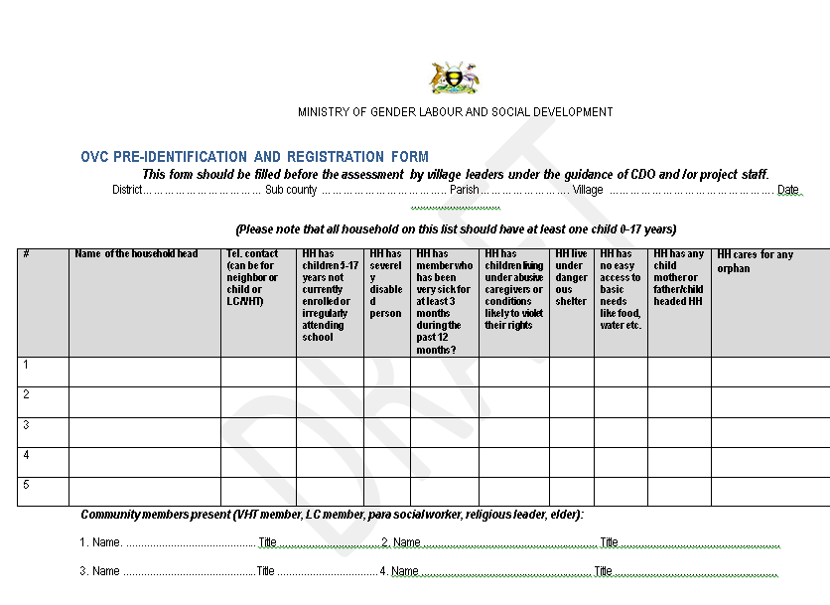
Notes:
Here is a copy of the OVC pre-identification and registration form discussed in the previous slide.

Slide 13
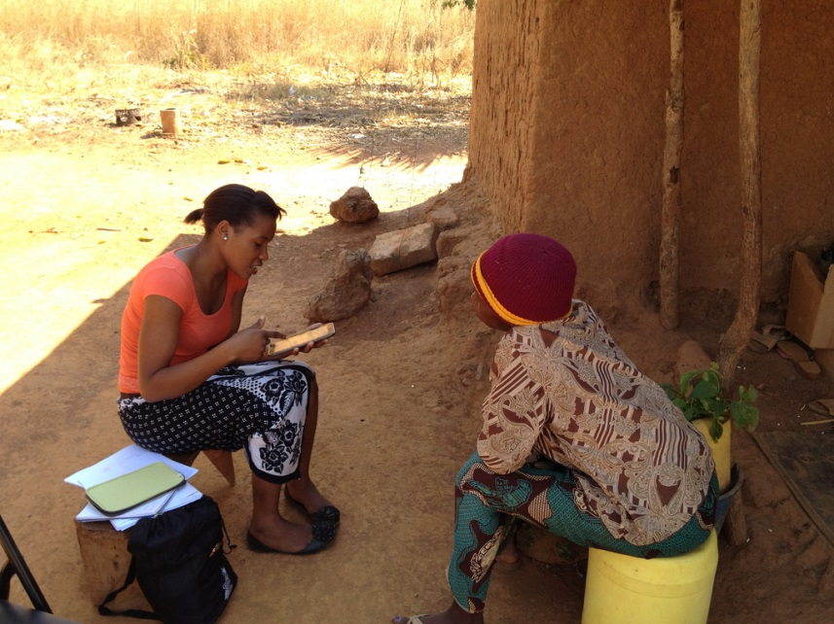
The HVPT Process
Engage district government
Community pre-selection process
Household visit
Source: https://www.flickr.com/photos/colalife/8633875141
Notes:
The trained individual will administer the OVC Vulnerability Prioritization Tool to the head of household or his/her designee.
The tool should be administered in the household and out of earshot of other community members, workers, and minors to protect the confidentiality of respondents.
When starting, the purpose of the tool should be explained and the person administering the tool should indicate in a sensitive way that participating in this brief assessment does not mean their household will automatically receive services.
After completing the tool, the person administering it will check that all questions have been answered and correct any errors in documentation. They will also be certain to note on the form where a referral is needed. In the case of severe issues (e.g., a child in danger or who has experienced a child protection issue such as severe physical abuse or sexual abuse), the situation should be reported immediately to appropriate authorities (e.g., local organization, local council, or in the case of child protection, reporting to a legal entity or to the toll free national child help line: 116).
Completed VPT forms will then be returned to designated officers (e.g., civil society organization [CSO] staff or, where CDOs are directly carrying out the activity, CDOs) where the prioritization of households will occur. People who directly administer the tool should NOT make decisions about enrollment.
Note: The respondent’s answer should not be challenged unless there is good reason to; if this happens please make a note in the space provided on the form.

Slide 14
1B. Getting to Know the HVPT
Instructions
Household Information
Economic Strengthening
Food Security and Nutrition
Health, Water, Sanitation, and Shelter
Education
Psychosocial Support and Basic Care
Child Protection
Notes:
Hand out copies of the HVPT and the accompanying Reference Guide.
Then, talk through each section. Ask participants to read questions out loud and interpret them. (Please see training manual for suggested ways to engage participants.) Clarify any uncertainty and ask them to refer to the reference guide.

Slide 15
Getting to Know the HVPT
Instructions
Household Information
Economic Strengthening
Food Security and Nutrition
Health, Water, Sanitation and Shelter
Education
Psychosocial Support and Basic Care
Child Protection
Notes:
Talk through each section. Ask participants to read questions out loud and interpret them. (Please see training manual for suggested ways to engage participants.) Clarify any uncertainty and ask them to refer to the reference guide.

Slide 16
Getting to Know the HVPT
Instructions
Household Information
Economic Strengthening
Food Security and Nutrition
Health, Water, Sanitation and Shelter
Education
Psychosocial Support and Basic Care
Child Protection
Notes:
Talk through each section. Ask participants to read questions out loud and interpret them. (Please see training manual for suggested ways to engage participants.) Clarify any uncertainty and ask them to refer to the reference guide.

Slide 17
Getting to Know the HVPT
Instructions
Household Information
Economic Strengthening
Food Security and Nutrition
Health, Water, Sanitation and Shelter
Education
Psychosocial Support and Basic Care
Child Protection
Notes:
Talk through each section. Ask participants to read questions out loud and interpret them. (Please see training manual for suggested ways to engage participants.) Clarify any uncertainty and ask them to refer to the reference guide.

Slide 18
Getting to Know the HVPT
Instructions
Household Information
Economic Strengthening
Food Security and Nutrition
Health, Water, Sanitation and Shelter
Education
Psychosocial Support and Basic Care
Child Protection
Notes:
Talk through each section. Ask participants to read questions out loud and interpret them. (Please see training manual for suggested ways to engage participants.) Clarify any uncertainty and ask them to refer to the reference guide.

Slide 19
Getting to Know the HVPT
Instructions
Household Information
Economic Strengthening
Food Security and Nutrition
Health, Water, Sanitation and Shelter
Education
Psychosocial Support and Basic Care
Child Protection
Notes:
Talk through each section. Ask participants to read questions out loud and interpret them. (Please see training manual for suggested ways to engage participants.) Clarify any uncertainty and ask them to refer to the reference guide.

Slide 20
Getting to Know the HVPT
Instructions
Household Information
Economic Strengthening
Food Security and Nutrition
Health, Water, Sanitation and Shelter
Education
Psychosocial Support and Basic Care
Child Protection
Notes:
Talk through each section. Ask participants to read questions out loud and interpret them. (Please see training manual for suggested ways to engage participants.) Clarify any uncertainty and ask them to refer to the reference guide.

Slide 21
Getting to Know the HVPT
Instructions
Household Information
Economic Strengthening
Food Security and Nutrition
Health, Water, Sanitation and Shelter
Education
Psychosocial Support and Basic Care
Child Protection
Notes:
Talk through each section. Ask participants to read questions out loud and interpret them. (Please see training manual for suggested ways to engage participants.) Clarify any uncertainty and ask them to refer to the reference guide.

Slide 22
Getting to Know the HVPT
Instructions
Household Information
Economic Strengthening
Food Security and Nutrition
Health, Water, Sanitation and Shelter
Education
Psychosocial Support and Basic Care
Child Protection
Notes:
Talk through each section. Ask participants to read questions out loud and interpret them. (Please see training manual for suggested ways to engage participants.) Clarify any uncertainty and ask them to refer to the reference guide.

Slide 23
Referrals & Urgent Situations
Referrals: determined based on training and available services
Urgent situations: child is in danger or has experienced severe physical abuse or sexual abuse
→ Report immediately to appropriate authorities (e.g., a local organization, a local council, or in the case of child protection, a legal entity or to the toll-free national child help line: 116)
Notes:
Referrals: During the process of meeting with a head of household and administering the HVPT, community workers may come across situations where they judge─based on their own training and understanding of services provided in the community─that a household requires follow-up on a specific condition or issue. After each question, the HVPT allows for the community worker to check a box on whether a referral is needed. By checking this box, this household─regardless of whether it is enrolled to receive services─will be included on a list of households generated through the HVPT database. This list will be provided to local government officials who can then follow up with the households on the list.
Urgent situations: In the case of severe issues (e.g., a child in danger or who has experienced a child protection issue such as severe physical abuse or sexual abuse), the situation should be reported immediately to the appropriate authorities (e.g., a local organization, a local council, or in the case of child protection, a legal entity or to the toll-free national child help line: 116). A note should also be made on the HVPT form.

Slide 24
1C. Practice Using the HVPT
Break into pairs: one will be the beneficiary, one will be the interviewer
Prepare for 10 minutes
  Interviewer can review the tool in detail and prepare
  Beneficiaries should think through their family profile
Interviewer will ask beneficiary all questions on the HVPT form and record responses (15 minutes)
Switch roles and conduct interview again
** Note all questions you have on the tool and we will discuss together
Notes:
Think of how best to divide class into two groups (based on birthdate, counting off, etc.). Give them 10 minutes of individual time to prepare, then 15-20 minutes to administer the HVPT. Make sure they note all questions they have and be prepared to share these as a group.

Slide 25

1D. Report Back on Practice
Notes:
Time to report back and answer all questions on the tool. Plan to go linearly through the tool. You can ask someone from the group to read sections as needed.
Time allowing, you can discuss how it felt as a beneficiary to be interviewed or as a parasocial worker doing the interviewing.

Slide 26
Potential Situations and How to Deal with Them
Beneficiary cannot answer a question
Beneficiary answers question in one way, but there is evidence to suggest the opposite is true
Beneficiary provides an unclear answer
Notes:
Beneficiary cannot answer a question
If a beneficiary cannot answer a question, leaving it blank is okay. Before you leave it blank, try to rephrase the question, make sure the beneficiary understands the meaning of all of the words, and provide definitions if the beneficiary does not understand. If they still cannot answer a question, then leave blank and move onto the next question.
Beneficiary answers question in one way, but there is evidence to suggest the opposite is true
There may be situations when a beneficiary answers a question a certain way but there may be visible evidence to suggest otherwise. For instance, Question 4 asks about severe disabilities of the head of household; these can be a physical, speech, visual, hearing, or mental handicap. When you are interviewing the head of household or his/her designee, he/she may say that he/she has no disabilities. However, if there are clear signs of a disability it is in the best interest of the family to mark the answer as yes, so they will be recognized as vulnerable and prioritized as such.
Beneficiary provides an unclear answer
When speaking with a head of household or his/her designee, you may find that his/her answers are not as clear-cut as the tool requires. For example, for a question like Question 5 (“Have all children in the household eaten at least 2 meals a day, every day, for the past month?”), a household head may have trouble answering the question. For example, they may struggle to conceive of the time frame of the past month or perhaps they were travelling outside of the home during the past month. That can lead to answers like “maybe” or “I don’t remember.” When receiving responses like this, it is the role of the interviewer to discuss what the most probable response to this would be, supporting the household head in answering the question. For example, help them conceive of the past month by thinking about the cycle of the moon, or thinking back to something that happened in the news in the past month. If they were travelling during the past month, ask them about the weeks they were home and what their best guess is. Essentially, guide them in answering the question and then use your best judgment based on their answers to record your response.

Slide 27
1E. Ethical Use of the HVPT
Information provided is confidential
Conduct interviews privately
Safely store HVPT forms
An interview does not guarantee service delivery
Notes:
Information provided is confidential: Confidentiality entails not disclosing any of the information you learn about a family you interview for the HVPT to anyone for purposes other than direct delivery of services (i.e., through referrals).
Conduct interviews privately: Interviews are considered private when they are out of earshot of other family members, neighbors, or others in the community. This ensures that the information they provide will be truthful and that the interviewee will have confidence that their information will also be treated confidentially.
Safely store HVPT forms: Because household personal information is stored on the HVPT forms and we are committed to keeping their information confidential, it is important to store these forms away from others who should not have access to them.
An interview does not guarantee service delivery: The HVPT was intentionally designed to be short, as long interviews tend to build up expectations among potential beneficiaries about future receipt of services. It is also important to make clear to the households you interview that an interview does not guarantee immediate service provision.

Slide 28

Parking Lot
Image from: http://www.monitor.co.ug/Business/Prosper/Used-vehicles--age-limit-the-only-reliable-criterion/-/688616/1461230/-/qqqugfz/-/index.html
Notes:
This slide is reserved for time for any questions that might have come up during the training but were “parked” for responses later on–either to allow time for facilitators to gather more information or because the question diverged from the content of a particular session.

Slide 29
Acknowledgments
The Government of Uganda wishes to thank the USAID- and PEPFAR-funded MEASURE Evaluation project for leading the development of this work.

Slide 30



This presentation was produced with the support of the United States Agency for International Development (USAID) under the terms of MEASURE Evaluation cooperative agreement AID-OAA-L-14-00004. MEASURE Evaluation is implemented by the Carolina Population Center, University of North Carolina at Chapel Hill in partnership with ICF International; John Snow, Inc.; Management Sciences for Health; Palladium; and Tulane University. Views expressed are not necessarily those of USAID or the United States government.
www.measureevaluation.org

