Slide 1


Launch of the
REVISED Kenya Malaria Strategy
and Kenya Malaria Monitoring and Evaluation Plan 2009-2018
Nairobi, October 8, 2015

Slide 2
“
It is important to remind ourselves that malaria is still a major public health problem in the African region and also a significant impediment to socio-economic development. It is the leading cause of morbidity and mortality in Africa, especially among children under five. Data from a 2013 report estimated that malaria was responsible for 430,000 deaths among children under five in Africa.
Dr. Custodia Mandlhate
WHO Country Representative
”

Slide 3
“
This launch is timely, as it comes just days after the new Sustainable Development Goals (SGDs) were launched by the United Nations, in which ensuring healthy lives and revitalizing the global partnership for sustainable development are priority goals. The revisions made in the Kenya Malaria Strategy also align with the SDGs.
Barbara Hughes
USAID Health Population and
Nutrition Office Chief
”

Slide 4
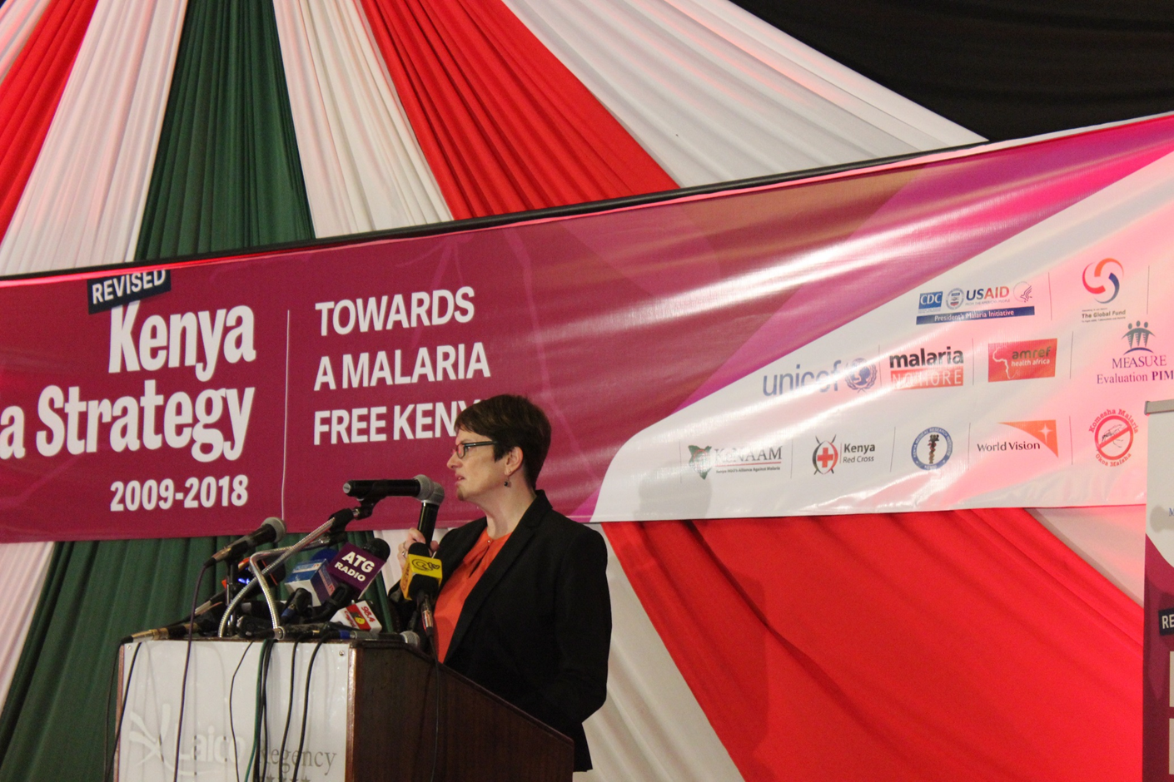
Barbara Hughes, USAID Health Population and Nutrition Office Chief giving a speech during the launch
Notes:
Barbara Hughes , USAID Health Population and Nutrition Office Chief giving a speech during the launch

Slide 5
“
This national strategic plan and other documents being launched today are excellent examples of a positive collaborative process for working together under a common goal, to fight malaria.
Barbara Hughes
USAID Health Population and
Nutrition Office Chief
”

Slide 6
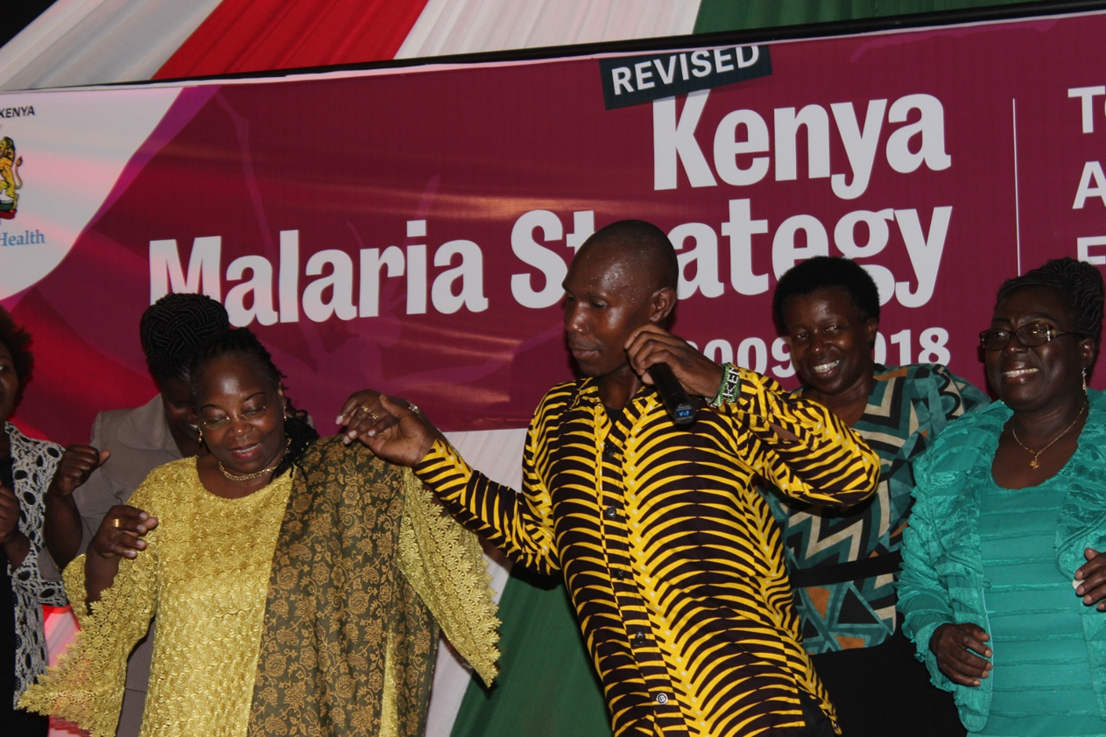
Dr. Custodia Mandlhate, WHO Country Representation and Dr. Elizabeth Ogaja, Kisumu County Chief Executive Committee member of Health (second from the right), celebrating the launch of the two documents. The process of the development of the strategy and the plan involved consultation of all stakeholders including the counties.

Slide 7
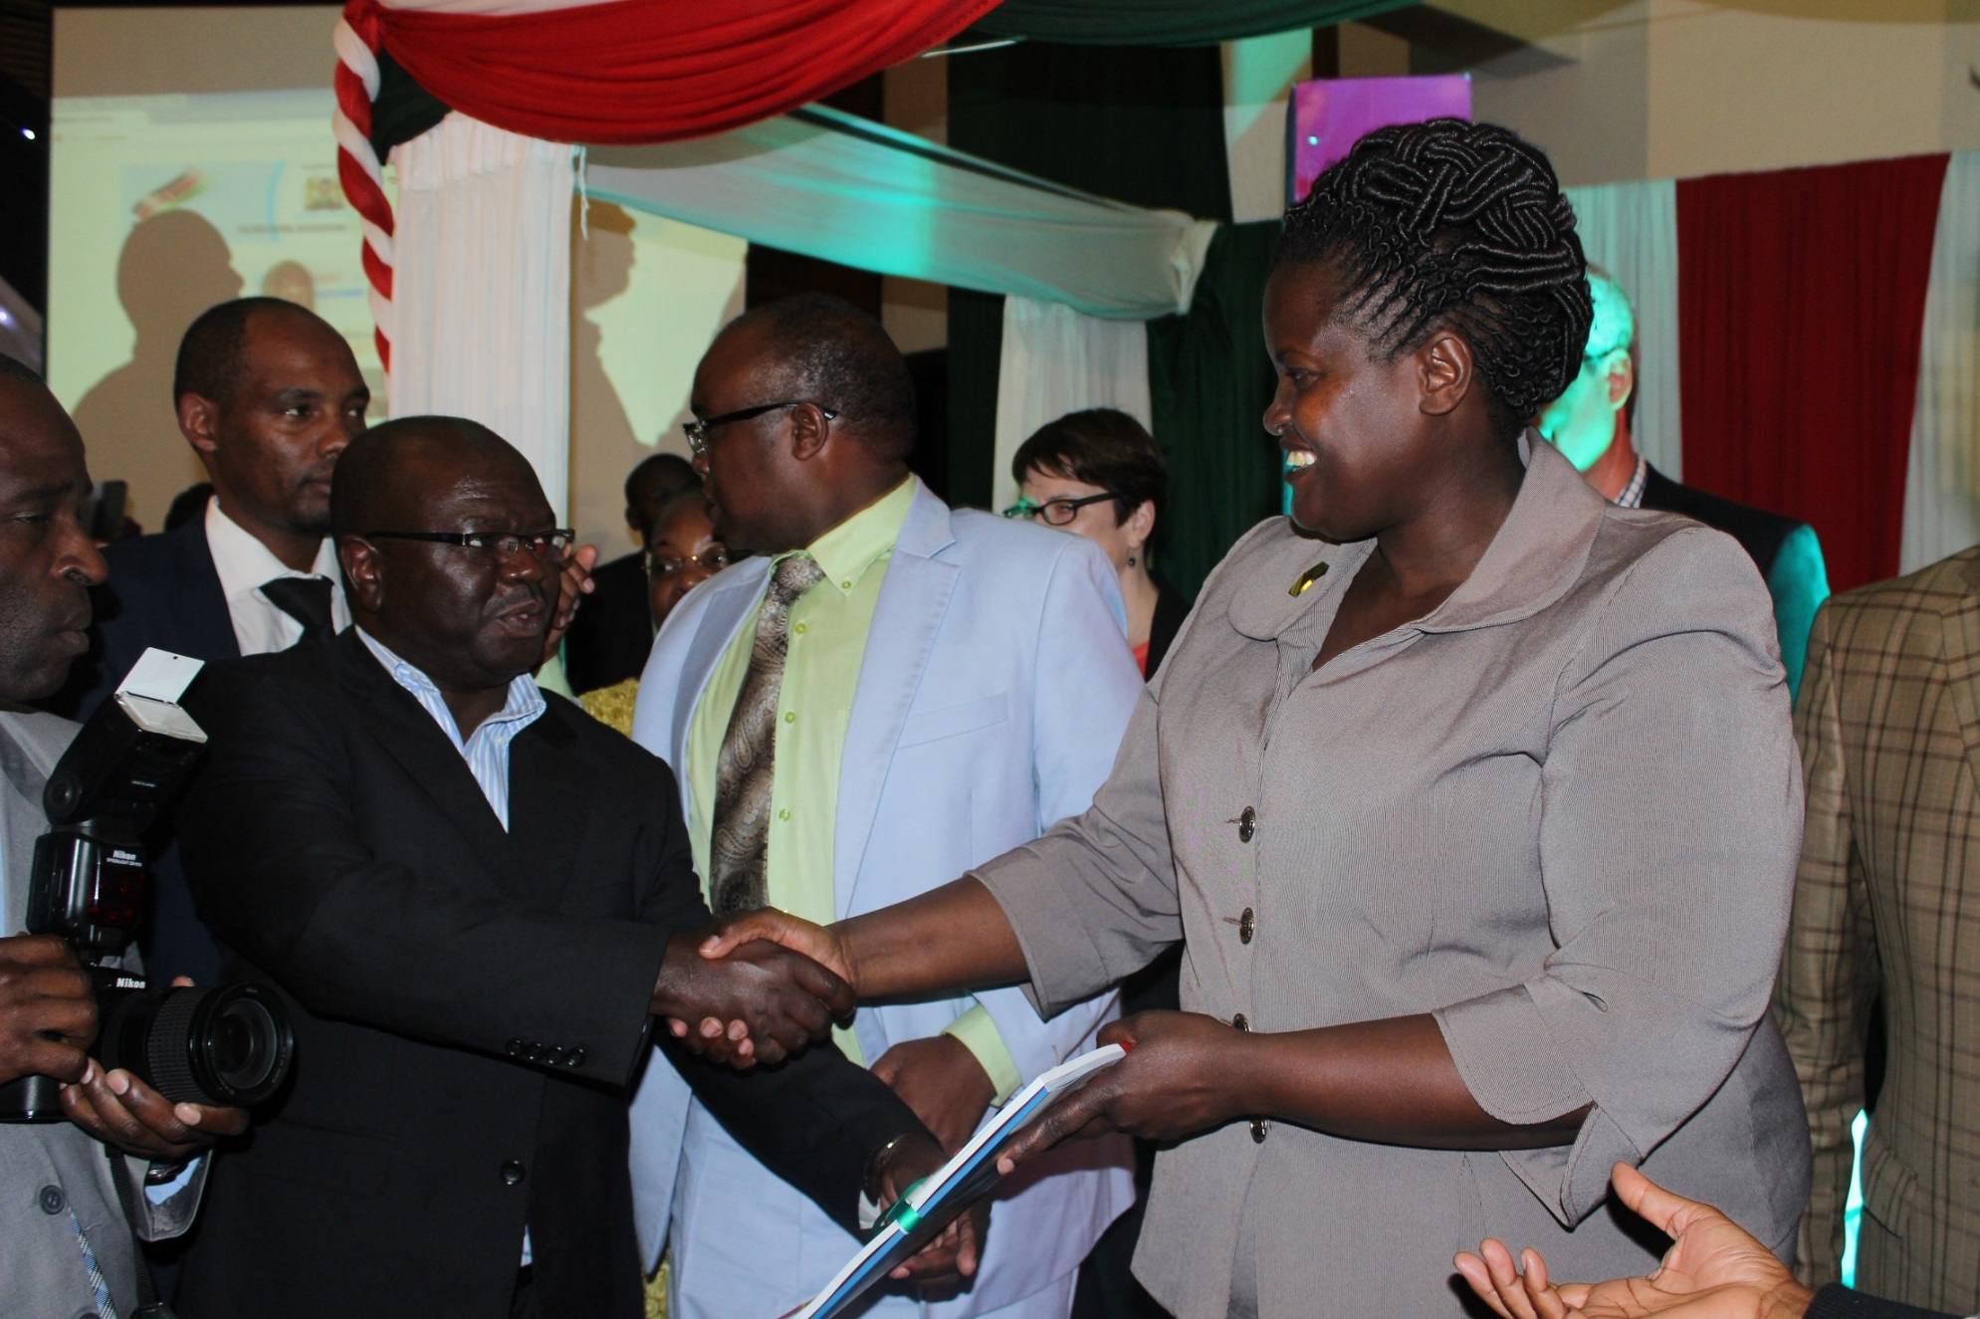
The Principal Secretary of Health, Dr. Khadijah Kasaachoni, gives a copy of the launched documents to MEASURE Evaluation PIMA Chief of Party, Edward Kunyanga.

Slide 8
“
The revised strategy recognized previous achievements, has suggested new approaches that acknowledge the important role of the private sector, need for commodity security, and strengthening health systems.
Nathan Bakyaita
Malaria Advisor
WHO Kenya
”

Slide 9
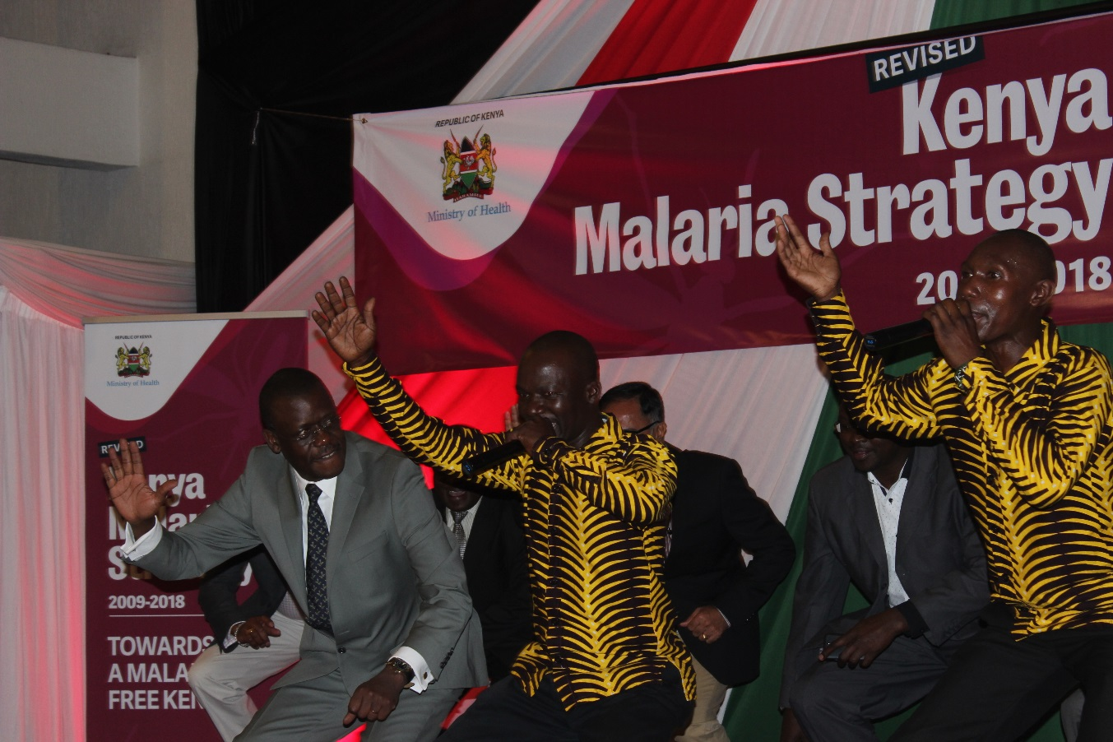
Dr. Nathan Bakyaita Malaria Advisor WHO Kenya
Notes:
Dr. Nathan Bakyaita

Slide 10
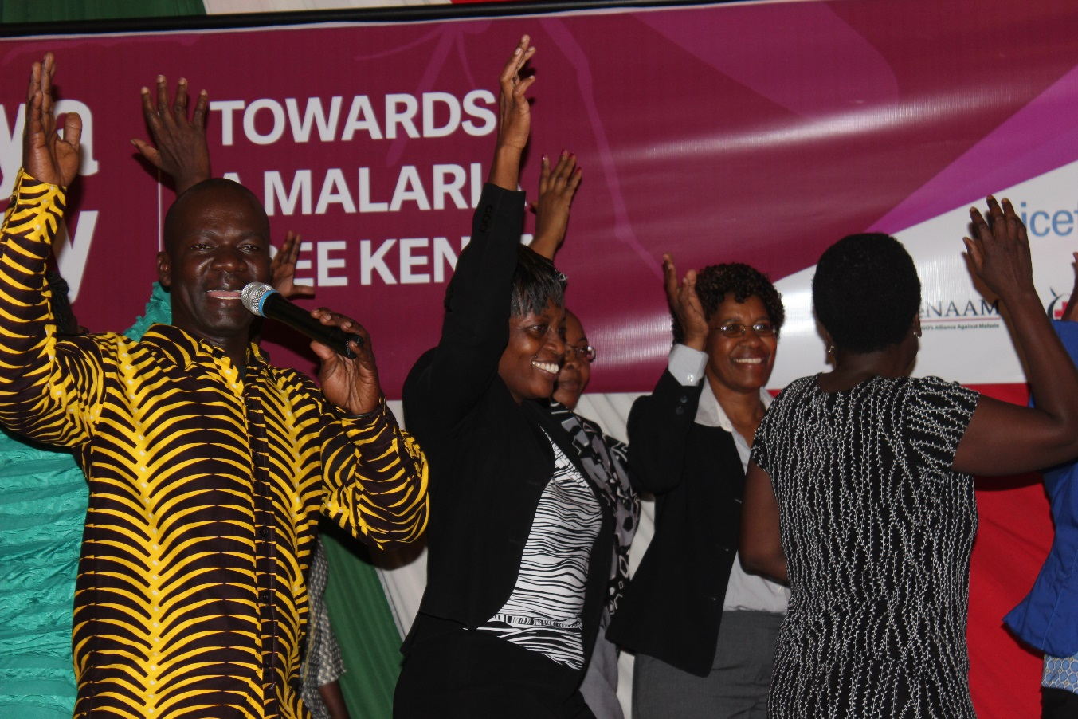
Dr. Mildred Shieshia, PMI Resident Advisor USAID Kenya and Margaret Mungai , AMREF Health Africa join the celebrations

Slide 11
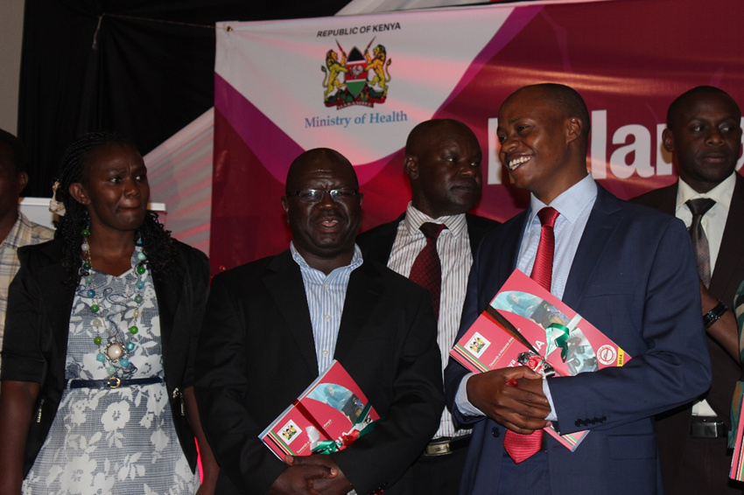
Foreground, left to right: Margaret Mungai of AMREF Health Africa, Edward Kunyanga of MEASURE Evaluation PIMA, Dr. Andrew Mulwa, the Chairman of Council of Health Ministers, and CEC of Health-Makueni
Notes:
MEASURE Evaluation PIMA Chief of Party, Edward KunyangaEdward Kunyanga and Dr. Andrew Mulwa – the Chairman of Council of Health Ministers and CEC of Health - Makueni.

Slide 12
“
Anyone involved in malaria elimination must borrow from three key documents – the National Malaria Policy, Kenya Malaria Strategy and Kenya Malaria M&E plan.
Dr. Erjesa Wako
Director
National Malaria Control Programme
”

Slide 13
“
The elimination of malaria in our lifetime is within our reach, but cannot be achieved without a strong joint commitment among governments, donors, civil society, and health workers on the ground.
Barbara Hughes
USAID Health Population and
Nutrition Office Chief
”

Slide 14
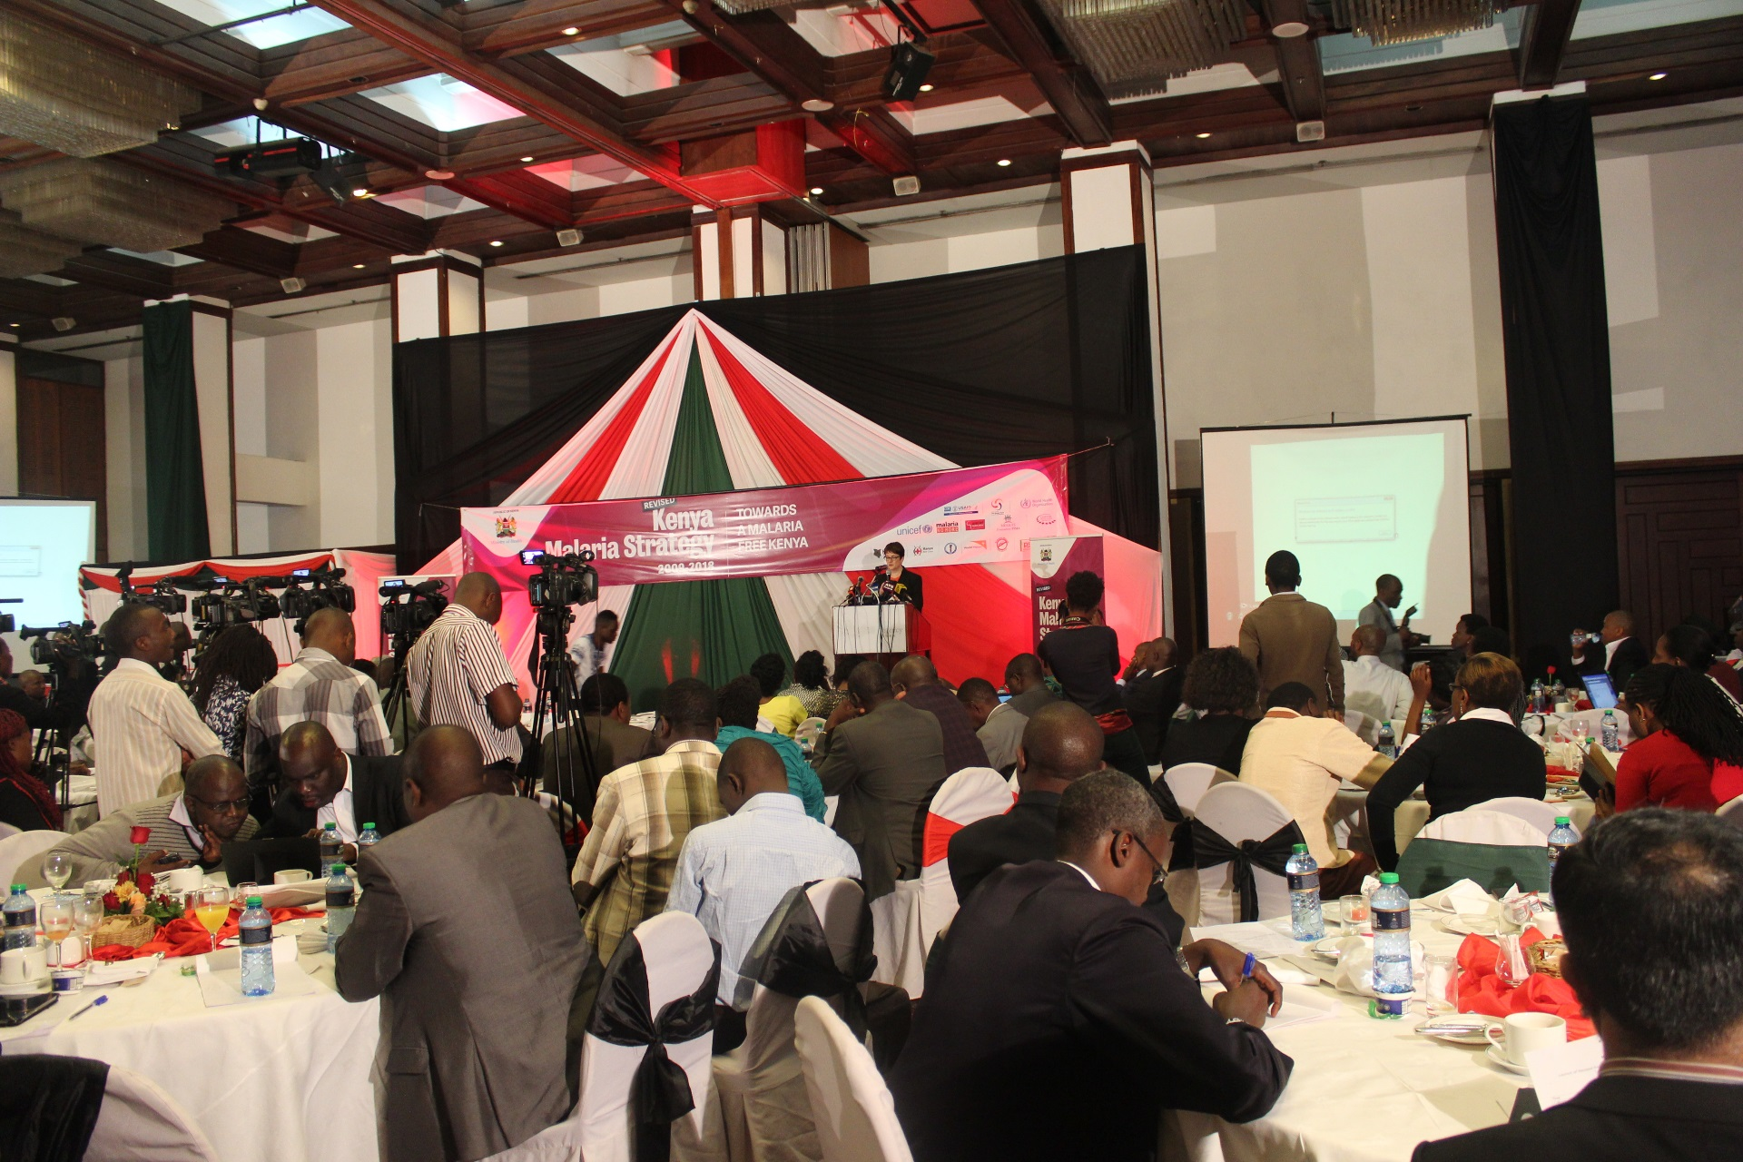
Check out the NMCP Website http://www.nmcp.or.ke/

Slide 15
We should all rally around the revised Kenya malaria strategy as we march towards a
malaria-free Kenya.

Slide 16
This powerpoint has been supported by the United States Agency for International Development (USAID) under the terms of MEASURE Evaluation PIMA Associate Award 623-12-000002. The views
expressed are not necessarily those of USAID or the United States Government. FS-14-116 (Revised February 2015) www.measureevaluation.org

