Slide 1


Digital Transformation Process and Framework of Health
Integrated Digital Health: Process and required skill sets
4 February 2019
Hani Eskandar (ITU), Derrick Muneene (WHO)

Slide 2

Regional Workshop on “Capacity Building for Digital Health Leadership” - Summary update report
Hani Eskandar (ITU), Derrick Muneene (WHO)

Slide 3
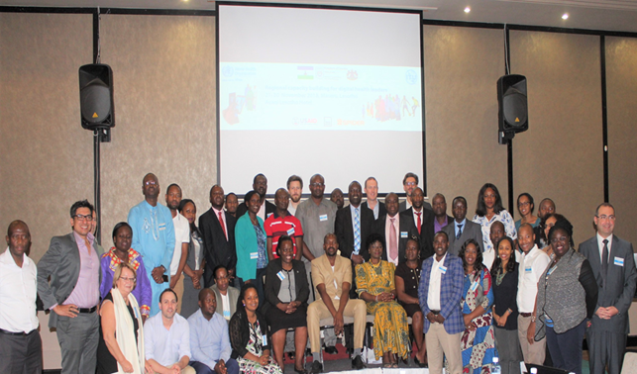
Group photo with Honourable Minister of Health, WHO Country Representative, ITU South Africa Area Representative and participants

Slide 4
- Total Participants : 71 – Grand total
- Number of countries : 12
(Sierra Leone, Niger, Ghana, Nigeria, Eritrea, Rwanda, Zambia, Zimbabwe, Mozambique, South Africa, Tanzania and Lesotho)
- Combination of Ministry of Health, Ministry of ICT, WHO Country Offices and development partners

Slide 5

Workshop objectives built on WHO resolution on digital health - WHA71.7
“…to build, especially through digital means, capacity for human resources for digital health, as appropriate, across both health and technology sectors, and to communicate areas of specific need to WHO in order to receive appropriate technical assistance” World health Assembly Digital Health Resolution – May 2016
Notes:
In the field of medical image analysis, one of the most publicized studies was by
Esteva et al.3, demonstrating the accurate classification of skin lesions using a deep neural network that was trained on clinical images, and assessing its performance by comparing its classifications to those made by board-certified dermatologists, revealing the network had reached human accuracy levels.

Slide 6
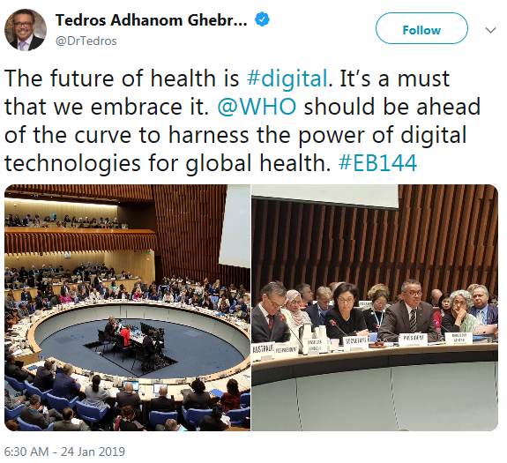
Why have a digital health curriculum
WHO Triple Billion Agenda
In closing the 71st World Health Assembly in May 2018, WHO Director General said that everything WHO did going forward would be evaluated in the light of the “triple billion” targets which were approved in WHO’s new five-year strategic plan.
By 2023 the targets aim to achieve:
1 billion more people benefitting from universal health coverage
1 billion more people better protected from health emergencies
1 billion more people enjoying better health and wellbeing.
“…to build, especially through digital means, capacity for human resources for digital health, as appropriate, across both health and technology sectors, and to communicate areas of specific need to WHO in order to receive appropriate technical assistance” World health Assembly Digital Health Resolution – May 2016

Slide 7
Why have a digital health curriculum
WHO Triple Billion Agenda
to build, especially through digital means, capacity for human resources for digital health, as appropriate, across both health and technology sectors, and to communicate areas of specific need to WHO in order to receive appropriate technical assistance
In closing the 71st World Health Assembly in May 2018, WHO Director General said that everything WHO did going forward would be evaluated in the light of the “triple billion” targets which were approved in WHO’s new five-year strategic plan.
By 2023 the targets aim to achieve:
1 billion more people benefitting from universal health coverage
1 billion more people better protected from health emergencies
1 billion more people enjoying better health and wellbeing.
“…to build, especially through digital means, capacity for human resources for digital health, as appropriate, across both health and technology sectors, and to communicate areas of specific need to WHO in order to receive appropriate technical assistance” World health Assembly Digital Health Resolution – May 2016

Slide 8



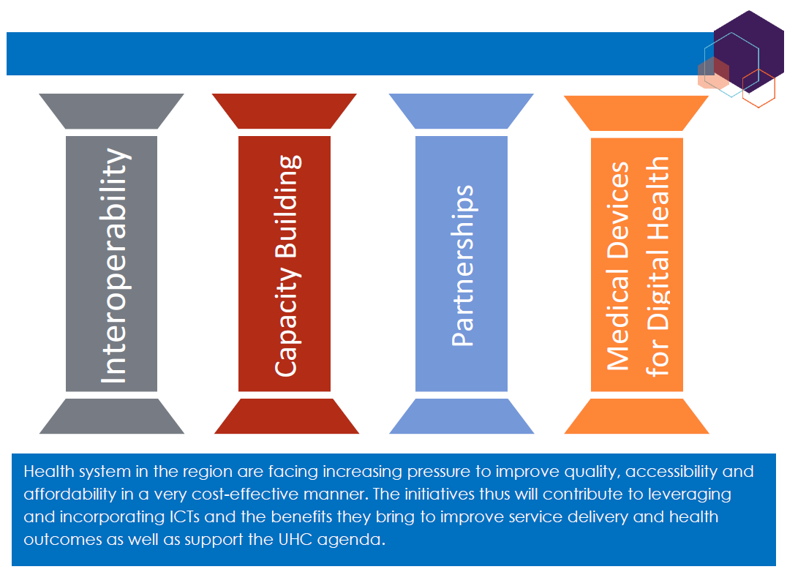

Slide 9
Lesotho – December 2018: The Workshop Objectives
Build digital health coordinators and leaders’ capacity for a wide range of digital health related skills
Develop a comprehensive digital health training curriculum and content that addresses existing digital health workforce capacity gaps
Ensure consistency and coherence across different digital health topics and training modules
Gain understanding of the holistic and system level approach to integrated digital health to ensure scalability, sustainability and interoperability.
Expected Outcomes
Countries' digital health leaders have the knowledge and understanding of the wide range of digital health skills and issues to be able to steer and orient national digital health stakeholders
A comprehensive Digital Health Training Curriculum and content developed addressing the main capacity gaps that are identified in countries
Consensus reached on main activities required to develop the country digital health infrastructure and systems for integrated care and what would be the minimum main deliverables per activity
Competencies and skills acquired for strategic digital health professionals at country level;
Notes:
In the field of medical image analysis, one of the most publicized studies was by
Esteva et al.3, demonstrating the accurate classification of skin lesions using a deep neural network that was trained on clinical images, and assessing its performance by comparing its classifications to those made by board-certified dermatologists, revealing the network had reached human accuracy levels.

Slide 10
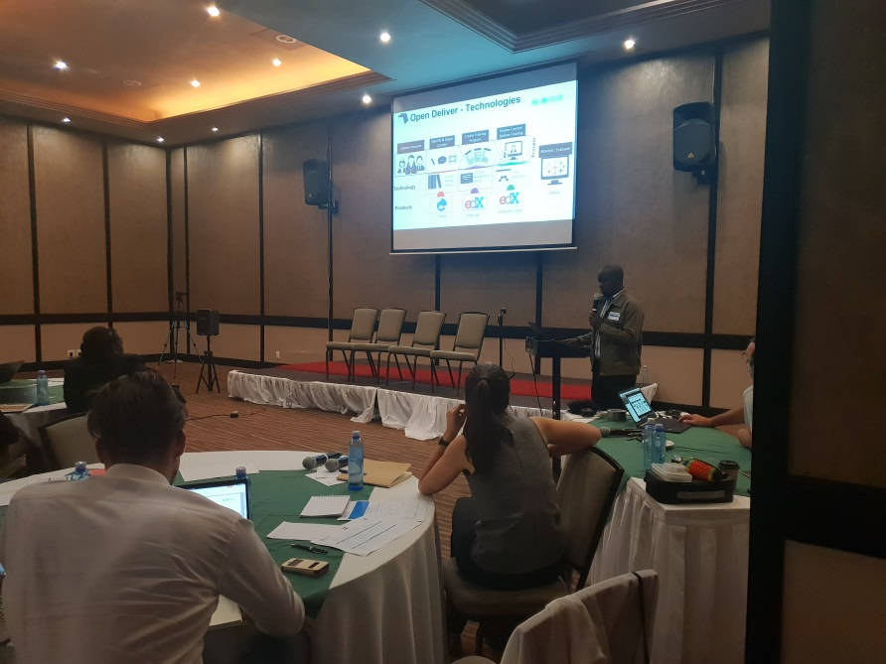
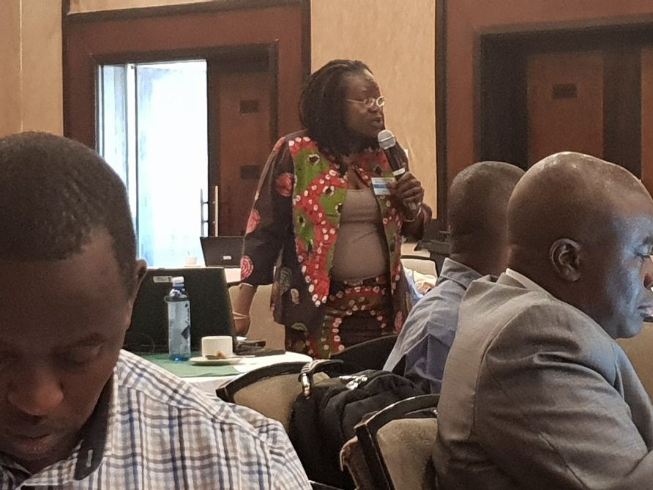
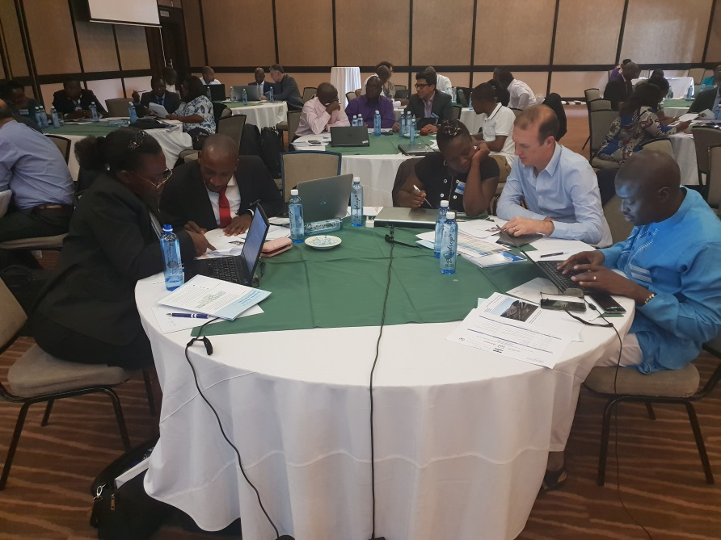
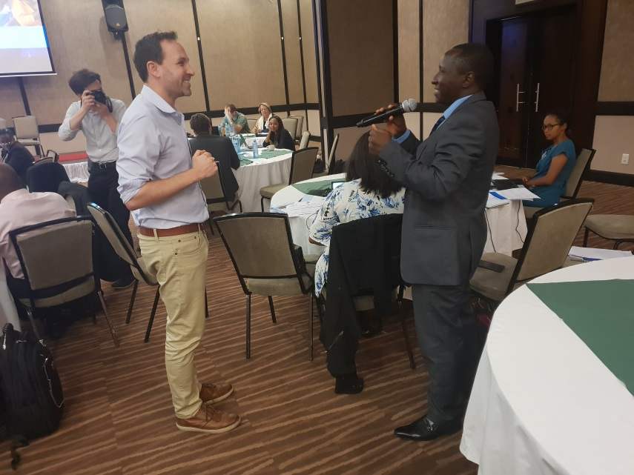
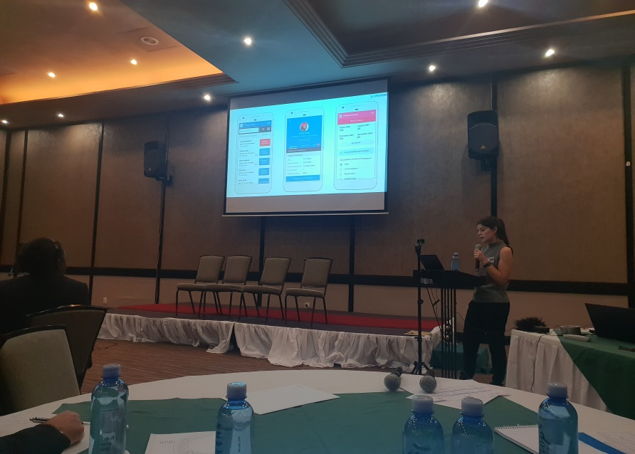
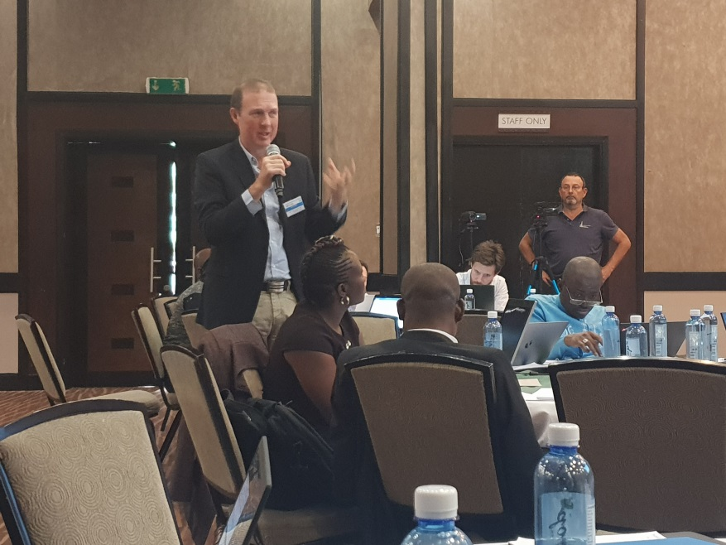
Workshop Process
Technical Presentations; Technical discussions ; Group work; feedback mechanism, Workshop App
NB: Presentation were recorded as speakers presented
Notes:
In the field of medical image analysis, one of the most publicized studies was by
Esteva et al.3, demonstrating the accurate classification of skin lesions using a deep neural network that was trained on clinical images, and assessing its performance by comparing its classifications to those made by board-certified dermatologists, revealing the network had reached human accuracy levels.

Slide 11
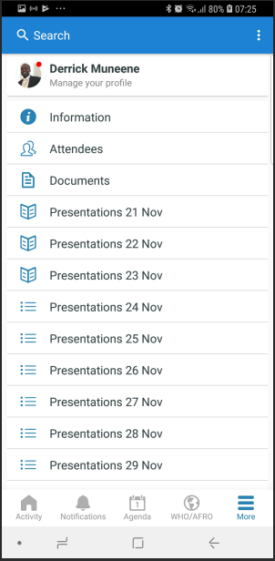
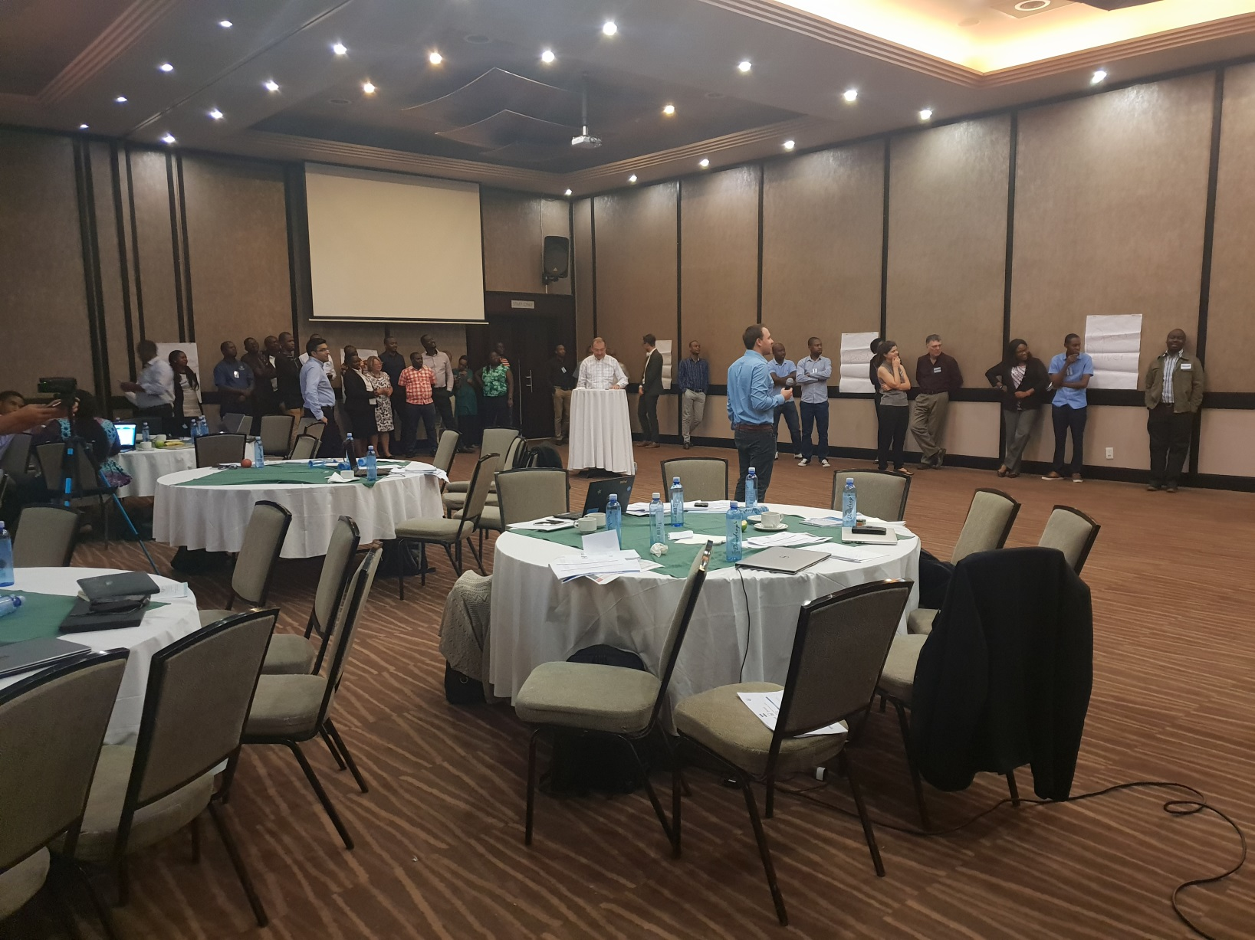
Workshop Process
Technical Presentations; Technical discussions ; Group work; feedback mechanism, Workshop App
NB: Presentation were recorded as speakers presented
Notes:
In the field of medical image analysis, one of the most publicized studies was by
Esteva et al.3, demonstrating the accurate classification of skin lesions using a deep neural network that was trained on clinical images, and assessing its performance by comparing its classifications to those made by board-certified dermatologists, revealing the network had reached human accuracy levels.

Slide 12
Integrated Digital Health: Process and required skill sets
Integrated Digital Health Building steps | Understanding Digital Health | National Strategy Development | Digital Health Interventions identification and Requirements Analysis | Digital Health Platform and Applications Design | Development, Deployment, Maintenance and Scale Up | Data Use & Analytics | Monitoring & Evaluation
Key Questions | What is Digital Health? What are its beneficial Applications? | What changes do we want to strengthen health systems? | Which Digital Health interventions are needed to improve existing processes and meet desired outcomes? How to redesign existing processes? Which existing applications need to be modified? | How to modify existing applications? What are the Functional Requirements for new applications How to design Common re-usable components for a Digital Health Platform | How to implement Digital Health Applications and Infostructure and ensure its sustainability | How to use and govern data | How to assess and continuously improve maturity of Health Information Systems to achieve better Health Outcomes
Deliverables |  | - Digital Health desired Outcomes & Outputs - Action Plan - Governance mechanism | - Digital Health Interventions - To-be processes (modified as-is processes) | Functional requirements for: - Modified existing applications - New Applications - Common Components - Information Architecture | Digital Health Applications Digital Health platform |  | M&E Framework and Implementation plan
Enterprise Architecture |  |  | Business Architecture | Information Architecture (Data and Application Architecture) | Technical Architecture
Training Modules | Mod 1: Introduction to digital health - Digital Health Systems and Services - Health System Building Blocks - Digital Health Solutions - Value of Digital Health & Transformative Role of Digital Health | Module 2: Digital Health Strategy, Governance & Regulations - Develop a national digital health strategy outlining overarching needs, desired activities, and outcomes - Formulate a digital health investment plan to support the national strategy - Establishing a governance mechanism | Mod 6: Implementing Digital Health - Requirements Gathering - Technology Inventory - Determining ICT functionalities to address needs: Prioritizing Digital Health Interventions - Costing - Project Management & Planning - Stakeholder Engagement - Human Centered Design | Module 4: Digital Health Global Goods Applications OpenMRS/OpenClinic, iHRIS, OpenLMIS, RapidPro, OpenSRP, Open Deliver, Telemedicine, OpenELIS, openIMIS Module 7: Digital Health Architecture Design - Business Architecture - Information Architecture - Digital Platform infostructure - OpenHIE as an example of a health information architecture | Module 5: Partnership models - Partnership models with telcos | Mod 10: Data use and Analytics - Techniques for information needs assessment - Principles of data harvesting - Data Visualization & Information Communication - Data related Regulation | Mod 9: Monitoring, Learning and Evaluation - Why and how- M&E - Global toolkits- When and how to use? - Continuous improvement - Adapt and accomplish - Assessing and monitoring implementation
 | Module 3: Examples of use of Digital Health MNCH, NCD |  |  | Mod 8: Interoperability Framework - What is interoperability - Standards & profile stacks - Developing the Interop. Framework | Mod 6: Implementing Digital Health - Digital Health Deployment - RFP development
Primary toolkits, Resources |  | WHO-ITU National eHealth Strategy Toolkit Digital Health: A Call for Government Leadership | Digital Health Platform Planning, Implementation, and Financing Guide for Health Programs Human Centered Design Toolkit | Digital Health Platform MEASURES Health Information Systems Interoperability Toolkit | Digital Health Platform Planning, Implementation, and Financing Guide for Health Programs Journey to Scale: Moving Together Past Digital Health Pilotitis | Defining and Building a Data Use Culture MEASURE Evaluation’s data demand and use | WHO M&E guide MEASURES Health Information Systems Interoperability Toolkit

Slide 13
Integrated Digital Health: Process and required skill sets
Integrated Digital Health Building steps | Understanding Digital Health | National Strategy Development | Digital Health Interventions identification and Requirements Analysis | Digital Health Platform and Applications Design | Development, Deployment, Maintenance and Scale Up | Data Use & Analytics | Monitoring & Evaluation
Key Questions | What is Digital Health? What are its beneficial Applications? | What changes do we want to strengthen health systems? | Which Digital Health interventions are needed to improve existing processes and meet desired outcomes? How to redesign existing processes? Which existing applications need to be modified? | How to modify existing applications? What are the Functional Requirements for new applications How to design Common re-usable components for a Digital Health Platform | How to implement Digital Health Applications and Infostructure and ensure its sustainability | How to use and govern data | How to assess and continuously improve maturity of Health Information Systems to achieve better Health Outcomes
Deliverables |  | - Digital Health desired Outcomes & Outputs - Action Plan - Governance mechanism | - Digital Health Interventions - To-be processes (modified as-is processes) | Functional requirements for: - Modified existing applications - New Applications - Common Components - Information Architecture | Digital Health Applications Digital Health platform |  | M&E Framework and Implementation plan
Enterprise Architecture |  |  | Business Architecture | Information Architecture (Data and Application Architecture) | Technical Architecture
Training Modules | Mod 1: Introduction to digital health - Digital Health Systems and Services - Health System Building Blocks - Digital Health Solutions - Value of Digital Health & Transformative Role of Digital Health | Module 2: Digital Health Strategy, Governance & Regulations - Develop a national digital health strategy outlining overarching needs, desired activities, and outcomes - Formulate a digital health investment plan to support the national strategy - Establishing a governance mechanism | Mod 6: Implementing Digital Health - Requirements Gathering - Technology Inventory - Determining ICT functionalities to address needs: Prioritizing Digital Health Interventions - Costing - Project Management & Planning - Stakeholder Engagement - Human Centered Design | Module 4: Digital Health Global Goods Applications OpenMRS/OpenClinic, iHRIS, OpenLMIS, RapidPro, OpenSRP, Open Deliver, Telemedicine, OpenELIS, openIMIS Module 7: Digital Health Architecture Design - Business Architecture - Information Architecture - Digital Platform infostructure - OpenHIE as an example of a health information architecture | Module 5: Partnership models - Partnership models with telcos | Mod 10: Data use and Analytics - Techniques for information needs assessment - Principles of data harvesting - Data Visualization & Information Communication - Data related Regulation | Mod 9: Monitoring, Learning and Evaluation - Why and how- M&E - Global toolkits- When and how to use? - Continuous improvement - Adapt and accomplish - Assessing and monitoring implementation
 | Module 3: Examples of use of Digital Health MNCH, NCD |  |  | Mod 8: Interoperability Framework - What is interoperability - Standards & profile stacks - Developing the Interop. Framework | Mod 6: Implementing Digital Health - Digital Health Deployment - RFP development
Primary toolkits, Resources |  | WHO-ITU National eHealth Strategy Toolkit Digital Health: A Call for Government Leadership | Digital Health Platform Planning, Implementation, and Financing Guide for Health Programs Human Centered Design Toolkit | Digital Health Platform MEASURES Health Information Systems Interoperability Toolkit | Digital Health Platform Planning, Implementation, and Financing Guide for Health Programs Journey to Scale: Moving Together Past Digital Health Pilotitis | Defining and Building a Data Use Culture MEASURE Evaluation’s data demand and use | WHO M&E guide MEASURES Health Information Systems Interoperability Toolkit
1. Introduction to Digital Health
2. Digital Health Strategy, Governance and Regulations
3. Digital Health for RMNCH and NCDs
4. Global Goods*
5. Partnership models with telcos
6. Implementing Digital Health
7. Digital Health Architecture Design
8: Interoperability Framework
9: Monitoring, Evaluation and Learning
10: Data Use and Analytics
11: DH Innovations & future trends
12: Global Health Security: EWARS, GIS
*4. Global Goods: :
DHIS2; DH Atlas; OpenSRP; Open Deliver; RapidPro; openIMIS; OpenMRS; Telemedicine (Bogou); OpenHIE/OpenHIM; iHRIS; OpenLMIS + OpenELIS; OpenClinic

Slide 14
Establishing National Digital Health Architecture and
Information Infrastructure and Systems
2
Tech inventory
- Existing applications to be modified to integrate with the platform
Telemedicine
HMIS
HRMS
LMIS
EMR
1
3
Information Architecture Design (part of EA)
Application Architecture
Functional Requirements for Applications and Functional components
Data Model
5
Information Exchange
National
e-Health /
e-Agriculture
Strategy
Requirements Gathering
(to-be processes)
- Health Journeys/Use cases/scenarios
- Process Flowcharts
Request for Proposal for System Integrators
Registries
Repositories
Terminology
Messaging
Payments
Analytics
Include
Technical Architecture
Workflow
Security
Identification
Business Architecture
Information Architecture
Digital Information Infrastructure
(Infostructure) –
A Commom Digital Platform
4
Interoperability Framework
Analysis
Design
Implementation
Strategic Planning
A shift from (siloed)
Applications
to System approach
Telemedicine
HMIS
LMIS
EMR
Functional and Technical Requirements Gathering Country Study

Slide 15
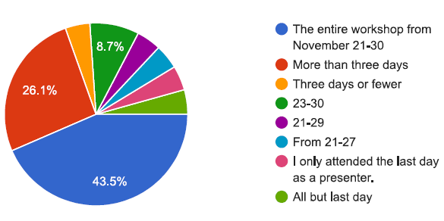
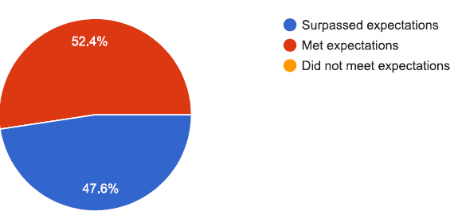
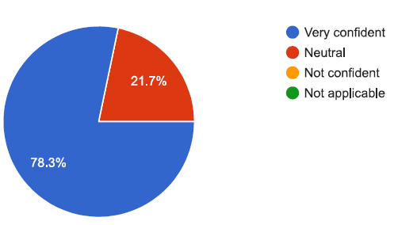
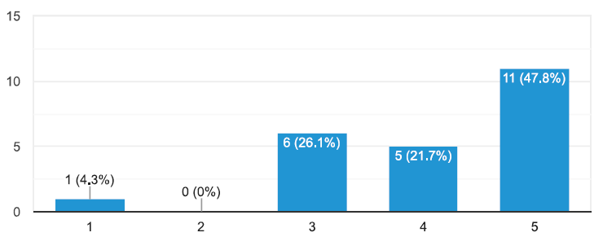
Post workshop feedback survey : N = 23
Which days of the workshop did you attend?
Which days of the workshop did you attend?
How confident are you to build capacity in this area when you return to your country ?
I have stronger understanding of digital health after this workshop

Slide 16
Next steps
Digital heath capacity building
Translation of content to an online platform (within first quarter of 2019)
French and Portuguese training and materials production (within second quarter of 2019 tentatively)
Translation of content into French and Portuguese
Dissemination (2019 – TBA)
Country digital health platform requirements documentation
Lesotho documentation – (Planned for June 2019)
Additional countries to be added based on requests from the workshop

Slide 17

Thank you, Merci boucoup, Muito Obrigado !

