Slide 1
Priorities for Local AIDS Control Efforts
The PLACE
Mapping Tool
Becky Wilkes, MS, GISP
Marc Peterson, MA, GISP
Sarah Hileman, PhD
Sharon Weir, PhD
MEASURE Evaluation

Slide 2


What does the tool do?
The Priorities for Local AIDS Control Efforts (PLACE) Mapping Tool allows public health professionals with limited mapping experience to view their own data on a map.
The tool is available for download here: https://www.measureevaluation.org/resources/publications/tl-19-39
A series of dialogue boxes walk users—even those who have never used a geographic information system (GIS)—through the process.

Slide 3

Tool documentation
The tool has the following elements:
Instruction manual for the PLACE mapping tool
Background information on how QGIS can be useful with the PLACE method
Information on how to format your data
Screenshots and sample maps
Links to additional resources from MEASURE Evaluation

Slide 4
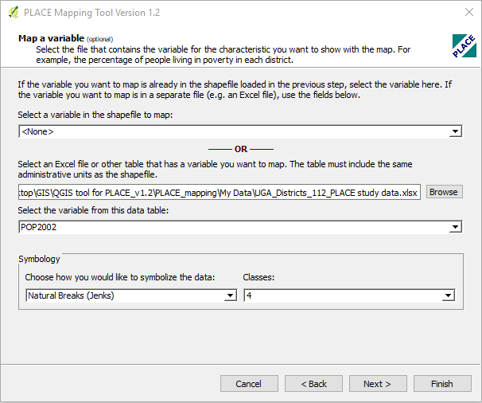
Tool screenshot

Slide 5
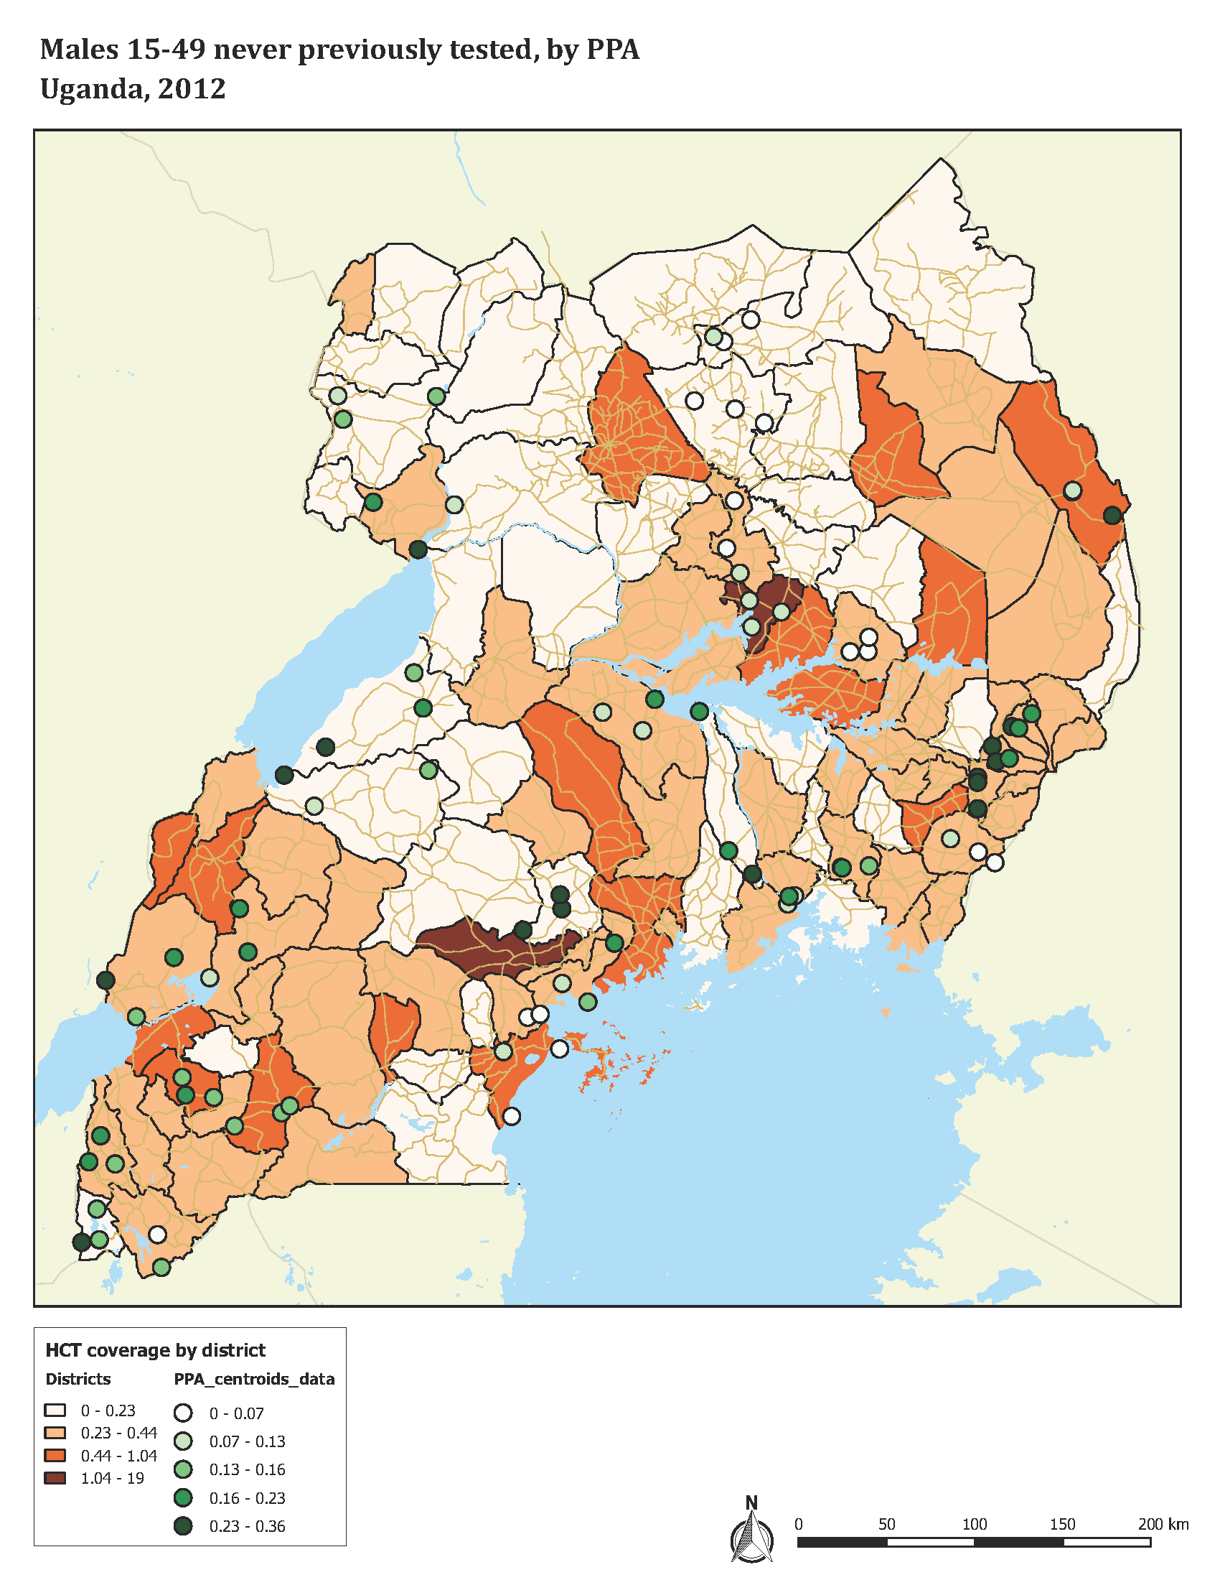
Sample output
Map is autogenerated and saved as a PDF for printing
Data can also be viewed, formatted, and analyzed and manipulated in QGIS, if desired

Slide 6




This presentation was produced with the support of the United States Agency for International Development (USAID) under the terms of MEASURE Evaluation cooperative agreement AID-OAA-L-14-00004. MEASURE Evaluation is implemented by the Carolina Population Center, University of North Carolina at Chapel Hill in partnership with ICF International; John Snow, Inc.; Management Sciences for Health; Palladium; and Tulane University. Views expressed are not necessarily those of USAID or the United States government.
www.measureevaluation.org

