Slide 1
Collecting Geographic Coordinates Using GPS Devices
<date of training>

Slide 2
Overview
Purpose
Presentation of maps from previous PLACE studies
Data collection process
Fundamentals of GPS operation
Saving and exporting spatial data
Practice using GPS devices, recording coordinates, and downloading points with their unique venue numbers to computer
Conclusion: How spatial data will be used in this project

Slide 3
Purpose
Create maps illustrating PLACE findings
Allows for visual interpretation of results
Valuable component of Step 3 of PLACE (Venue Verification)
Common types of maps:
Map 1: Venues, condoms and prevention activities
Map 2: Venues by venue types
Map 3: Venues by venue size and type

Slide 4
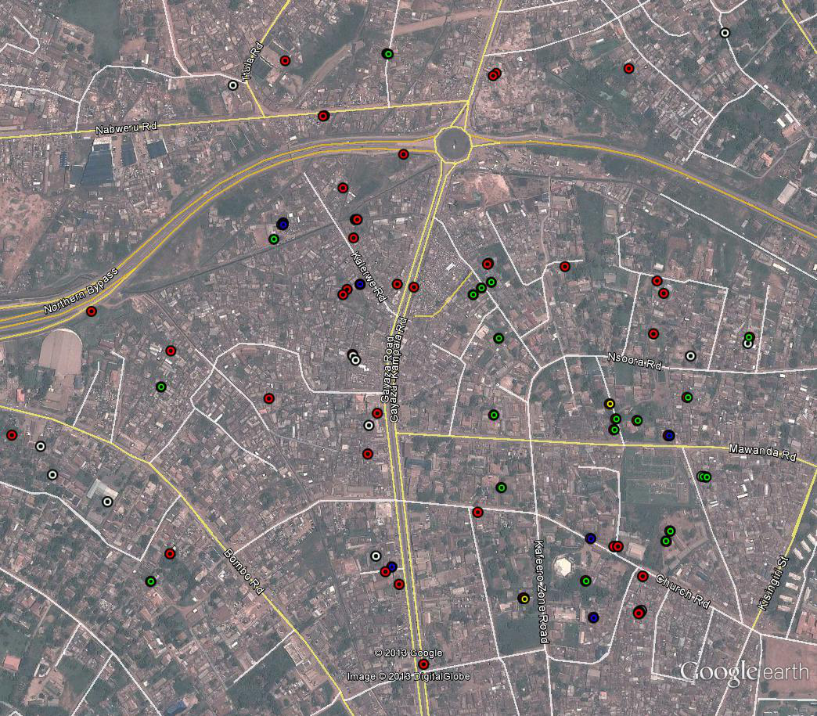
Illustrative Map Produced with PLACE Data
Venue Types
Eat/Drink/
Dance/Sleep
Transportation/Public/
Commercial
Events
Other

Slide 5
This guide illustrates how to make the five types of maps suggested by PLACE:
1. Map of venues in the priority prevention area by type of venue (4 general categories from B19*)
2. Map of venues by venue size (number of men from B35a*) and type of venue (5-7 categories for size)
3. Map of venues with condoms available on day of visit and shown to interviewer (B40*=2)
Alternate to 3: Onsite outreach (B38d*=1)
Priority Sites for Action Plan. ??? Decide criteria.
*Question numbers correspond to Uganda questionnaires

Slide 6
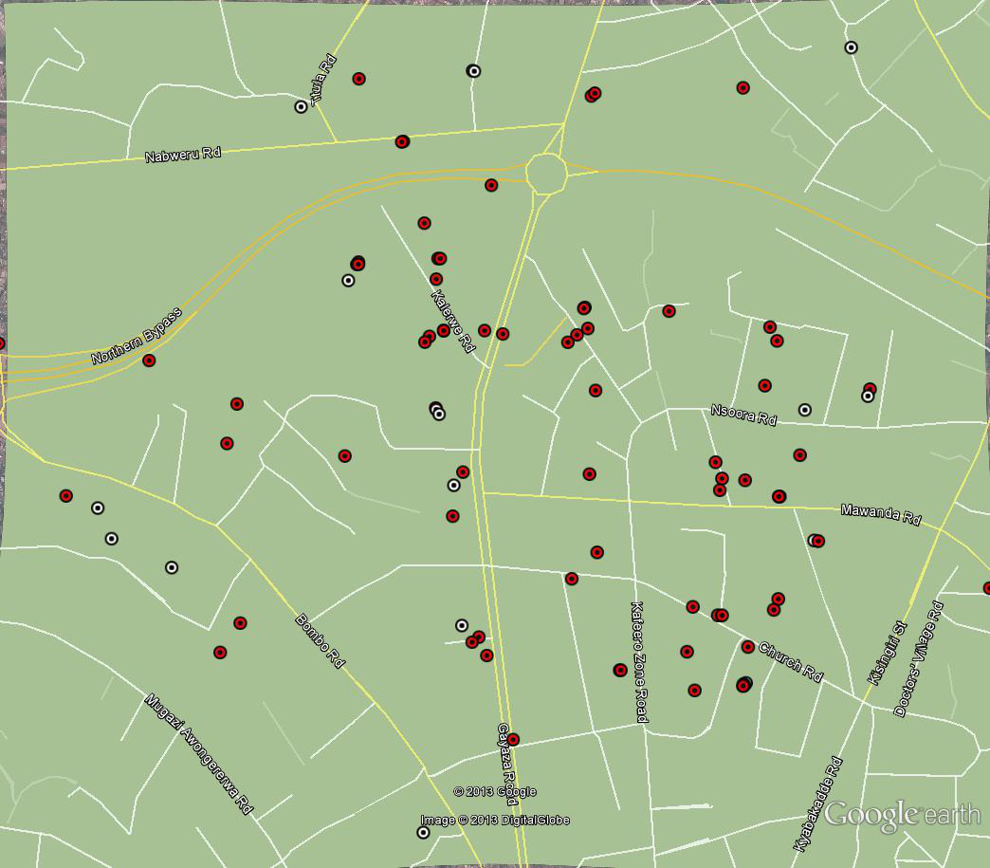
Illustrative Map Produced with PLACE Data
Condom Availability during Site Visit
No Condoms
Condoms

Slide 7
Data Collection Process
PLACE
Collected at venues at the same time Form B is completed
Individual interviewers may be assigned to collect spatial data

Slide 8
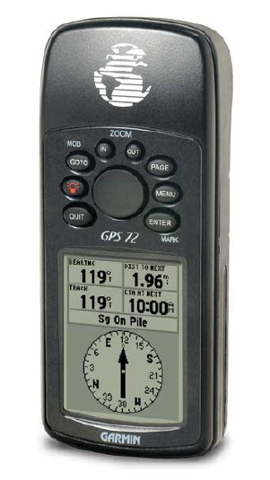
Using a GPS Device
Demonstrate Pages
Hands-on

Slide 9
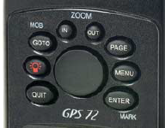
Garmin 72H GPS
Antenna
Control Buttons
Display Screen
Notes:
(Hold Up Garmin)
This is the Garmin GPS unit you will be using.
This section (point to the antenna area) is the antenna.
These are the control buttons that you will use to move through the screens.
This is the display screen. (Point to the display screen). There are several different “pages” that the Garmin uses. You can cycle through to the page you need by using the “Page” button.

Slide 10
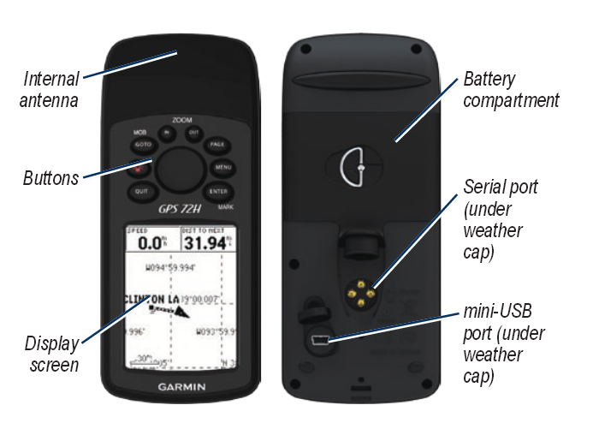
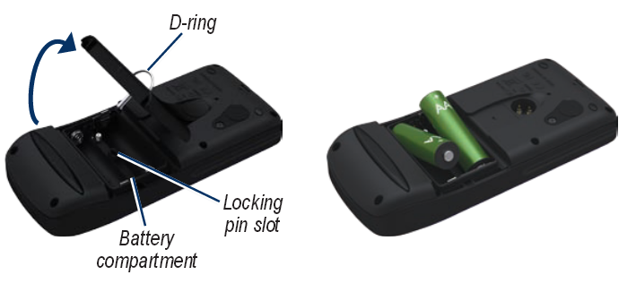
Batteries, ports, etc.
Notes:
First let’s familiarize ourselves with this particular GPS Unit. It runs on 2AA batteries. (You might want to try opening the battery compartment by turning the D-ring a quarter-turn to the right and lifting.) It’s also important to note where the antenna is housed, as blocking this antenna can interfere with the signal strength and give an inaccurate or false location read-out. Ideally, the unit should be held straight out in front of you at arm’s length, with the antenna end pointed upward. Avoid leaning over the unit or holding it down at your waist when taking a reading.
Also note the position of the mini-USB port; we’ll eventually use this to connect the USB cable to your computer to upload the points.

Slide 11
Garmin GPS
Step 1: Turn on Unit
After a couple of seconds, the GPS unit will start looking for satellites.
Off/On Button
Notes:
I am going to walk through the steps you will take when you collect a GPS point. For right now follow along on the projector screen, you’ll get a chance to do this for yourself later.
The first step is to turn on the unit. There is a small button with a picture of a red lightbulb on it. Press this button and hold it down for a second to turn on the unit.
After a couple of seconds, the unit will start searching for satellites.

Slide 12
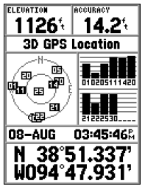
Search for Satellites
Step 2: Wait for Satellites
Satellites Located
(lock indicated by black box around number)
North Indicator
Outer circle represents
horizon, inner circle
represents 45 degrees
above horizon
Signal Strength
for each satellite (if bar is grey it is not yet locked in)
Current date, time, and lat/long coordinates
Satellite Acquisition Page
Notes:
This page is the Satellite Acquisition Page. (If you cannot see it, press the Page button several times to get to it.) It will tell you where the satellites are in the sky and how many the receiver “sees” and how many it has locked on to. (see next slide for diagram) These satellites are in orbit around the earth and are constantly moving.
At any given time the Garmin can see up to 12 satellites, however it only needs to lock onto 4 to get a position. The best accuracy will occur when those 4 satellites form a pyramid above you; i.e. 3 make a triangle at points around the horizon, and a fourth is directly overhead. As you can see the receiver in this picture sees and is locked onto 10 satellites.
What does it mean to be locked in to a satellite? It means that the signal from the satellites is strong enough to read reliably by the receiver. When the satellite has been found, but not locked in it is highlighted in grey, once its locked in, the highlighting turns black. Note the bars at the bottom. They display the strength of the signal. The higher the bar the stronger the signal.

Slide 13
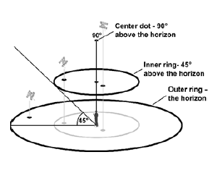
Satellite sky view (detail)
Outer circle represents
horizon, inner circle
represents 45 degrees
above horizon
Notes:
One of the helpful things about this page is it tells you where the satellites are in the sky. This is helpful when identifying potential obstructions in the sky (such as trees or buildings, through which the signal cannot travel) as well as determine potential accuracy problems due to poorly positioned satellites. On this display the dot in the middle represents you, the inner circle is 45 degrees above the horizon and the outer circle represents the horizon. (There is a north indicator to help you orient yourself in relation to potential obstructions.)

Slide 14
Acquire Position
Step 3: Once enough satellites have been located, the GPS unit will provide you with a position.
Position
Example in digital degree format:
N 0.18123 E 31.50385
Notes:
After enough satellites have been located, you are ready to take a “Waypoint”. This is a point stored in the unit that records your position at the current time. Of course, as you’ll notice when you’re outside doing this for real the position may keep changing, even though you may not be moving. This is due to signal strength and current satellite location.
Another feature on the screen that is worth pointing out is the direction indicator on top. This acts similar to a compass, telling you in which direction you are travelling. However it is not a magnetic compass, so there is a bit of a lag time between when you change your direction and when that change shows up on the receiver.
The unit will also display your speed, as well as your altitude. However the altitude reading is subject to the greatest error, so don’t pay too much attention to it.
Finally, there is a clock which displays the current time.
Now let’s talk more about Position Formats.

Slide 15
Lat/Long Formats:
Be aware that the most common formats for latitude and longitude coordinates are:
dd.dddddd (decimal degrees)
dd mm.mmm (decimal minutes)
dd mm ss (degrees, minutes, seconds)
The symbol for degrees:
The symbol for minutes: ’
The symbol for seconds: ’’
Kampala is near the equator. It’s important to
note whether your latitude is N or S. You can
denote this with a (+) or (-), too.
Notes:
The equator is at zero degrees Latitude and the Prime Meridian (running through England) is at zero degrees Longitude. 90 degrees N is the north pole, and 180 degrees W or E falls near the “international date line” in the Pacific ocean. Kampala is near the equator (0 degrees Latitude) and also near 32 degrees East Longitude. So your readings should be something like this, give or take a degree or 2. (one degree, near the equator, is approximately 110 kilometers, for reference; thus one minute is about 2 kilometers (110/60).

Slide 16
Conversions:
There are 60 seconds in a minute, and 60 minutes in a degree.
Thus to convert from:
Lat. 00 24.019’
Long. 32 02.918’
24.019/60 = 0.40032 + 0 = 0.40032 degrees N
2.918/60 = .04863 + 32 = 32.04863 degrees E

Slide 17
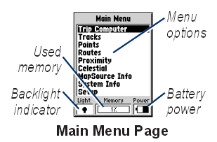
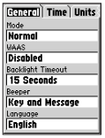
Set it up right first!
The least confusing format, and that which is most “GIS-friendly” is decimal degrees. This can be set ahead of time to avoid a lot of confusion and guesswork later on.
“Units” tab
Setup Menu
Notes:
Click on the Menu button twice to reach the main menu. Near the bottom is the word “Setup”. Navigate down to this choice using the rocker button and click on it to get to the Setup menu. Then use the Rocker button to navigate right to the “Units” tab. Here you will see several choices; make sure the Decimal Degrees option is the one chosen. If you do this for each unit before assigning the GPS units to your field crew, everything will be set in Decimal Degrees BEFORE collection has begun, and later confusion can be avoided.

Slide 18
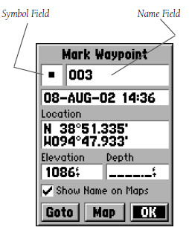
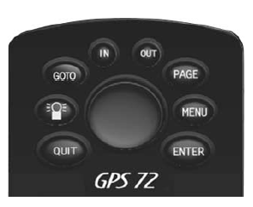
Collect a Point
Step 4: Press and hold the Mark button and begin collecting data (in this case, a Waypoint).
Mark
Button
H
MARK
Name of waypoint (could be venue ID)
Mark Waypoint Page
Notes:
So you’re out in the field, and you’ve turned on the Garmin. You have found enough satellites, and you’re ready to collect a point. The first thing you do is press the “Mark” button. (Press and HOLD the “Enter” button).
After the Mark button is pressed, the Garmin displays the Waypoint page. This action assigns a number to the waypoint you are about to collect. (The assigned waypoint number is not the number that you will be recording. Instead, change the waypoint number to the appropriate venue ID number. The process of changing the waypoint name and the venue ID numbers will be covered later when we discuss GPS collection protocols for the survey.)

Slide 19
Record Point
Step 5: Press “Enter” while highlighting “OK” to record point
Waypoint ID (very important; this ID ties the location to the survey data!)
H
MARK
Position
Rocker
Button
Enter
Button
OK button puts point into memory
Waypoint Page
Notes:
Use the main Rocker button to navigate around the Waypoint Page. (if necessary, navigate to the Waypoint ID field using the Rocker button. Press Enter to begin editing this field, using the Rocker button left and right to highlight each digit in turn, and up and down to advance or decrease each digit, selecting the appropriate letters and numbers and pressing Enter once more when the correct ID is displayed).
Then record the coordinate and Waypoint ID by hand in your log sheet and finally, making sure the word “OK” is highlighted, press “Enter” to record your point in the unit’s memory. Until the OK button is selected and Enter is pressed, the point will NOT be saved!

Slide 20
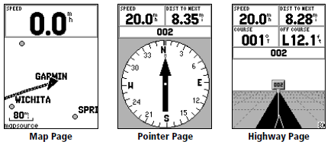
Other Pages
Notes:
These are other pages that are available in the Garmin. They can be ignored as they won’t be used during the survey.

Slide 21
Step-by-Step for Spatial Data Collection
Turn on the receiver.
Initialize the receiver, if needed.
Acquire satellites until a 3D GPS LOCATION is obtained.
Press the ENTER button until the WAYPOINT screen appears.
Enter the appropriate ID value in the WAYPOINT ID field.
Record the coordinate displayed on the GPS survey form.
SAVE the averaged coordinate by highlighting OK (use Rocker if necessary) and pressing ENTER.
Turn off the GPS receiver.

Slide 22
ID Values
Type of Site | What ID Value to Use
PLACE Sites | Unique Site Number (from the completed Site List) as filled out by the Supervisor on Form B

Slide 23
Let’s Practice!

Slide 24
Saving and Exporting Spatial Data (for Supervisors)
Download the downloading software before you go into the field
Each day, download coordinates from GPS device onto laptop
Make sure they’re in decimal degrees!
See the Mapping Toolkit for more details
Save the coordinates in a file on your laptop
Send to the Study Coordinator as soon as you are able

Slide 25
End of GPS Overview

