Slide 1
Lesson 3 GIS Fundamentals
MEASURE Evaluation
PHFI Training of Trainers
May 2011

Slide 2
Objective
To provide background on GIS and introduce QGIS
Notes:
Since you all have completed the online course, I won’t spend a lot of time going over definitional issues with GIS but I think it’s important to do a quick review before we get into the first exercise. So the objective of this lesson is to provide a brief refresher on GIS.
Just as a show of hands, how many people in the class have used a computer program to make a map before? [ASK CLASS – FIND OUT WHAT PROGRAMS CLASS MAY HAVE USED, THIS CAN BE HELPFUL TO GAUGE PRE-EXISTING KNOWLEDGE AND IDENTIFY SOME PARTICIPANTS WHO CAN HELP MENTOR OTHER STUDENTS]

Slide 3
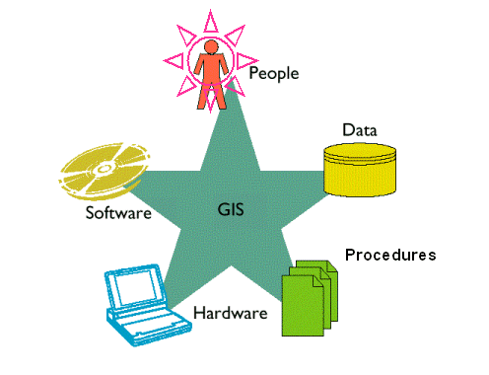
Geographic Information System (GIS) is an integration of five basic components
GIS is more than just a computer program that produces maps.
Notes:
A Geographic Information System is an integration of five basic components, people, data, software, hardware and procedures for managing and analyzing the data. GIS is more than just a computer program that produces maps. To be considered a GIS, a software program has to have some advanced data management capabilities.

Slide 4
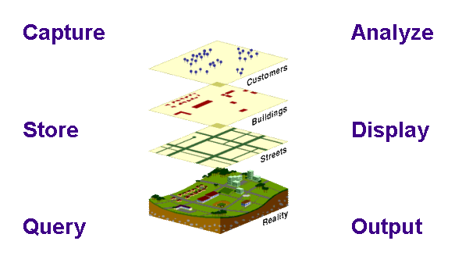
Capturing
Storing
Querying
Analyzing
Displaying
Outputting
Notes:
A key characteristic of a GIS is it’s ability to manage data in layers. A GIS will be able to do all of the above for layers.
In a GIS the world is represented by layers. So in this instance there’s a layer in the GIS representing customers, a layer representing buildings, a layer representing streets. Each of these layers is a representation of an aspect of reality. A GIS can manage the layers and help you understand the relationship between and within layers.

Slide 5
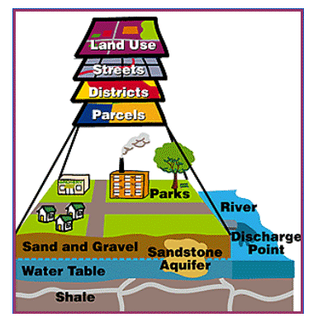
A GIS combines layers of spatial data
Answers questions by comparing layers
Notes:
In other words, a GIS combines layers of spatial data and answers questions by comparing layers.

Slide 6
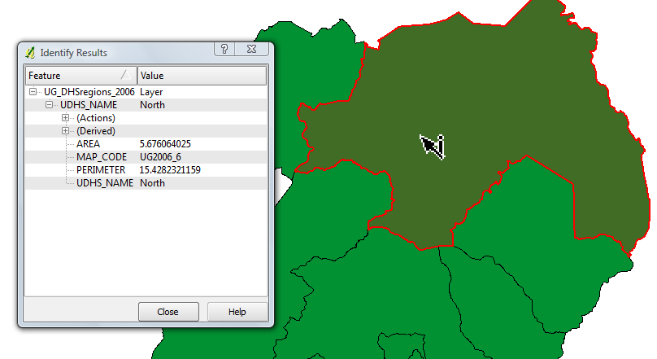
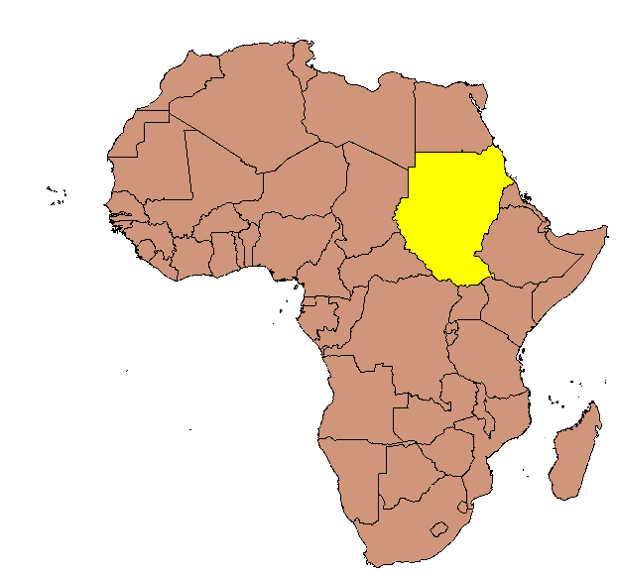
Querying Data
Identify features based on location
Identify features based on a condition
An African country with a population greater than 300,000
Notes:
Another key feature of a GIS is it’s ability to query data. For instance selecting features based on location, such as selecting all points within 1 kilometer of a well. A GIS should also be able to query the data and make selections based on a condition such as “An African country with a population greater than 300,000.

Slide 7
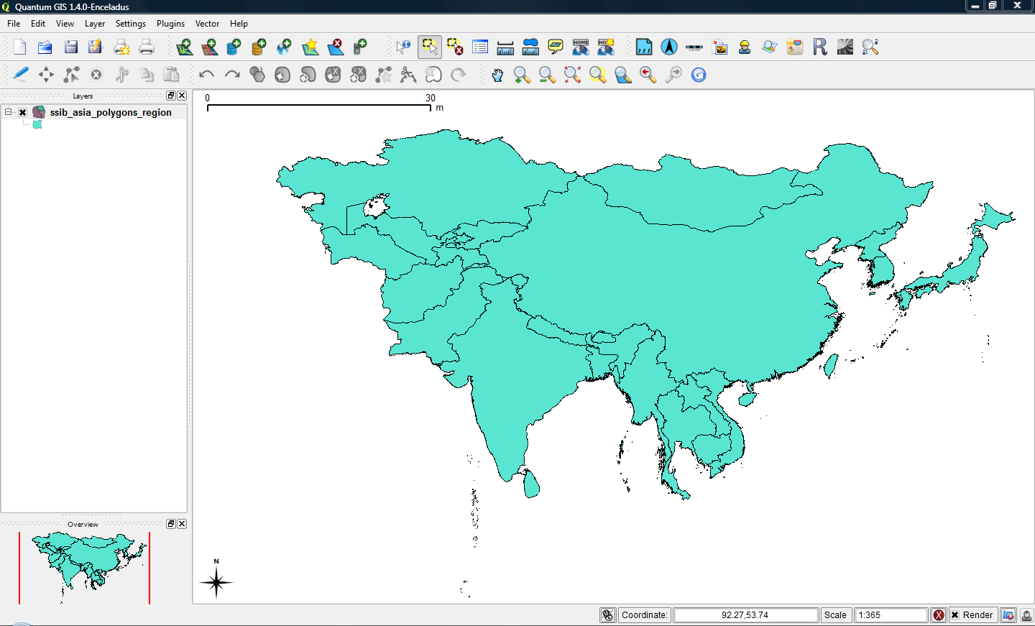
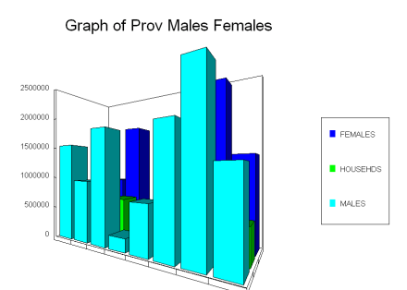
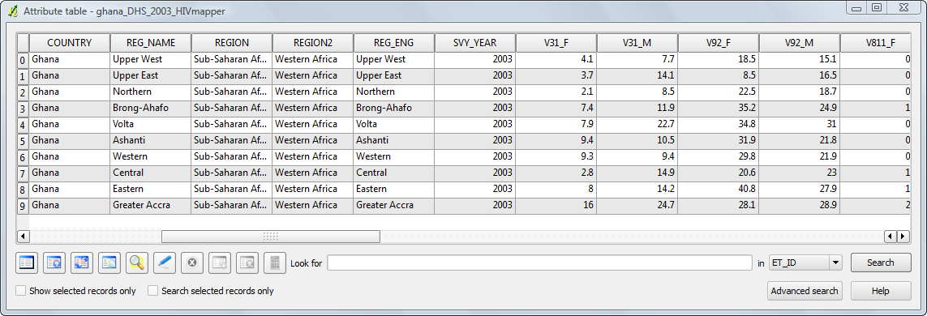
Displaying Data
Maps
Graphs
Tables
Notes:
A GIS should be able to display data in a variety of ways such as a map, a table or a graph.

Slide 8
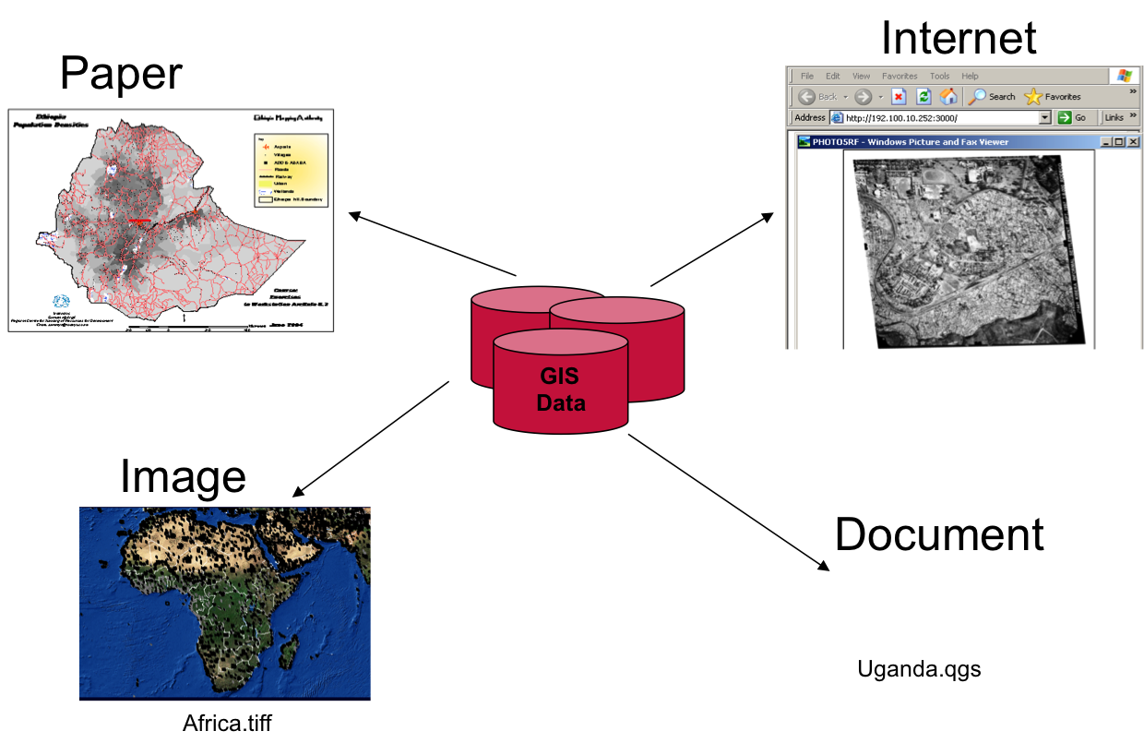

Outputting Data
Notes:
A GIS system should have different ways of outputting data such as on paper, exporting the data as an image, putting the map on the web or by saving it as a document that can be shared with other GIS users.

Slide 9
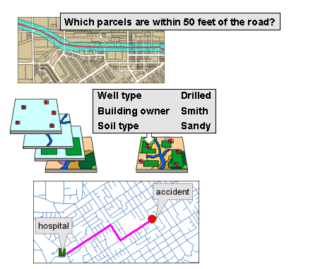
Analyzing Data
Proximity
Overlay
Network
Notes:
A GIS should be able to also facilitate analysis through techniques that utilize geography such as proximity – an example of which might be asking the GIS to identify features of one layer based on proximity to features of another layer. Overlay is another key GIS analysis technique – having the GIS overlay data on top of another. Lastly, network analysis is another important analytical technique. Network analysis uses a network (most often a road network, though it could be another type, such as a river network) as the basis for analysis, such as by calculating travel time from one feature to another.

Slide 10
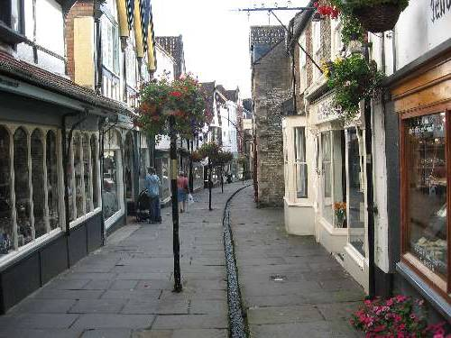
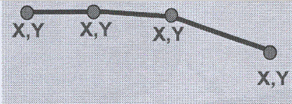
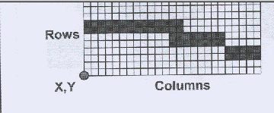
Storing Data
Vector formats
  Discrete representations of reality
Reality
  Raster formats
  Use square cells to model reality
Notes:
GIS can store data in two ways: vector or raster formats. Vector formats are discrete representations of reality. Individual elements can be selected. For instance a vector layer might contain points representing the location of health facilities. Each individual facility can be selected.
The second way GIS programs store data is in raster formats. These are gridded representations where each cell in the grid has a value. Individual elements can’t be selected. In the health arena both types of formats are used, though vector formats may be a little more common.

Slide 11
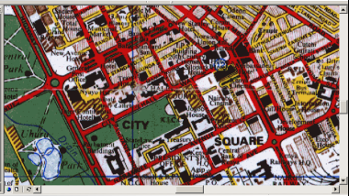
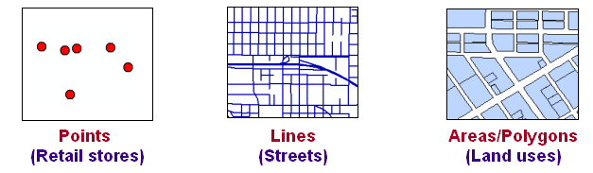
Representing features in vector data
Real-world entities are abstracted into three basic shapes
Notes:
To explain a little further, vector data represents real world entities as three basic shapes: points such as stores or health facilities, lines or areas/polygons

Slide 12
Vector Data
Vector data provides a complex representation of the world it stores both:
  Attributes -- text or numerical information that describe the features
  Geometry -- the shape of the features
Notes:
Vector data provides a complex representation of the world. It stores both the attributes associated with a feature and the geometry or shape of the feature

Slide 13
Attributes
Nonspatial information about a geographic feature in a GIS
Stored in a table and linked to the feature by a unique identifier
For example, attributes of a river might include its name, length, and basin.
Unique_ID | River_name | Length_km | Basin_km2
1 | Mississippi | 3,730 | 2,981,076
2 | Amazon | 6,937 | 7,050,000
3 | Niger | 4,180 | 2,117,700
Notes:
Attributes are the non-spatial information about a geographic feature in a GIS such as population in a state or length of a river. It is stored in a data table and linked to the feature by a unique identifier. For example this is a data table that contains information about the length and basin size of rivers.

Slide 14
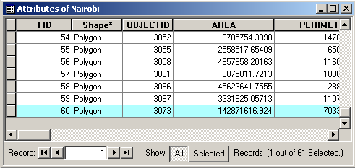
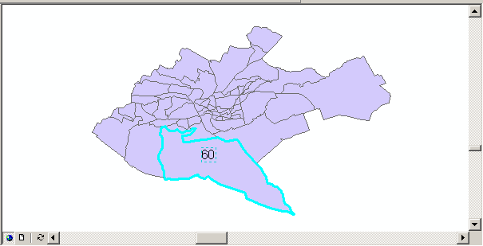
Linking geometry and attributes
  Unique identifier links geometry and attributes
FID = 60
(Feature Identifier)
Notes:
So to expand a little bit more, each record in a vector file must have a unique identifier that allows the GIS to make the link and tie together the data and the geometry.

Slide 15
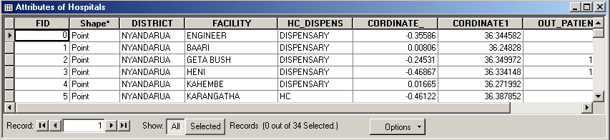
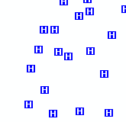
Shapefile data format
Actually, multiple files
Attributes stored in dBASE table (.dbf file format)
Shapefile.dbf table
Hospital
shapefile
“Shape” field
Access separate
Coordinate file
Notes:
One of the most commonly used vector formats are “Shapefiles”. The name “shapefile” is a little misleading because shapefiles are actually multiple files. There are files that provide the geographic description of the features, a file that acts as an index and attributes stored in a .dbf file.
A word of warning, the DBF file format is a somewhat old file format that was used in a database program from the 1990’s, called dBase. Because it is such an old file format and there are so few uses of the format (shapefiles are one of the last holdouts) new versions of Excel (2007 and 2010 versions) don’t export spreadsheets into .dbf format.

Slide 16
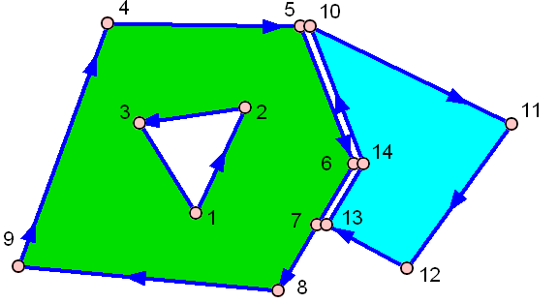
Topology
The arrangement that constrains how point, line, and polygon features share geometry.
Topology defines and enforces data integrity rules (for example, there should be no gaps between polygons).
Notes:
Topology is the arrangement that constrains how point line and polygon features share geometry and defines and enforces data integrity rules such as no gaps between polygons.

Slide 17
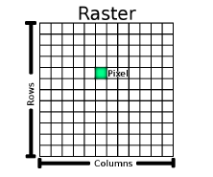
Raster: Images and grids
Rows and columns of equally-sized cells
  Each cell stores a value
  Detail depends on cell size
Can be stored in various image file formats including: JPG, IMG, TIF, ASC, BMP, etc
Notes:
Next I’ll talk about raster formatted data. Raster data represents the world as a series of cells in a grid. The cells represent features.

Slide 18
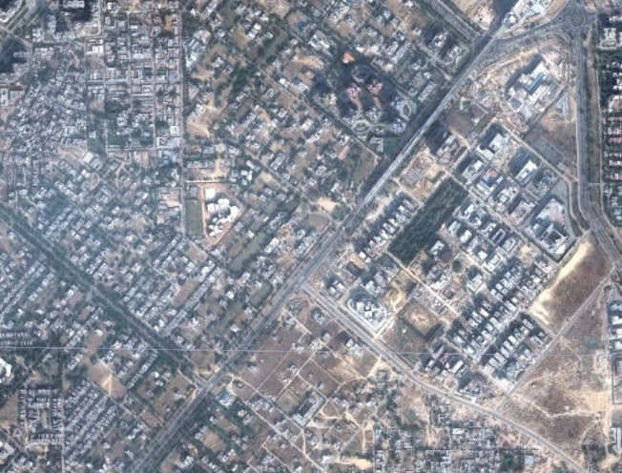
Rasters
Images
Data based grids
Notes:
Raster data files can be data based grids or images such as satellite images

Slide 19
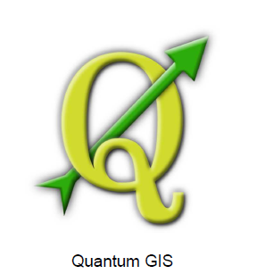

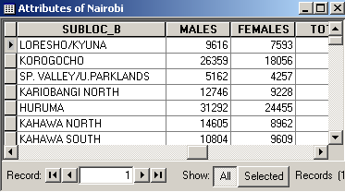
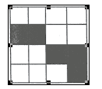
Spatial data formats
QGIS can work with spatial data in multiple formats including the following
Vector
Shapefile
KML
-keyhole markup language
Table
Raster
Notes:
QGIS, which we’ll be using in this class can work with spatial data in multiple formats. It can ha

Slide 20
Key Points
GIS is an integration of 5 components
GIS represents the world as layers
Data can be stored as raster or vector
There are standard features that should be present in a GIS:
  Storing, Querying, Displaying, Outputting Data
Any questions?
Notes:
During this session we reviewed the previous key points. [READ SLIDE]
Are there any items covered that you have questions about, or anything that wasn’t clear or the class would like more information about?
Next, we’ll give you a chance to actually use a GIS program.

