Slide 1
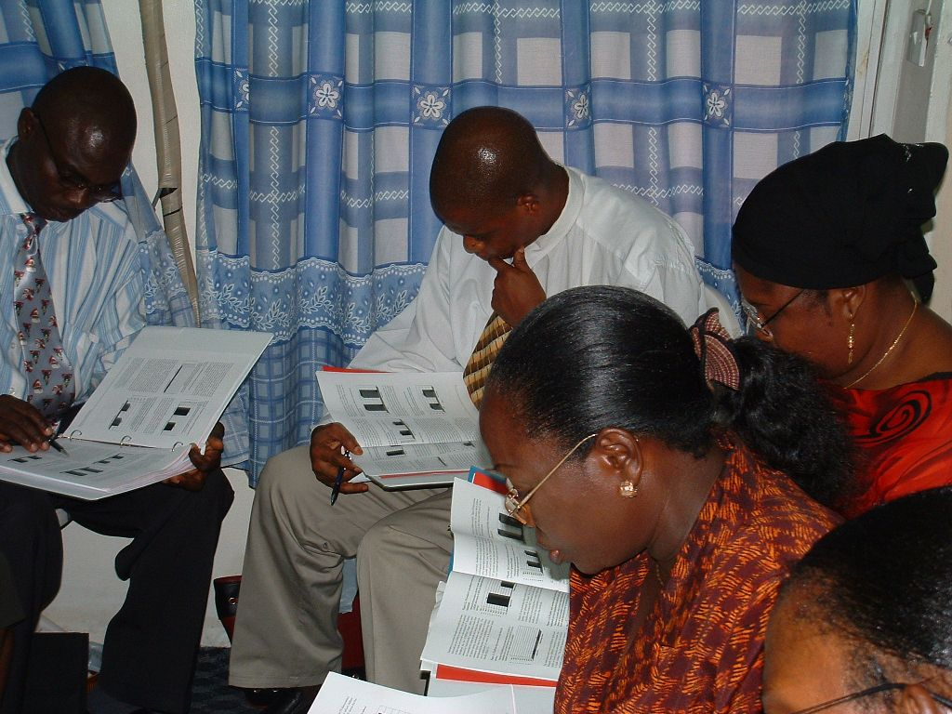
What don’t we know?
Notes:
Often M&E data are reviewed, but questions still remain to truly understand why a program is not meeting it objectives.
In this group activity, we review a scenario where a gender analysis is applied to M&E data, but there are still further questions that need answers.
In the next session, we review options for obtaining more information and what to consider when conducting further data collection.

Slide 2
Scenario: Review of data reveals…
Both adult men and women access HIV/AIDS Counseling, Testing, and Treatment services, but the % women > % men for:
  Treatment
  Testing +
  Volunteer counseling & testing
  Gap highest for provider-initiated testing
Notes:
For this example, let’s say that our review of the M&E data indicates that…

Slide 3
Scenario: Reasons for findings…
Health Goal: Increase % of men seeking HIV/AIDS counseling, testing, and treatment services
Gender Dimensions:
    Access to Resources
    Knowledge, Beliefs, and Perceptions
    Practices and Participation
    Laws, Legal Rights, Policies, and Institutions
Notes:
From our analysis of the data packet, we think that our health services are not adequately reaching adult men within our catchment population.
In our gender analysis to identify possible underlying causes of this difference in services between adult men and women, our team decides to focus on 2 gender dimensions:
1.) Knowledge, Beliefs, and Perceptions
3.) Practices and Participation

Slide 4
Scenario: What more to know…
Health Goal: Increase % of men seeking HIV/AIDS counseling, testing, and treatment services
Gender Dimension: Knowledge, Beliefs, and Perceptions
  Are men aware of services? Are men aware of the health risk?
  Does the community dis/approve of services?
  Who has influence over men?
  How do men feel about the service?
  What are the benefits/costs to men?
Notes:
What more would we want to know about men’s individual knowledge, beliefs, and perceptions to support our health goal:
Knowledge:
Are men aware of counseling and testing services? Are men aware of HIV/AIDS as a health risk in their community?
Beliefs:
Do others in the community approve or disapprove of men accessing these services?
Who has influence over men’s behavior in the community?
Perceptions:
How do men feel about visiting a counseling and testing clinic?
What do men think are the future benefits and costs of receiving counseling and an HIV test?

Slide 5
Scenario: What more to know…
Health Goal: Increase % of men seeking HIV/AIDS counseling, testing, and treatment services
Gender Dimension: Practices and Participation
  What are the facilitators and barriers to using the health service?
  How strongly do these facilitators and barriers affect a man’s decision to use the health service?
  Despite all the challenges, how confident are men about using the health services?
Notes:
What more would we want to know about men’s practices and participation outside of the individual, and in the surrounding community that could be modified to support our efforts to ensure gender equitable health services:
Practices
What are the environmental facilitators and barriers to men visiting a counseling and testing clinic?
- How easy is it for men to access the clinic?
- Are clinics affordable?
- Do men in the community accept the quality they find at their local clinic?
What are the social facilitators and barriers to men visiting a counseling and testing clinic?
- Do those who have influence over men promote the use of counseling and testing clinics?
Participation:
To what extent do these facilitators and barriers influence a man’s decision to visit a counseling and testing clinic? How powerful is their influence?
Finally, you may want to know whether despite all the challenges men face in their community, how confident are they in their ability to walk into a clinic and get tested for HIV?

Slide 6
Scenario: reaching your audience…
How to reach your audience:
  What segment(s) of men do we want to target?
  What communication channels/settings are most appropriate?
  What is the key health message?
  How can we pretest our ideas?
  Who else can we work with to communicate our message?
  How do we measure success?
Notes:
We may also want to know how best to reach our audience of men. Questions concerning this may include:
What segment(s) of men do we want to target? What are some additional characteristics about the kind of men who we want to be using our counseling and testing clinics?
Examples include certain age groups, income levels, education levels, occupations, ethnicities, or personalities…
How do we want to target these specific segment(s) of men? What channels of communication would be most effective? What would be the most appropriate setting? When and where do we want men accessing our counseling and testing clinics?
Examples of communication channels include Internet, television, radio, print, billboards (signs), pamphlets, or key messages delivered by community volunteers.
Examples of settings include near the clinic, at work, places of worship, schools, in households, or areas of large social gatherings.
What is the key health message we want to communicate to this target audience? What is our strategy to change behavior?
How can we pretest our ideas, messages, and materials?
What other individuals or organizations within the community can we work with to communicate our message?
How do measure success? How do we track target audience exposure and reaction to our health message?

Slide 7
Interpreting Data – possible causes?
Supplement with expert opinion:
Others with knowledge of the program or target population
Relevance of finding
Reasons for finding
Notes:
We have already determined from the data that the most relevant finding is that men are not sufficiently accessing HIV/AIDS counseling, testing, and treatment facilities.
When seeking potential reasons for the finding [CLICK ANIMATION], we often will need additional information that will put our findings into the context of the program.
Supplementing the findings with expert opinion is a good way to do this. For example, those attending this workshop who may be familiar with the health service could have some insight into these health services and could answer our additional questions.
Or you may want to talk to others with knowledge of the program or target population, who have in-depth knowledge about the subject matter, and get their opinions about possible causes. You could talk to community leaders, program managers, subject matter experts, or health service providers to get their opinions.
Sometimes ad hoc conversations with experts are insufficient. To get a more accurate explanation of your findings, you often will have to consider other data resources.

Slide 8
Interpreting Data
Use existing other data source to clarify questions:
Financial & management information
Commodities data & client load
Modeling, estimates, & projections
Other health research
Project documents
Census
Surveillance data
Household surveys
Facility-level service statistics
Other M&E systems
Relevance of finding
Reasons for finding
Consider other data
Notes:
The analysis may indicate there is a problem, but may not provide the necessary details to know how best to resolve all the issues. To answer your interpretation questions you may need to bring in additional secondary data to look at comparisons with other data sources.
Additional data may provide answers from a different perspective. Also, when you reference multiple data sources it strengthens the credibility of your research. More evidence with similar indicators gives you a stronger and more accurate indication of what is happening in your program.
As you know, there are many sources of data and information that we can use in decision making, from the national level to the facility level. We have listed some of the more common sources on this slide. They include:
Census
Surveillance data
Household surveys
Facilities-level service statistics (Routine Health Information System or Health Management Information System)
Other M&E systems
Financial and management information
Commodities data and client load
Modeling, estimates, and projections
Other health research
Another good secondary source is a content analysis of any project documents [CLICK ANIMATION] related to the operations of a health program or service such as policies, records, meeting minutes, reports, surveys, checklists, training materials, etc. There is typically a paper trail with any project. The only disadvantage is that project reports are not always created for research purposes and so they may not always be relevant to what you want to know.

Slide 9
Interpretation – conduct further research
Data gap conduct further research
Methodology depends on questions being asked and resources available
Relevance of finding
Reasons for finding
Consider other data
Collect additional data
Notes:
Once you review additional data, it may become apparent that these data are not sufficient to explain the reasons for your findings – that a data gap exists. In these instances, it may be necessary to conduct further research.
The types of research designs that are applied will depend on the questions that need to be answered, and of course will be tempered by the feasibility and expense involved with obtaining the new data.
We will discuss options for further investigation in the next session.
Are there any questions?

Slide 10
What don’t we know?
Where can we get the answers?
Notes:
Given your main conclusions about the data you have been reviewing, what else would you like to know?
ENGAGE PARTICIPANTS: Facilitate an open discussion of this question and note the group’s conclusions on flip chart paper.
When the group has agreed on a list of questions, review each question and facilitate discussion on where they could obtain the answers. Note on flipchart paper the following sources, and ask the group to identify the actual person or data source they could then consult.
Using your own knowledge about the health problem or service,
Identify an expert to consult
Identify another data source you can review
Define the data gap that exists
As groups continue their gender analysis over the next hour, encourage them to contact some of the people or data sources identified during the group discussion.

Slide 11
MEASURE Evaluation is a MEASURE project funded by the
U.S. Agency for International Development and implemented by
the Carolina Population Center at the University of North Carolina
at Chapel Hill in partnership with Futures Group International,
ICF Macro, John Snow, Inc., Management Sciences for Health,
and Tulane University. Views expressed in this presentation do not
necessarily reflect the views of USAID or the U.S. Government.
MEASURE Evaluation is the USAID Global Health Bureau's
primary vehicle for supporting improvements in monitoring and
evaluation in population, health and nutrition worldwide.

