Slide 1

Conceptual Introduction to the RDQA

Slide 2
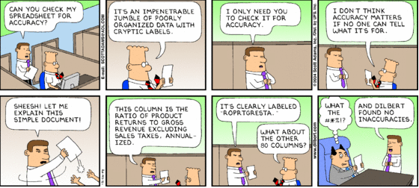

Slide 3

Session Outline
RDQA Rationale and Functionality
Strenghts and Limitations
Deployment Context
Modification and Cross-Industry Application

Slide 4
QUALITY DATA
Dimensions of Quality
ISO
Accuracy, Completeness, Reliability, Timeliness, Confidentiality, Precision, Integrity
Data-Management and
Reporting System
Functional Components of a Data Management System Needed to Ensure Data Quality
M&E Unit
Reporting Levels
I
M&E Structure, Functions and Capabilities
II
Indicator Definitions and Reporting Guidelines
Intermediate Aggregation Levels (e.g. Districts, Regions)
III
Data-collection and Reporting Forms / Tools
IV
Data Management Processes
V
Links with National Reporting System
Service Points
VI
Data management processes
VII
Data quality mechanisms and controls
VIII
Links with the national reporting system
Source: RDQA Guidance

Slide 5
RDQA Uses
The RDQA can serve multiple purposes:
  Routine data quality checks as part of on-going supervision
  Initial and follow-up assessments to measure performance improvement over time:
  Strengthening program staff’s capacity in data management and reporting:
  Preparation for a formal data quality audit·
  Partner and other stakeholder assessment (internal)

Slide 6
Terminology
Lets take a look at the tool -
  Service Delivery Points/Sites = Facilities/Source of Data Collection
  District Aggregation Sites
  Regional Aggregation Level
  National M&E Level
  Verification Factor = A standard, quantitative measure of Validity and reporting Consistency. A ratio of the actual count for a specific reporting period/indicator and the number reported to the next level.
  Cross Checks - Checks of the verified report totals with other data-sources
Notes:
Ask participants- is this the definition of an audit or assessment – ask to point out differences

Slide 7
RDQA Components
Trace and Verification Protocol
Systems Assessment Protocol
Recommendations and Action Plan
Graphic Displays
Notes:
Taken from ISO Store Templates

Slide 8
M&E Unit/National
Monthly Report
District 1
65
District 2
45
District 3
75
District 4
250
TOTAL
435
District 1
District 2
District 3
District 4
Monthly Report
Monthly Report
Monthly Report
Monthly Report
SDS 1
45
SDS 3
45
SDS 4
75
SDP 5
50
SDS 2
20
TOTAL
45
TOTAL
75
SDP 6
200
TOTAL
65
TOTAL
250
Service Delivery Site 1
Service Delivery Site 2
Service Delivery Site 3
Service Delivery Site 4
Service Delivery Site 5
Service Delivery Site 6
Monthly Report
Monthly Report
Monthly Report
Monthly Report
Monthly Report
Monthly Report
ARV Nb.
45
ARV Nb.
20
ARV Nb.
45
ARV Nb.
75
ARV Nb.
50
ARV Nb.
200
Source Document 1
Source Document 1
Source Document 1
Source Document 1
Source Document 1
Source Document 1
Notes:
Refer back to handouts – MANY dimensions – important to understand their contextual uses and common operational definitions

Slide 9
Outputs
Verification Factor (Plain English – reported number vs Recount)
DMS Spider Graph
Note: Difference btw facility and district graphics – Why?

Slide 10
Interpretation
Margin of Error
Point of discussion – Comparison between facilities/regions/provinces

Slide 11
Potential Modifications
Guidance
Questions
Cross Industry Applications

Slide 12


Strengths and Weaknesses
Strengths | Potential Weaknesses | Pay Special Attention to
Baseline and Measurement of Continuous Improvement | Insufficient Information to determine Root Cause | Inclusion of Comments
Ease of Use/Cost Effectiveness | Instrument/Methodology Mismatch | Methodology
Can be deployed as self assessment/internal assessment | Potentially difficult to customize if VB Code needs to change | Indicator and Reporting Period Selection
Capacity Building | Implementation of Action Plans | Sampling
Sustainability | Verification factor Fear | Interpretation of Results

