Slide 1
Data Use:
Strengthening Programs through Improved Use of Data
Andy Beke

Slide 2
SESSION GOAL
To enhance the understanding of key concepts of data and information dissemination and utilization for the purposes of information sharing, accountability, and programme improvement.

Slide 3
INVOLVEMENT BRINGS COMMITMENT

Slide 4
SESSION OBJECTIVES
By the end of this session, participants will be able to:
  Define key concepts and the purposes of data and information dissemination and utilization, and how it relates to strengthening the overall M&E capacity.
  Demonstrate an understanding of decisions and decision making.
  Use different ‘Data Demand and Information Use’ tools
  List common barriers to information dissemination and utilization, and propose methods to overcome them.

Slide 5
SESSION OVERVIEW
Key Concepts: Data – Information – Decision-making
  Decision Exercise
Purpose of Dissemination & Utilization of Information
  Indicator Use Exercise
Barriers to Data use
Seven steps to data use
Use

Slide 6
Decision Focus of a M/E System
Data Flows
Information
Decisions/ Actions
Flows
MIS
USERS

Slide 7
Decision Focus of M/E system
Information System
MIS:
- Data/Information Processes:
  Collection/compilation
  Calculation/analysis
  Reporting/dissemination
- Databanks: e.g.
  Population
  Service statistics
  Morbidity/mortality data
  Human resources
  Financial data
  Unit activities
  Transport pool
  Other organizations info
  Other data
User Management System
Users: e.g.
  Top management
  Unit managers
  Planners
  Donors
  Operational staff
  Researchers
  Statisticians
Used in: e.g.
  - Reviews
  Media: reports
  articles, minutes
  - Meetings,
  discussions
Information
Decisions
Actions

Slide 8
Common Data Demand and Information Utilization
(DDIU) Concepts

Slide 9
M&E IS AN ESSENTIAL PROCESS
that produces information to:
Make informed decisions regarding operations management and service delivery including effective and efficient use of resources as well as future programme planning
Determine the extent to which the program/project is on track and to make any needed corrections accordingly
Evaluate the extent to which the program/project is having or has had the desired impact

Slide 10
DATA VS. INFORMATION
Can be used interchangeably, but:
Data often refers to raw , unprocessed facts.
Information usually refers to processed data, or data presented in some sort of context.

Slide 11
DISSEMINATION
The process of sharing information or systematically distributing information or knowledge to potential users and/or beneficiaries
Should produce an effective use of information
    Thus
The goal of dissemination is utilization

Slide 12
UTILIZATION
The process of putting:
Information to use, such as to make decisions, to make changes, or to take other specific actions designed to improve outcomes.
M&E information is to be applied in planning, policy making, program administration/ management, and delivery of services

Slide 13
FEEDBACK
The transmission of information to parties for whom it is relevant and useful so as to facilitate learning.
Collection and dissemination of information, conclusions, recommendations and lessons learned from the experience.
Notes:
Monitoring provides regular feedback to compare what was planned to actual events by tracking:
costs
personnel
implementation time
organizational development
economic and financial results

Slide 14
WHY EMPHASIZE A FEEDBACK SYSTEM?
Maintains interest & ownership of M&E stakeholders
Validates M&E budget, results
Motivates partners & participants for improved data collection and data quality
Increases collective stock of knowledge
Must be well-organized to be effective

Slide 15
ESSENTIALS OF M&E INFORMATION
M&E information must:
be manageable and timely
be presented according to the audience’s
  interest
  capacity to understand and analyze
  time, competing demands on time
have transparent quality (VRIPT)
focus on activities, results of interest
focus on meaning and direction for action
Notes:
To ensure use…it is important that M&E information maintains the qualities that we have been referring to throughout this week. These are:

Slide 16
INFORMATION (MIS) USE
Focus should be knowledge generation

Slide 17
INFORMATION USE EXERCISE
Identifying Opportunities to Use Data
Choose one indicator and write out on flipchart
List all the ways that you can use information from this indicator
Report back
Notes:
Participants form into assigned groups. Review and direct group towards one indicator ask specfically how they will use them?
Write down on flip chart the indicator and the use.
Quick report back with feedback from faciliator

Slide 18
UNDERSTANDING DECISION-MAKING
Decision Making:
The process of choosing from among various alternatives using information at hand
What decisions have you made already today???

Slide 19
In the process of understanding decisions and decision making, it is important to understand:
What is the decision to be made?
Who makes the decision?
When or why is the decision made?
How is the decision made?
What information is needed?
More over:
What is my role in decision making?

Slide 20
IDENTIFYING DECISION-MAKERS (WHO)
Sector
Health
Education
Commercial
Function
Policy
Planning
Budgeting
Service delivery
Advocacy
Evaluation
Level
National
Regional
Local
Decision Makers

Slide 21
DECISIONS WITHIN PROGRAMS (WHAT)
Decisions ensure program activities are executed as planned and services are delivered as intended
Are we doing the right things, doing them right, and reaching those we intended?
Decisions about employment & manpower
Decision about mobilization & allocation of resources (physical & financial)
Decisions about needed information and developing channels for feedback

Slide 22
TYPES OF DECISIONS
Policy, Planning & Advocacy
Program Design & Improvement
Program Management & Operations
Notes:
Decisions are categorized into three types. These three types are not always mutually exclusive however, they are divided this way based on the following criteria:
Who is involved in making the decision
The type of data required to make this decision and how it is presented
The process by which decisions of this type of made..
The reason it can useful to categorize decisions is because doing this can help operationalize integrating use of information into the decision making process-
If you have a decision to make and the data that informs that decision what is the plan for entering for entering it into the process?

Slide 23
POLICY, PLANNING & ADVOCACY
HIV/AIDS Workplace Policy
Family Planning Counseling Protocol
National allocation of funds to a Health Information Unit
HIV/AIDS National Strategy Document
Notes:
Considering that policy and advocacy decisions and issues typically require a specific process for formalization and approval they are there in their own category. This area includes national, sector-wide planning and resource allocation.

Slide 24
PROGRAM DESIGN & IMPROVEMENT
Design of Prevention of Mother to Child Transmission of HIV/AIDS program
Procurement of drugs and commodities
Improving performance of family planning counselors
Notes:
Depending on the scope and timeline of the program there could be a wide range of program specific decisions that need to be made beginning with program design and improvement, scale-up, sustainability and possibly close out.

Slide 25
PROGRAM MANAGEMENT & OPERATIONS
Number of staff to support program monitoring
Reporting mechanisms
Allocation of national program funds to districts or local implementers
Notes:
Aside from decisions that directly influence the content and success of a program are the operational and management decisions that will affect its success. These include administrative and financial decisions that a program manager must make in order to support an ongoing program. Administrative and financial data should be used to support these decisions.

Slide 26
APPROACHES TO DECISION-MAKING (HOW)
Rational/Scientific
Political
Routine
Notes:
Optional 1: Rational/Scientific approach
Recognize the need for a decision
Establish, rank, and weigh the decision criteria
Gather available information
Identify possible alternatives
Evaluate each alternative with respect to all criteria
Select best alternative. Utilize M&E information
BUT IN THE REAL WORLD WE LIVE, OTHER OPTIONS DO EXIST. THE SAD SITUATION IS THAT THEY MAY NOT BE EVIDENCE-BASED
Optional 2. Political (directives etc)
Optional 3: Routine
“the way things are done out here” you cannot identify why things are being done the way they are. No basis.

Slide 27
Traditional Health Management
Decision Making

Slide 28
Data/Information Use Constraints

Slide 29
Assessment of Data Use Constraints
Rationale
  Vast amounts of data & reports that will never be used for decision-making due to constraints or barriers
Description
  Key informant interview guide designed to identify barriers & constraints to data use
  Identifies best practices in data use so they can be applied
  Aids in designing & prioritizing approaches for addressing barriers and constraints
Notes:
The Assessment of Data Use Constraints is a tool for rapid assessments that :
Identifies existing barriers and constraints to data use.
Identifies existing best practices in data use, so these practices can be applied elsewhere.
The assessment is made by interviewing key informants at various levels, such as national and district-level policymakers and program managers from the public and private sectors. The assessment can also be used to examine processes within a single organization, and can be incorporated into health information and organizational capacity-building assessments at the national and sub-national levels.
As Ed discussed, there are three different types of determinants and constraints to the use of data and information –
the behavior of individuals who produce and/or use data,
the technical aspects of data processes and tools and
the system/organizational context that supports data collection, availability and use.
The interview guide is organized by these three categories to examine individual constraints, such as an individual’s motivation to use data in their work;

Slide 30
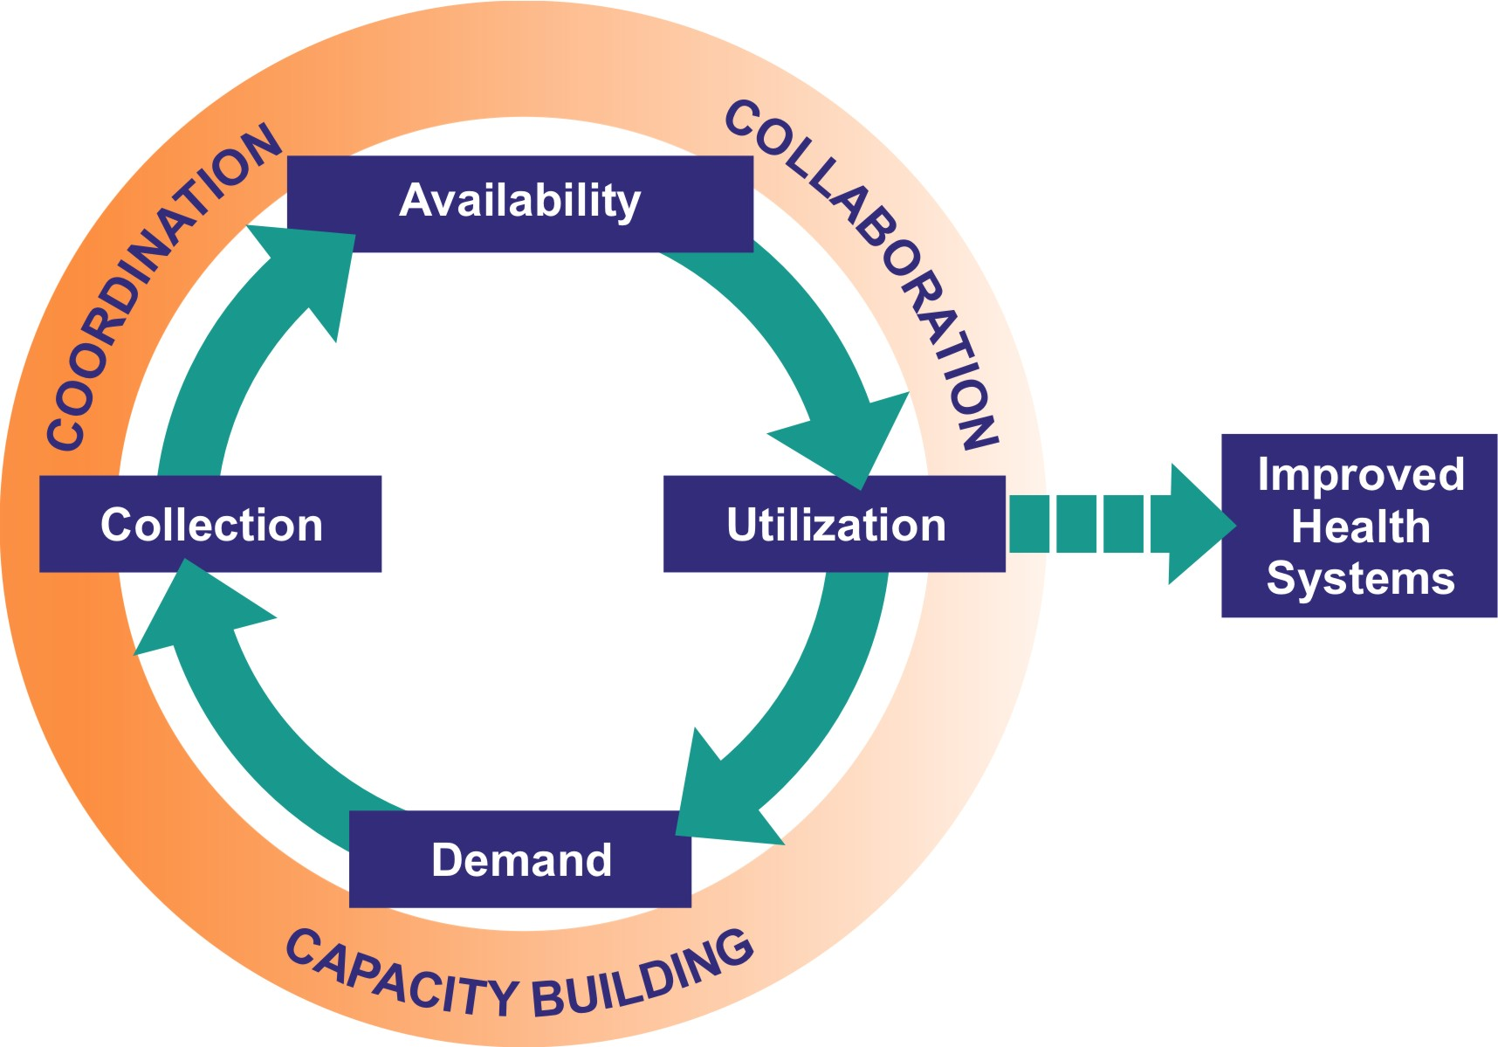
Data Demand & Information Use
Notes:
Data demand involves Stakeholders actively and openly requesting quality, health-related data and information
The decision-maker understands information is needed to inform the decision; and
The decision-maker proactively seeks out that information.
data demand could include managerial or policy directives to collect specific data, new or increased resource allocation for data collection and analysis (e.g., budget line items, establishing or strengthening statistical units inside ministries or programs, modifying job descriptions), and requests for special analyses. Demand for data helps to improve the quality of data collection and interpretation.
Information Use steps beyond dissemination. It is the process by which stakeholders use information in an evidence-based process to:
Reach decisions,
Make changes, or
Take other specific actions designed to improve outcomes.
Information can and should be used in practical applications:
Program administration/management
Delivery of services
Planning and/or policy making
this framework outlines a continuum of M&E efforts needed to support improved health outcomes
In order to achieve improved health outcomes, and in this case- in the area of HIV/AIDS, this framework outlines a continuum of M&E efforts needed to support improved health outcomes
The over-arching principle of the MEASURE Evaluation Project is that evidence-based decision-making will promote the achievement of improved health outcomes. The conceptual framework for the MEASURE Evaluation project posits that evidence-based decision making results from generating demand for information, collecting and analyzing data, making information available, and finally, from using the information to improve health systems. Figure 1 presents the MEASURE Evaluation conceptual framework as a cycle from demand to utilization (which directly affects demand); embedded in the cycle is the decision-making process.

Slide 31
Conceptual Framework
Notes:
It is important to note, however, that every organization and individual faces barriers at different points in the M&E cycle when attempting to use information to make decisions or improve the quality of their work.

Slide 32
What Determines Data and Information Demand & Use?
CULTURE
ORGANIZATIONAL APPROACH
TECHNICAL APPROACH
POLITICS
SOCIETY
INDIVIDUAL BEHAVIOR
Decision making occurs within political, cultural, and social contexts
Notes:
In trying to understand the context in which decisions are made and how this influences the use of information but also the collection and availability of data, three main determinants of the use of health information have been identified:
the technical aspects of data processes and tools,
the behavior of individuals who produce and/or use data, and
the system/organizational context that supports data collection, availability and use .
Create a link to terminology page which contains the definition of the word “determinant”.
Technical determinants of information use include the technical skills of the project staff to perform their job functions, the availability of computers and analysis software to support them in their work, and the ability of the information system to organize and store project data. An M&E system needs to address all of these technical elements in order to produce the information needed for making decisions.
Behavioral determinants often involve concepts such as individual motivation and attitudes toward using data and information. Influencing these behavioral factors will require interventions that go beyond simple training that improves knowledge and skills in understanding data and using information. If health system information is to be used, individuals must understand the utility of using the information to make decisions and feel confident and competent in using it.
System/organizational determinants represent the broader context that supports data collection, availability and use. This can include organizational factors such as the clarity of roles of those who not only produce but use information, support from organizational leadership for the need, use and funding of information systems, human and financial resources, and the flow of information throughout the organization. Without an organizational context that supports and values data collection and use, it is difficult to make the links between health information and decision making.
The political, cultural and social context is an important determinant of data demand and information use also, because decision-making, sharing of information, and data collection and reporting all occur within these contexts.
Be sure to note that the political, cultural and social context is an important determinant of data demand and information use also, because decision-making, sharing of information, and data collection and reporting all occur within these contexts. This framework of three main determinants of data demand and information use is taken from the PRISM framework.

Slide 33
Determinants of Data and Information Use
Individual aspects
  Decision maker attitudes, staff motivation
Technical aspects
  Technical skills, availability of computers, data system design
Organizational aspects
  Structural – roads, telecommunication
  Organizational – clarity of roles, support, flow of information
* Based on PRISM analytical framework (LaFond, Fields et al. 2005 The PRISM: An Analytical Framework for
Understanding Performance of Health Information Systems in Developing Countries. MEASURE Evaluation).
Notes:
In the DDIU approach, there are three main determinants of use.
The first, and possibly most important determinant, are the behavioral aspects of those who produce and use the information. If health system information is to be used, the decision maker must be open to the idea of using the information to make decisions - and see value in using it.
The other determinants of information use are:
the technical aspects of data processes and tools
the system/organizational context that supports data collection, availability and use, and
DDIU is a strategy to address these three components, and can be used to identify opportunities for and constraints to use.

Slide 34
Brainstorm
What barriers have you faced to using or getting others to use data and information?

Slide 35
Data are often underutilized because of…
Organizational structures
Lack of a “data culture” among decision makers
Lack of technical skills and technology, particularly at local levels
Training often ad hoc and not sustainable
Structural constraints– roads, telecommunication
Poor funding for M&E
Political interference
Notes:
Organizational structures can be a constraint on efficient data management processes
Lack of a “data culture” among decision makers and low staff motivation
Lack of technical skills and information technology, particularly among staff at local levels
Training is often ad hoc and not sustainable
Structural constraints– roads, telecommunication
Unclear staff roles and poor flow of information
Poor funding for M&E
Political interference

Slide 36
Small Group Work
Convene into small group
Identify notetaker and reporter
Brainstorm potential barriers to information use within your organisation

Slide 37
Questions to consider
Do any of the following impact information use? How? Why?
  Individual behavior?
  Flow of information or the M&E system?
  Organizational hierarchy or structure?
  Type of services provided?
  Resources available?

Slide 38
Brainstorming Activity
Data Use Constraint Exercise
In your group context
  Use Assessment of Data Use & Constraints by interviewing at least 2 people in your group
  Write up the summary table
  Present and discuss to group

Slide 39
Instructions for Small Groups
Get back into the same groups
Using barriers brainstormed during the last group work:
  Prioritize at least five key barriers
  Develop solutions to these barriers
  Define steps to implement

Slide 40
Assessment of Data Use Constraints – Purpose
Identifies barriers & constraints to data use
  Why M&E systems not producing all value they could
  Why findings are inconsistent among different reporting entities
  What are impediments for sharing data
Identify best practices in data use
  Good existing information flow to serve as example for improvements in other initiatives
Provide essential knowledge for addressing constraints & barriers
  Demonstrating ways of overcoming them in each of the three areas
  Plan M&E system to change, acknowledge (work around) what you cannot change (underlying political/other environment)

Slide 41
Assessment of Data Use Constraints – Types of Constraints
Organizational
  Processes not support use of data for various reasons
    Not officially sanctioned
    Sensitive material
    Lack of established channels for data sharing
Technical
  Shortage of computers or software
  Lack of good definitions for indicators
  Use of different sources for same indicator or different algorithms in creating it
Individual
  Shortages of M&E skills (manage, interpret & use data)
  No guidelines to establish protocols for data collection & use
  Lack of motivation & incentive to produce high quality data or to rely on data for decision making

Slide 42
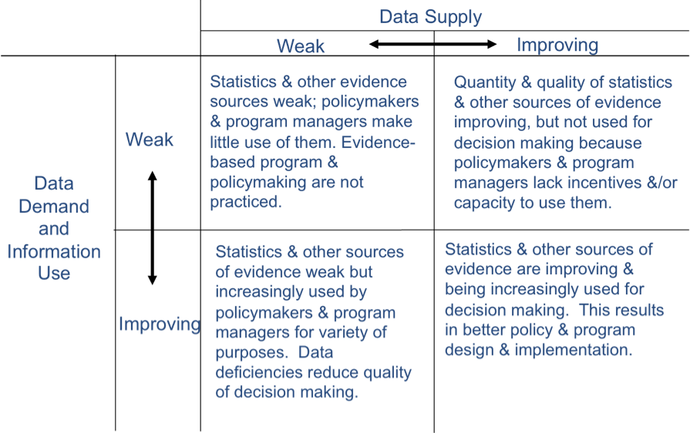
DDU PROCESS & RESULTS-BASED SYSTEMS APPROACH
Four distinct steps in the Data Dissemination & Use Process:
Assess the Situation – Supply & Demand Matrix
Source: Scott, 2005

Slide 43
Session 3
7 steps to use routine information to improve HIV/AIDS Program
Nicole Judice

Slide 44
Session Outline
Why use the Seven Steps Approach?
What are the Seven Steps?
Small group work applying Steps 1 and 2

Slide 45
What is the Seven Steps Approach?
Guidance for using existing information to improve programs and services
Dialogue and participation of data users and data producers
  Management team meetings
  Departmental meetings
  Staff meetings

Slide 46
Stepwise guidance helps to…
Identify and understand trends and needs;
More effectively plan and set priorities;
Support changes in program and service delivery;
Support requests for additional resources;
Justify changes in technical and administrative policies affecting service delivery;
Provide evidence-based clinical decision making;
Facilitate accountability for expended resources;
Communicate the importance of HIV/AIDS services to the community.

Slide 47
What kinds of data can be used at the facility?
Routine data
Non-routine data

Slide 48
Non Routine Data
Provide data collected on a periodic basis – annually or even less frequently;
Include surveys, census
Collected less frequently because of high cost

Slide 49
Routinely collected data
  Data collected on a continuous basis, such as patient registers
  Can be used effectively to detect and correct problems in service delivery
  Decision makers and service providers benefit most from using routine data
  Limitations include - routine data do not reflect the population that does not receive services

Slide 50

No need to go fishing…
Instead…answer questions that respond to true need and interest.

Slide 51
Seven Steps Approach
Step 1 - Identify questions of interest
Step 2 - Prioritize key questions of interest
Step 3 - Identify data needs and potential sources
Step 4 - Transform data into information
Step 5 - Interpret information and draw conclusions
Step 6 - Craft solutions and take action
Step 7 - Continue to monitor key indicators

Slide 52
Step 1 - Identify questions of interest
Participatory discussion of indicators demonstrating program success;
Mapping how the clients flow through the service
Generating new questions through the analysis of data
General brainstorming about what different staff are interested in knowing about the program;
Feedback from clients
External factors, such as audits, program evaluations, and donors questions

Slide 53
Step 2 – Prioritize Key Questions of Interest
Programmatic relevance
Answerable
Actionable
Timeliness of the question
Others?
Ensure question is specific

Slide 54
Step 3 – Identify Data Needs and Potential Sources
Enlist M&E Officer
How frequently or at what intervals do we need this information?
Do the data already exist and are they available?
Are the data of sufficient quality?

Slide 55
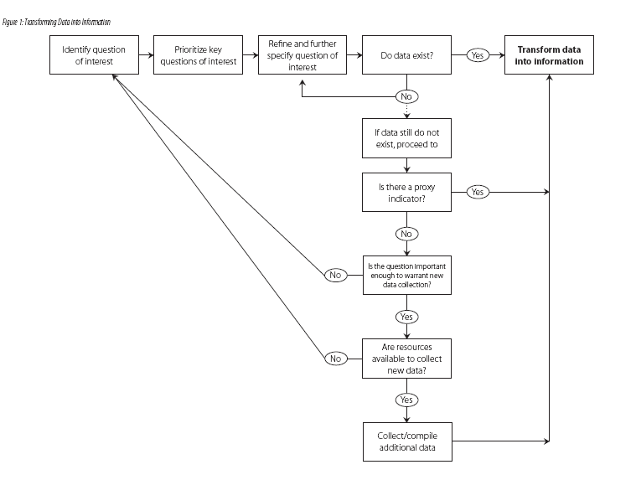

Slide 56
Step 4 – Transform Data into Information
Isolate required indicators and/or data elements
Analyze the data and calculate the indicator
Depict data in an image (graph, chart, table)

Slide 57
Step 5 – Interpret Information and Draw Conclusions
Convene group or team
Review graphs, tables, and information
Discuss the meaning of these analyses for our programs and facilities

Slide 58
Step 6 – Craft Solutions and Take Action
Discuss conclusions from interpretation
Brainstorm potential solutions
Further specify, craft and prioritize these solutions
Develop an action plan

Slide 59
Step 7 – Continue to Monitor Key Indicators
Monitor key indicators to ensure successful implementation of action plan
Consider monitoring needs: frequency, duration
Develop tool for monitoring

Slide 60
Small Group Work – Step 1
Convene in small groups and choose notetaker
Brainstorm a list of questions
Further specify and refine the list of questions

Slide 61
Defining Program Success
What do you want or need to know in order to say your program is working?
How do you know that your program or service is working?
Is your program or service improving client’s health?
How do you know if there are problems or that your program is not achieving its pre-determined objectives?

Slide 62
Small Group Work – Step 2
Reconvene in small groups and choose notetaker
Using the prioritizing worksheet, identify three priority questions to investigate

Slide 63
Session 4
Use

Slide 64
Step 5 – Interpret Information and Draw Conclusions
Convene group or team
Review graphs, tables, and information
Discuss meaning of these analyses for our programs and facilities

Slide 65
Team to involve
Management
Administrators
Service providers and counselors
Data specialists
Representatives of community

Slide 66
Data Analysis
Process of describing data.
Turning raw data into useful information.
Do not need special computer software.
Provides answers to questions within programs or research questions being studied.
Even the greatest amount and best quality data mean nothing if not properly analyzed or if not analyzed at all
Notes:
It is important to note that while the terms data and information are often used interchangeably; there is a distinction.
Data refers to raw, unprocessed numbers, measurements, or text.
Information refers to data that are processed, organized, structured or presented in a specific context. The process of transforming data into information is data analysis.
The purpose of data analysis is to provide answers to questions being asked at a program site or to research questions being studied.

Slide 67
Analysis vs. interpretation
Analysis
  describing data with tables, graphs, or narrative;
  transforming data into information
Interpretation
  adding meaning to information by making connections and comparisons and by exploring causes and consequences
Notes:
Analysis is summarizing the data and turning it into information. Interpretation is the process of making sense of the information. What does it mean for your program?

Slide 68




…FOUR BASIC GRAPHS
Pie charts
Bar graphs
Line graphs
Histograms

Slide 69
Epidemiological approach
Person
Place
time

Slide 70
How should we approach interpretation?
Relevance of finding
Reasons for finding
Consider other data
Conduct further analysis
Notes:
After we have considered the relevance of the finding to our program we need think about the potential reasons for the finding. To answer this question consider other data resources that could be used to respond to the key questions of interest. At this point we should ask whether we need routine health data or non-routine data, such as a population-based survey or a census and whether the data already exists.
Once we make those decisions then we can move forward with further analysis, if needed.

Slide 71
Interpreting data
Are we doing better or worse than we expected?
  Does the indicator meet the target?
  How does the coverage of services compare to what we expected to achieve?
  What percent achievement have we attained?
What is the programmatic relevance of the finding?
What are the potential reasons for the finding?
What other data should be reviewed to understand the finding?
How does it compare? (trends, group differences)
Notes:
When interpreting data we may ask these questions: What is the relevance of the unmet target for the program? What could be causing this? How are we doing in comparison with other clinics? Districts? Is it because we are not meeting our coverage or efficiency goals? Is our quality of care poor?

Slide 72
Different paths may appear
Analysis and Interpretation
No problem detected
Corrective action required
Collect information about root cause
State conclusion and decision needed
Notes:
In answering the question of interest, you may find that there is no problem and this particular part of your program or service is working well or according to plan. Alternatively, you may find that there is a problem and corrective action is required. Additional information may be needed to understand fully the root cause of this problem and design a solution.

Slide 73
All pregnant women (2000 women)
Coverage =
Service users
Target population
1000
Sought prenatal care
500
400 received HIV- result
Tested for HIV
100 received HIV+ result
Received prophylaxis
40
Notes:
We see that 2000 pregnant women are the target population with only 1000 of them seeking prenatal care. In many settings now, all women receiving ANC services are tested for HIV, but in this hypothetical example, 500 of the 1000 women coming for ANC services were actually tested for HIV. Among the 100 women testing postive for HIV, 40 received prophylaxis.

Slide 74
All pregnant women
What actions can we take to improve performance?
1000
Sought prenatal care
400 received HIV- result
500
Tested for HIV
100 received HIV+ result
Received prophylaxis
40
Notes:
Depending on the reporting system in place, some facilities only report the number of women receiving prophylaxis. Others may report more comprehensive information at each step of service delivery. Facility and program managers can then look at each step or interval to assess loss of clients and understand where there may be opportunities for improvement.
Rather than looking primarily at the number of women coming into antenatal care, we should begin by looking at the final steps in providing care. If we look at this particular interval, is the performance in this example good or bad? Why? What actions can we take to improve performance?

Slide 75
All pregnant women
1000
Sought prenatal care
400 received HIV- result
500
Tested for HIV
100 received HIV+ result
Received prophylaxis
40
Notes:
We can then take a step back in the services provided and look at HIV testing. Is the performance at this point in the program good or bad? Why? What actions can we take to improve performance?

Slide 76
All pregnant women
What actions can we take to improve performance?
1000
Sought prenatal care
400 received HIV- result
500
Tested for HIV
100 received HIV+ result
Received prophylaxis
40
Notes:
Is the performance at this point in the program good or bad? Why? What actions can we take to improve performance?

Slide 77
All pregnant women (2000 women)
What actions can we take to improve performance?
1000
Sought prenatal care
400 received HIV- result
500
Tested for HIV
100 received HIV+ result
Received prophylaxis
40
Notes:
Now that we have assessed our performance in providing a complete package of services to those families that come to the facility, we can consider our performance in bringing in new clients to the facility.
Is the performance good or bad? Why? What actions can we take to improve performance?

Slide 78
PMTCT Summary Form
Summary Data from General ANC, VCT and Partner Registers
 | Variables | Number
1. | New ANC clients
2. | Group pre-test counseled
3. | Individual pre-test counseled
4. | Accepted HIV test
5A. | HIV test result - Positive
5B. | HIV test result – Negative
5C. | HIV test result - Indeterminate
6 A. | Post-test counseled - Positive
6 B. | Post-test counseled – Negative
8A. | ARV therapy received – Current NVP

Slide 79
PMTCT Summary Form
Summary Data from General ANC, VCT and Partner Registers
 | Variables | Number
1. | New ANC clients
6 A. | Post-test counseled - Positive
6 B. | Post-test counseled – Negative

Slide 80
 | Variables | Facility 1 | Facility 2 | Facility 3 | Facility 4
1. | New ANC Clients | 744 | 2708 | 105 | 1077
6A. | Post-test counseling – positive | 54 | 105 | 10 | 43
6B. | Post-test counseling – negative | 440 | 2045 | 93 | 800
 | Total post-test counseled | 494 | 1940 | 83 | 843

Slide 81
Are facilities reaching coverage targets?

Slide 82
Tips on Interpreting Graphs
Read the title and subtitle of the graph
Identify the type of graph
Look at the heading and numbers or categories along the bottom of the graph
Look at the heading and categories or numbers along the left side of the graph
Read the data presented in the graph in the form of bars, lines, etc.
Look for the highest and lowest numbers; look for trends; patterns
If you are reading more than one graph, write down notes about what you noticed from each graph.

Slide 83
Questions
Which province is performing better/worse than expected?
What is the ratio for this group of provinces?
How would you assess each provinces’s performance based on the data?
What other data or information should you consider in providing recommendations or guidance to the EPI secretariat?

Slide 84
PURPOSE OF M&E (THE BIG PICTURE)
Program
Improvement
Share
Data with
Partners
Reporting/
Accountability
Notes:
Therefore this fits into the BIG PICTURE OF M&E in the following manner as demonstrated by the diagram

Slide 85
Key Message on M&E
There should be no enemies in M&E - we are all (stakeholders) in it together
We are dependent on each other – together we can find solutions and achieve much more than each on our own

Slide 86
REMEMBER...
Information:
  must be based on quality data in order to be useful
  and
  must be communicated effectively in order to be useful
Information must be used in order
to strengthen overall M&E capacity

Slide 87
FINALLY...
If you identify problems early in implementation, you can respond promptly by modifying your program strategy, reassigning staff or shifting financial resources to improve the chances of meeting your program goals and objectives.
Use Information Effectively for decision-making and action taking
and Disseminate Information Consistently

Slide 88
acknowledgement
Nicole Judice
Verne Kemerer
Elizabeth Miller
Dauda Dauda

Slide 89


MEASURE Evaluation is funded by the U.S. Agency for International Development (USAID) through Cooperative Agreement GPO-A-00-03-00003-00 and is implemented by the Carolina Population Center at the University of North Carolina in partnership with Futures Group, John Snow, Inc., ORC Macro International, and Tulane University.
Visit us online at http://www.cpc.unc.edu/measure.

