Slide 1
Generating Demand for Data
Module 1
Notes:
We are going to start out by talking about the importance of using data to inform decisions around health policies and programs.

Slide 2
Session Objectives
Understand the importance of improving data-informed decision making
Understand the role of monitoring and evaluation (M&E) data in decision making
Notes:
By the end of this session, the learner will:
NOTE to facilitator: Read slide.

Slide 3
“… without information, things are done arbitrarily and one becomes unsure of whether a policy or program will fail or succeed. If we allow our policies to be guided by empirical facts and data, there will be a noticeable change in the impact of what we do.”
National-level Policymaker, Nigeria
Notes:
The importance of data-informed decision making is expressed on this slide by a national-level policymaker in Nigeria who participated in a data use assessment conducted by MEASURE Evaluation. The assessment involved interviews with a range of professionals at the national, regional, and facility levels. The policymaker interviewed, stated… (READ SLIDE).
“… without information, things are done arbitrarily and one becomes unsure of whether a policy or program will fail or succeed. If we allow our policies to be guided by empirical facts and data, there will be a noticeable change in the impact of what we do.”
This statement nicely summarizes why we are here today to discuss the importance of improving data-informed decision making.

Slide 4
Why Improve Data-informed Decision Making?
HIV epidemic
Resurgence of TB
Continued prevalence of malaria
Pockets of stalled fertility decline
Population burden
Shortage of health care workers
Notes:
The need for quality health care services is known intimately by all of us.
As we know, there is evidence to suggest that the global HIV epidemic is stabilizing, although at an unacceptably high rate. There were an estimated 33 million people living with HIV at the close of 2008, the majority of whom either need or will soon need treatment.
Approximately, one-third of the world‘s population is infected with TB. Moreover, many new cases are resistant to major TB therapeutic drugs.
Each year, malaria causes nearly one million deaths, mostly among children under 5 years of age, and an additional 190 to 325 million clinical cases that need to be addressed by the health system.
In much of sub-Saharan Africa, the transition from high to low fertility has stalled.¹ In two-thirds of countries in the region, there was no meaningful change in the TFR during the interval between the two most recent Demographic and Health Surveys.
In many countries, young people—those below the age of 20—account for the largest proportion of the population. In the next few years, we will see larger numbers of people needing health services as this cohort ages. In the face of this demand we are experiencing …
Inadequate numbers and poor distribution of qualified health workers and an inadequate human resource systems to support them.
4

Slide 5
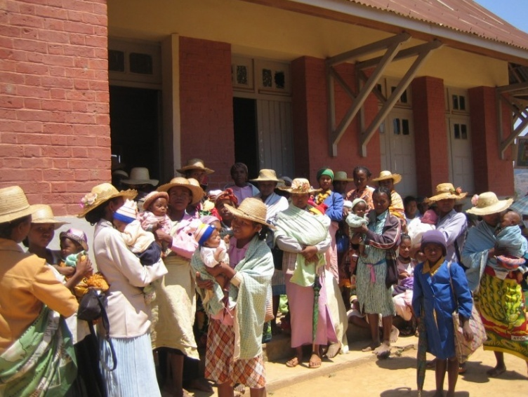
Context
Pressing need to develop health policies, strategies, and interventions
Notes:
It is within this context of a high disease burden, a growing population, and insufficient health services, that it becomes extremely important for governments to make the best use of their limited resources. The need to develop strategies, policies, and interventions that are based on quality data and information is urgent.
5

Slide 6
Why Improve Data-informed Decision Making?
Increased financial investments for service delivery
Increased accountability requirements
Improved national HMIS
Increased demand for evaluation and other research
Notes:
The good news is that, as we face a great need to deliver health services, we have seen increased financial commitments by the international community to provide the necessary programs and services to meet the critical health needs of target populations, although this is largely for HIV services.
The increased influx of funds and resulting expanded programs have led to increased accountability requirements by donors, governments, and civil society. As we know, many donors are not only requiring regular reporting on services delivered, but funding for continuation of activities frequently is based on performance.
These accountability requirements have led to strengthened programmatic M&E systems, a commitment for integrated HMIS, and a demand for other types of quality data.
However, these commitments and improvement do not always lead to data-informed decision making.
6

Slide 7
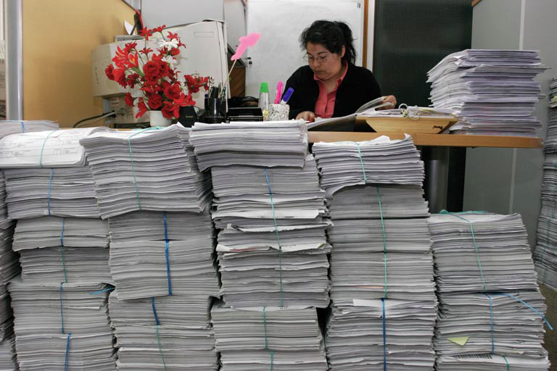
Why Address Data Demand & Use?
Notes:
The picture above may look familiar to many of you. In today’s environment, many health professionals have become overwhelmed with collecting and using data related to services they deliver. In some contexts, data requirements from government and donors have grown exponentially, to the point where some providers and implementing partners have pages and pages of forms to fill in daily.
Rarely are data used to monitor programs and make decisions beyond individual patient care. This is a huge lost opportunity because data are critical to the program improvement and decision-making process.

Slide 8
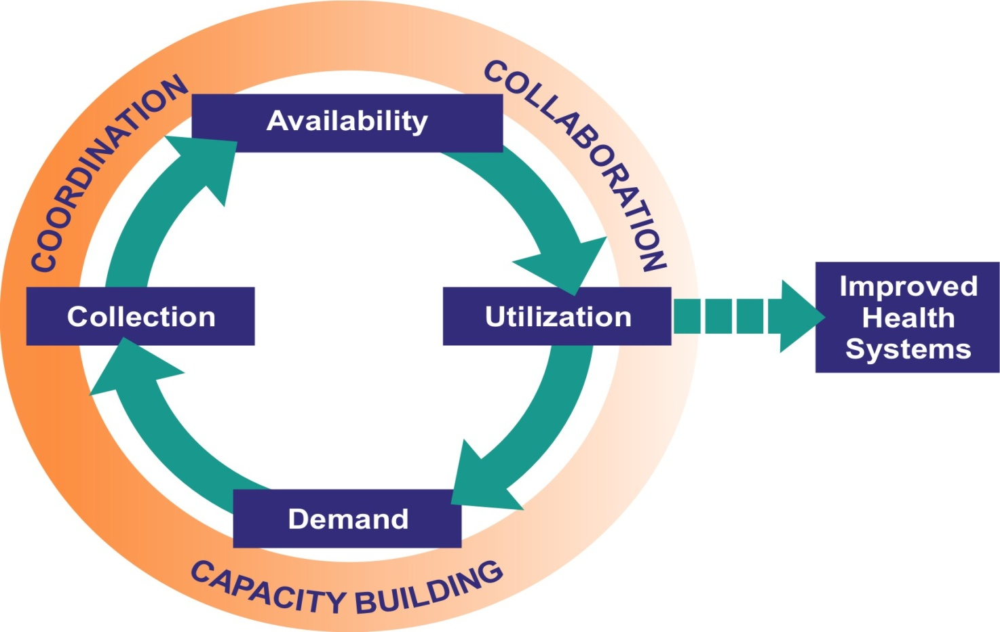
Evidence-based Decision-making Process
Notes:
To understand the factors that inhibit or encourage data-informed decision making, we need to review the entire process that leads to evidenced-based decisions and eventually to improved health outcomes. There are many other contributing factors that affect data use.
The framework presented here illustrates the entire cycle of evidence-based decision making. This approach illustrates the ideal. Note that in addition to data collection and therefore availability, there are also the considerations of:
Securing the technical and human capacity to manage and analyze the data
Ensuring that the information is available and in a format that is easily understood by the relevant stakeholders
And fostering the interpretation of the information and ultimate use to improve policies and programs
The cycle supports the assumption that the more positive experiences a decision maker has in using information to support a decision, the stronger the commitment will be to improving data collection systems and continuing to use the information they generate.
This raises the question—is this what we are experiencing in our own work environments? Most of us would agree that it is not.
8

Slide 9
Level of Dissatisfaction that Policy is Based on Scientific Evidence
Percent dissatisfied
Overseas Development Institute, Jones et al., 2008.
Notes:
This sentiment is reflected in the opinions of our peers who participated in an international survey conducted by the Overseas Development Institute (Jones et al.) in 2008. The study found that there is a high level of dissatisfaction among policymakers, program implementers, and researchers alike with the degree to which policy decisions are informed by research evidence.
Y axis = %
Specifically, we see that:
42% of policymakers,
60% implementers, and
54% of researchers stated that they were dissatisfied that policy is based on evidence.
Why is this? Why are our decision makers not using data and evidence to inform their decisions?

Slide 10
Challenges
Integrated HMIS still not fully functioning
Little or no communication between data producers and data users
Low capacity to collect, analyze, & interpret data
Limited or no culture of data use
Data collection and use not a priority
Notes:
Even in the face of improvements in systems to collect quality information, there often is a disconnect between decision making and available data. Much of the data collected are not used as effectively as they could be.
There are many possible reasons for this disconnect, many of which will be illuminated during our discussions throughout the workshop. Some of the most common barriers that thwart a functioning cycle of evidence-based decision making include:
Little or no communication between data users (policymakers, service program managers) and data producers (researches, M&E experts). As a result, data collection efforts don’t address the key needs of the data users.
Low capacity to collect, analyze, and interpret data. Skills needed to ensure that the data being collected are of good quality are lacking. The tools and skills needed to analyze and then apply data to programmatic needs also are weak in many contexts.
There isn’t a culture of data use
because the value of data in improving the provision of services is not fully recognized, it is therefore not prioritized. As a result, data frequently are not used beyond populating a report to a donor or filling out form.
10

Slide 11
The Response
Monitoring & Evaluation Systems
Better Health Outcomes
Data-informed Decisions
Notes:
What can we do to address these challenges and improve evidence-informed decision making?
We can commit to utilizing data that result from M&E systems in the decision-making process. These data can inform the design of new programs and interventions, planning, and managing programs and facilities, which, in the end, contribute to better health outcomes.

Slide 12
Group Participation
  How do you and your organization use data and information?
Notes:
Now that we have talked about the global importance of using data and information in health decision making, let’s bring the discussion down to a more personal level. Who would like to share with the group how you use data and information in your job?
NOTE to facilitator: Encourage participants to share their experiences with the group. Record the participant responses on a flip chart. Be sure to highlight that organizations can use information beyond reporting or producing reports.

Slide 13
We Can Use Information to…
Inform health policies and plans
Raise additional resources
Strengthen programs and improve results
Ensure accountability and reporting
Improve quality of services provided
Contribute to global lessons learned
Notes:
Thank you for noting your responses and experiences. In summary, we can use information to…?
NOTE to facilitator: Have the participants suggest responses. After three to four participants speak, show the answers by clicking to reveal them.
We can use data and information to:
Inform policies and plans
Raise additional resources
Strengthen programs and improve results
Ensure accountability and reporting
Improve quality of services provided
Contribute to global lessons learned

Slide 14
“Making Data Speak” in Thailand
Need: Strengthen commitment of policymakers to HIV prevention
Data: Behavioral and epidemiological data
Response:
  Analyzed data with Asian Epidemic Model and GOALS model
  Determined responses and resources needed
  Communicated data to stakeholders
Decision/Action:
  Successfully emphasized prevention agenda in national strategic plan and developed an operational plan to guide prevention programming
Notes:
Now let’s look at some other examples of how data were used at different levels of the health system to improve programs.
In Thailand, the Analysis and Advocacy project (or ‘A squared’) facilitates the use of data and information in advocacy messages to policymakers and decision makers. The project seeks to strengthen the commitment of policymakers to HIV prevention by identifying behavioral and epidemiological data that can be analyzed in different ways to provide insight on what can be done to strengthen the response to HIV.
The project and its partners analyzed data with the Asian Epidemic Model and the GOALS model. They determined the responses and resources that would be needed to implement the responses and finally, they communicated these data to stakeholders.
As a result of these efforts, Thailand successfully emphasized the prevention agenda in the national strategic plan and developed a “UA Operational plan.”

Slide 15
Using NNRIMS Data to Inform Resource Allocation
Need: Strengthen monitoring of HIV/AIDS service delivery
Data: HIV service delivery indicators
Response:
  Development of NNRIMS, a routine information system
  Quarterly reports summarizing data prepared for and reviewed by LGA managers & decision makers
Decision/Action:
  Chairman procured 480 HIV Test Kits, enabling more people to get tested in Doma
Notes:
Now let’s look at another example.
In Nigeria, MEASURE Evaluation has worked with the Nigerian government, international organizations, and other implementing partners in the development of a new routine information system for HIV/AIDS called the Nigerian National Routine Information Management System, or NNRIMS.
States and local governments have been trained in the system and regularly prepare and review quarterly reports. In Nasarawa state in Doma LGA, the local government authority (LGA) Chairman noted that only 53 people in Doma tested HIV positive in the first quarter of 2006. The Chairman was alarmed and also concerned that testing was not yet widespread in the LGA. As a result, the Chairman procured 480 HIV test kits to be distributed to four local health facilities, enabling more people to be tested for HIV in Doma.

Slide 16
Key Messages
Decisions based on evidence lead to better health outcomes
We all have a role in M&E – partners in progress
High-quality information is needed for decision making at policy, planning, and program levels
Purpose of M&E is not just to produce more information but to inform action
Notes:
In summary:
NOTE to facilitator: Read slide.

Slide 17
Small Group Activity 1: Instructions
Select a reporter
Read the case study and answer the following questions (45 min):
  What prompted the data use undertaking?
  What was the decision taken?
  What types of data were used to make the decision?
  What was the outcome of the decision?
  Report back (10 min per group)
Notes:
Now we will spend some time discussing data use concepts in small groups. Within your small groups, please select a reporter, then read the case study assigned to you and answer the following questions:
NOTE to facilitator: Read questions.
You will have 45 minutes to read the case study and answer the questions, and then we will ask each group to report back in plenary.

Slide 18
THANK YOU!
MEASURE Evaluation is a MEASURE project funded by the U.S. Agency for International Development and implemented by the Carolina Population Center at the University of North Carolina at Chapel Hill in partnership with Futures Group International, ICF Macro, John Snow, Inc., Management Sciences for Health, and Tulane University. Views expressed in this presentation do not necessarily reflect the views of USAID or the U.S. Government. MEASURE Evaluation is the USAID Global Health Bureau's primary vehicle for supporting improvements in monitoring and evaluation in population, health and nutrition worldwide.
Visit us online at http://www.cpc.unc.edu/measure.

