Slide 1
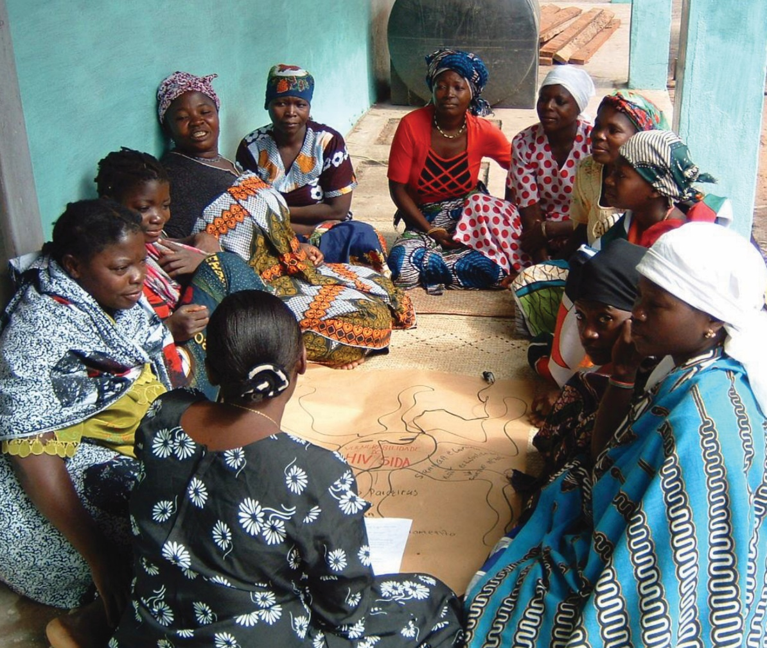
Data Presentation
and Dissemination
[insert date]
Qualitative Methods
in Evaluation of Public Health Programs
Session 10
Notes:
[Introduction]

Slide 2
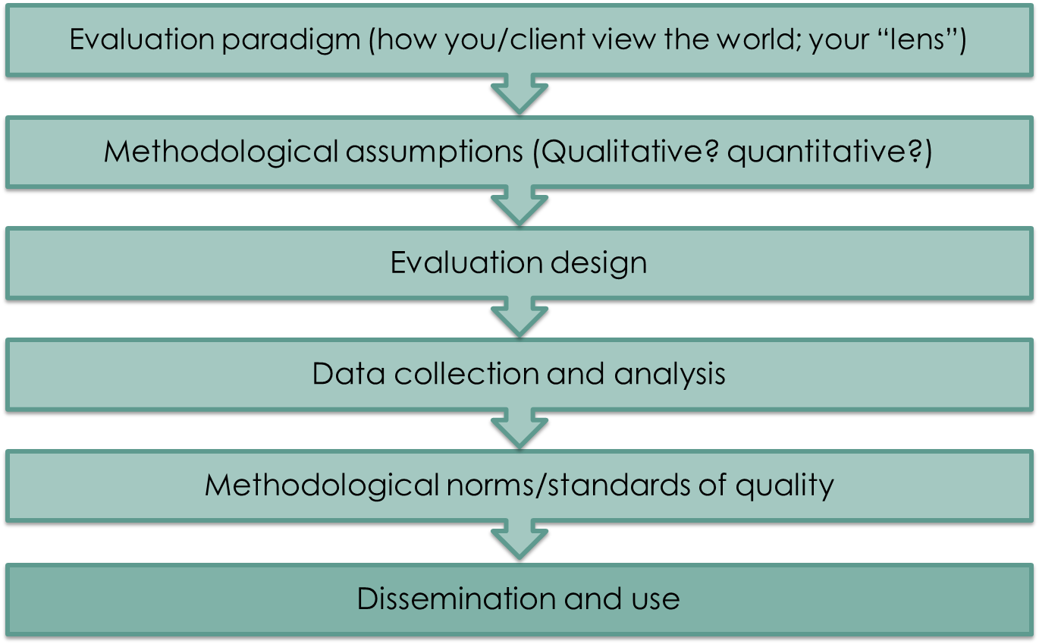
The evaluation process
Notes:
The last step of the evaluation process is dissemination and use. We will now discuss that.

Slide 3
Learning objectives
At the end of this session, participants will be able to:
Organize evaluation findings in a coherent and clear story line
Propose and negotiate the report format
and dissemination plan with stakeholders
Demonstrate how dissemination will be appropriate for various stakeholders, including potentially vulnerable or special populations
Formulate a dissemination plan that provides actionable recommendations based on qualitative data
Notes:
[Instructions: Review the objectives for this session.]

Slide 4
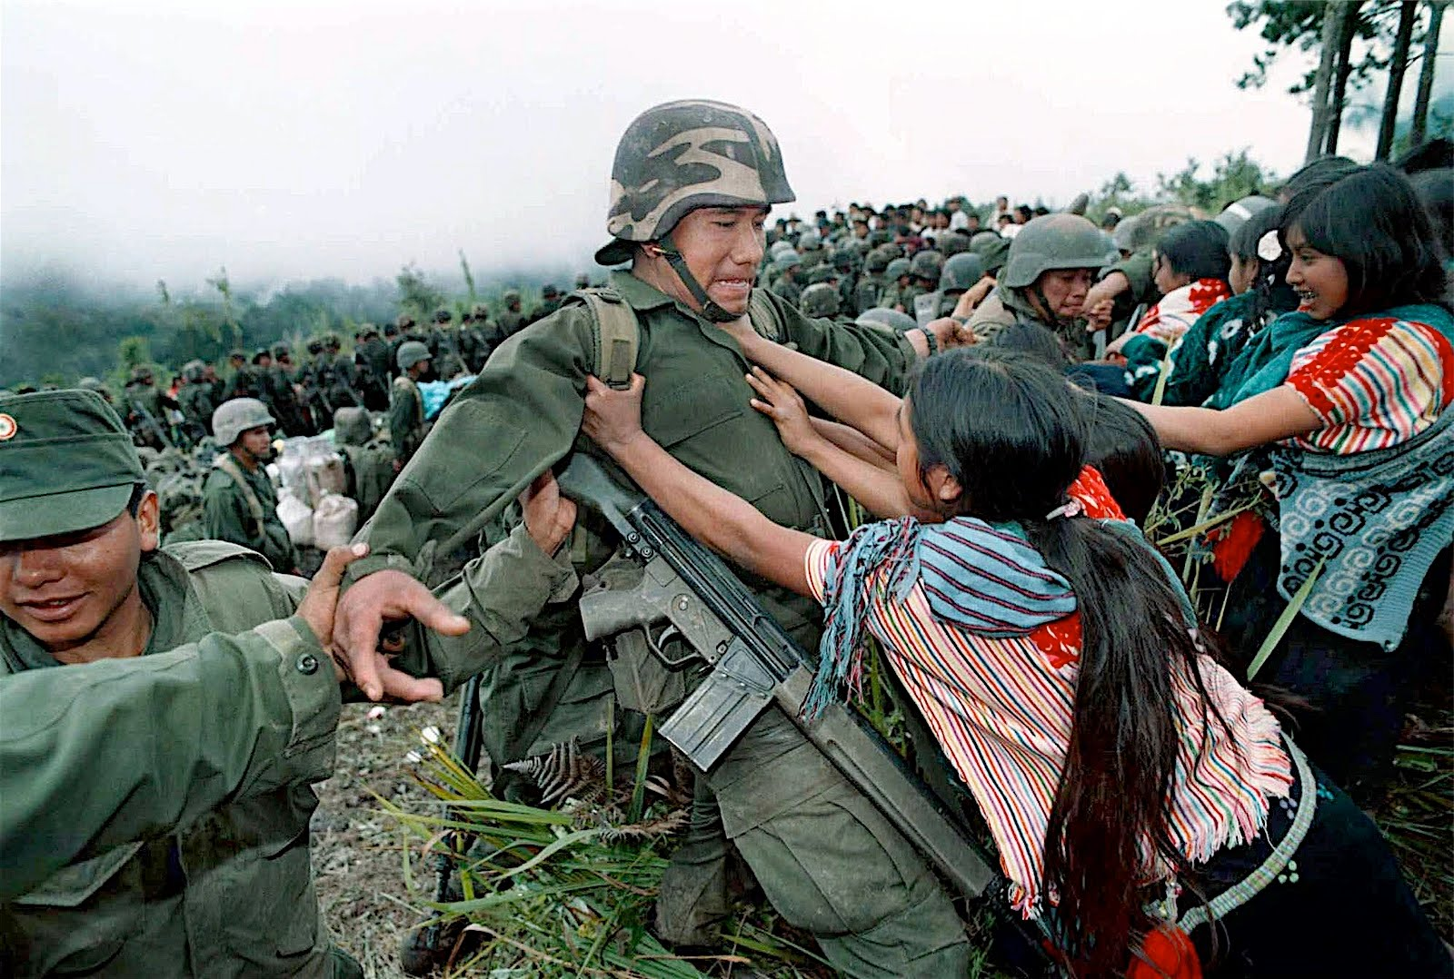
Qualitative evaluation
Must tell a story
Mexico, Indigenous Resistance, 1994
Notes:
A qualitative evaluation must tell a story.

Slide 5

But you can’t say it all…
Notes:
However, we can’t say it all in an evaluation report. We must be selective on what we include in our “story.”

Slide 6
Organizing qualitative reports
Executive summary and extended content
  Reports must contain two sections: Executive summary and extended content
  Although qualitative data (fragments of speech) can consume large amounts of space, never delete them completely: They are your evidence.
Government or agency versus program report
  Answering terms of reference (TOR) versus answering key questions of evaluation
  Transparency law
Notes:
Qualitative reports can be very long, due to the vast explanations that are needed to justify the finding. This is the reason why it is convenient to present findings in two sections. The extended section describes the details of the fieldwork and a detailed list of the findings. The other section will contain an executive summary of the content.
The short versions of the report must be straight to the point and show the central findings that are the foundation of the evaluation’s conclusions and recommendations. The qualitative data, as it consists of testimonies, observation notes, or visual evidence, could take up too much space, but it is a mistaken tendency to erase them completely from the executive versions of the reports. This is an error! Even though the qualitative data takes up space, at least some quotes or central testimonies must appear to illustrate and give voice to the subjects.
The reports that follow the terms of reference (TOR), those that may have been contracted by government or international agencies, are generally stricter and ask for an accurate and direct answer to each of the TOR, even if in some occasions there is no data. If this is the case, it is worthwhile to elaborate in an additional report, one in which the results respond directly to the evaluative questions. That report could also be used as a frame of reference to understand the recommendations the evaluation team will make.
On the other hand, the reports that are commissioned by the programs, could fall into the other extreme and focus too much on the positive results of the program and have the tendency to not address the challenges. The evaluator must be careful to manage a good balance between those two extremes.
When reports are made for governments or international agencies, they are often put on public websites for transparency or other data use reasons. As we have seen in the ethic sessions, when qualitative evaluations are made public, there is a high risk of subjects being identified. It is very important to keep confidentiality, and, if necessary, the anonymity of the subjects that participate in the study.

Slide 7

How to write a qualitative report

Slide 8

How to write a qualitative report (2)
Consider your audience and their interests:
  Program personnel
  Academics
  Stakeholders
  Decisionmakers
  or policymakers
  Nongovernmental
  organizations (NGOs)
  General population
  or program beneficiaries
Notes:
[Instructions: The facilitator must focus the discussion on the main differences between these audiences.]
There are many online resources on how to write qualitative evaluation results, and a number of these resources are listed at the end of this presentation.

Slide 9

How to write a qualitative report (3)
Report writing starts early; don’t wait until
the end of the project
Concepts, theories, and methods
should be updated (and may
change during fieldwork)
The report should tell a story
The report should answer the main
evaluation questions or TORs
Recommendations must be practical
and supported with evidence
Notes:
The main result will tell the story and construct the argument. As has been mentioned, qualitative reports must tell a story that makes sense in order to be useful. The main result of the evaluation must be mainly an argument that will not only explain what, and how, but why.
Do not wait until the end of project to start writing the report. The report must be started before you end to collect data. Doing this, you will realize if you have collected enough data to meet your objectives.
Concepts and theoretical sections must be revisited during fieldwork. As concepts are revisited during fieldwork, they can be changed or modified. These changes must be mentioned in the report, since evaluating is creating theory, too.
Methods must be revisited. The same can happen to methods. The methods section should include any changes made during fieldwork.
The main results sections should correspond to the original design. Since your fieldwork is a result of the design, results must respond to main questions. Extra sections can be added.
Findings that will be translated into recommendations must be highly supported by evidence and must also be practical. Your results have to be grounded in your data, but particularly those that will lead to a change or recommendation must be supported with sound data. Recommendations must be discussed with the program in order to be practical, or feasible.

Slide 10


How to write a qualitative report (4)
  Presentation is important
    Dependent on audience
    and funding requirements
  Body of the report contains
  the key findings and
  supporting evidence
  An appendix is useful for:
    Additional evidence
    Supporting documents (codebook, interview guide, etc.)
Notes:
Presentation is important, and it is dependent on your audience and funding requirements. Funders may have examples from other reports which can give an idea of what they expect.
There are many ways in which reports can be structured, but they usually have sections that include: background, methods, results, recommendations, and discussion/conclusion (containing the key findings and supporting evidence).
Use appendices to add useful information that does not need to be in the body of the report. You can include such documents as additional quotes, codebooks, interview guides, etc.

Slide 11


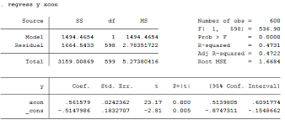
Reporting qualitative data
Produced with qualitative methods
Notes:
When we need to report quantitative results, there is a specific set of steps to follow: We run a regression analysis, get outputs, and report odds ratios/confidence intervals/etc.
We usually picture something like this [click on slide], but when it comes to reporting qualitative results this is more challenging.

Slide 12

How to report data?
Notes:
This image illustrates the need to clearly communicate a message with qualitative methods. The message must be clear and concise; that is, it should not require complex theoretical knowledge to be understood.

Slide 13
How to report data: Interviews
Citing interview quotes
Quotes need to be contextualized
When people speak indigenous/different languages:
  Specify that it was translated and who did
  the translating
“ R. (it was) the long duration of the project that discouraged some people, because they thought that they would never see results and stopped participating. It was long (the project)… it was a water pipe project, over 50 km long.”
(International NGO Promoter, Sept. 8, 2015)
Notes:
Certain evidence that originated in interviews, focus groups, and observations requires knowledge of the context.
Quotes need to be contextualized. It's also important to mention that quotes need to be contextualized. Novice evaluators tend to include quotes without first explaining what the point of the quote is. Evaluators have to be selective in the number of quotes and type of quotes used in a report or paper.
Labeling. It is important to remember that all the qualitative evidence must be correctly labeled so the readers will know who the voice belongs to when reading the report.
This example shows that the part of the testimony used as evidence is different in italics to highlight the case. This could be one of the reasons why the program for drinking water in Honduras was not successful.
It is important not to shorten the quotes too much, because it will hinder the reader's correct understanding of how the argument was constructed.
In the quote it is identified that this has been drawn from an interview with an international NGO promoter, and when it was conducted.

Slide 14

Contextualize data (1)
Notes:
Presented here is an example of how data must be explained and contextualized.

Slide 15
Contextualize data (2)
Notes:
Here is another example.

Slide 16
How to report data: Focus groups
Q. I would like you to tell me the following:
What made it difficult to understand the proposed label?
  R1. The percentages
  R2. The percentages
  R3. For this example here, it has zero fat.
  Do we need this? Does our body need
  fat or doesn’t it?
(FGD_SLP, SES Low)
Notes:
In this case, focus groups were used to evaluate front pack labeling for food. In the results report, it is clarified which is the facilitators voice with a Q (question) and which are the answers of the different participating subjects. It is also stated that the tool used was focus group discussion (FGD), and that the location of the focal group was in San Luis Potosi (SLP). Also, a relevant piece of information about participant characteristics is added—that the group was of low social economic level (SES).

Slide 17
How to report data: Observations
Observation from unconditional cash transfers in an indigenous community. Observation of payment day processes:
On the other side, the person who was organizing
the line of people would scream at them and even
pull them:
“Go back!”; “Go in front!”; “Don`t come closer!” Or he shouted the name and also grabbed the arm to pull the person back or put him in front. He shouted—maybe because he felt that they wouldn`t understand him, and this was the case; most of them didn't speak Spanish. The more he shouted, the less they heeded his order. He also moved the people physically, sometimes gently and other times pulling them. His screams were heard all over the auditorium.
(Fieldnotes_Observation_May5_Locality 2_AF)
Notes:
To report the results of an observational study, the data must be transformed from observation or visual evidence, like photographs or video, to written evidence.
In this case, the observation of the delivery of unconditioned transfers to elderly people in indigenous communities can be seen.
The observer’s comments here relate to the category of “a delivery with dignity,” regarding the way resources are handed over to the beneficiaries (respecting human rights).
In this example, there are aspects of reality that can only be observed. In this case, the promoter in charge of forming a line, cries out to make the subjects get into the right order, however, he speaks in Spanish and the beneficiaries speak Nahuati, an indigenous language.
The beneficiaries do not understand what he is saying, the promotor does not know why they are not heeding his orders, and he resorts to physical force.
Again, we point to the origin of observation. It is a field diary in which Observations (Obs) are registered, from May, in Site 2 and the last two initials correspond to the observer.

Slide 18

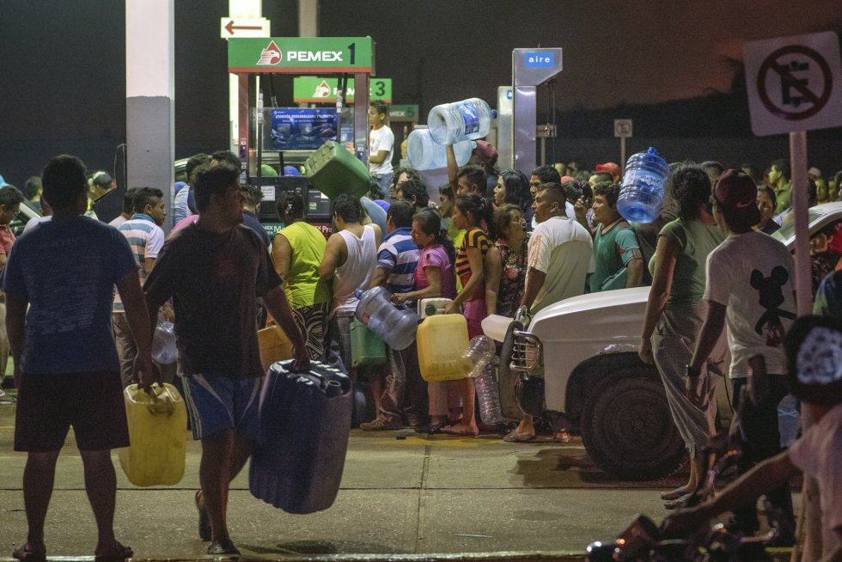
Including photos
Photography should only be included to convey
a message, not merely as decoration
Photos must be explained
Photos should imply IMPORTANT ethical, cultural,
or social issues
Handicapped international: Results in physical activity
Economy in Mexico: Petrol prices evoke anxiety in population
Notes:
[Instructions: Ask participants: What value can we add by including photos?]
Photographs must have an explanation, otherwise they will not be understood.
In the first picture, we see handicapped individuals who are beneficiaries of a social integration program. The picture shows how facilities are not adapted to their needs.
In the second photography, we see people with containers at a gas pump. This picture was taken during a gas shortage, when gas prices were increasing rapidly in Mexico.
Photos imply IMPORTANT ethical, cultural and social issues. Concern must be given about exploiting people financially by showing their photographs.
Ethical issues. You must have permission from people to show photos.
Cultural issues, such as those who believe that photographs steal the soul.
Permission and model release before taking and using photos of any kind of dissemination.

Slide 19
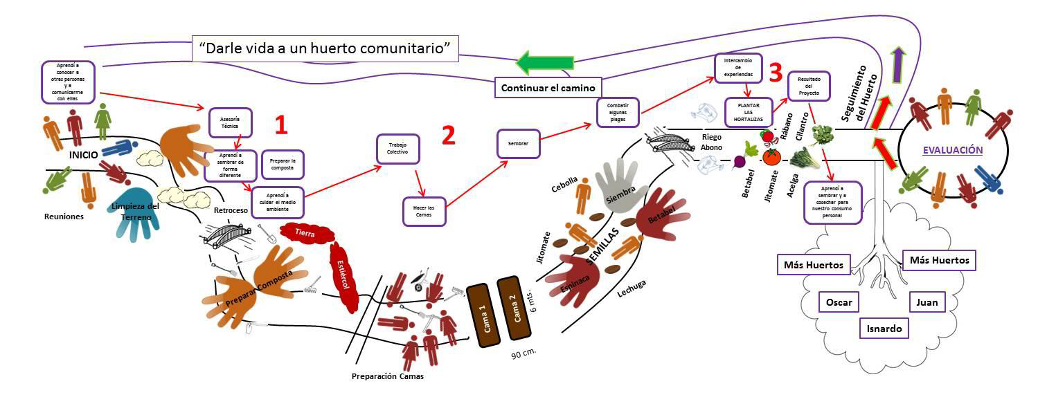
Reporting participatory techniques
Roadmap
Figure 7. Digitalized path that was drawn by the participants of “Centro …” in the activity “Telling the Story of our Vegetable Garden,” May 2015.
Notes:
This slide shows a digitalized image of a project for school vegetable gardens that was evaluated through a participatory methodology in which participants were asked to draw the path of their experience with the program.
This image shows the perspective of the beneficiaries of the school vegetable gardens.
The image must be explained to the reader.
In this case, at the beginning of the path, people standing in the circle represent the first stage of the meeting. It is clear that the path is not straight and the curve gets more pronounced because a lot of time was dedicated to those meetings, and this tired people out. In the end, some persons did not want to participate in rehabilitating the garden due to the time it took to get organized.
Later, the participants used images of rocks and hands to represent the work that had been done to prepare the land. The hands symbolizes that they worked together to prepare and clean the land, and make compost.
For them, the bridges they used in the depiction are synonymous with going backward in the process. They mentioned that the constant lack of definition within the group caused delay and they had to go back to topics again and again.
This is the way to present the evaluation results of a school vegetable garden program.

Slide 20
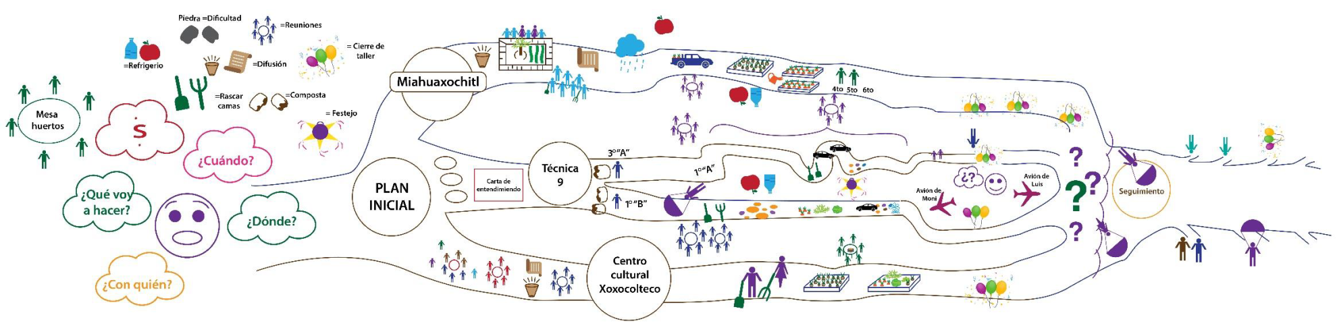
Participatory techniques
Figure 11. Digitalization of the path that was drawn by the participants of the vegetable workshop,
May 2015
Notes:
In this slide we see a different path, because this is the perspective of the people in charge of the community gardens and not of the beneficiaries (as in the previous slide).
Where the path starts, we can see the creation of job tasks. The faces that express surprise and the thought clouds around the faces represent the different doubts they had about where to direct the action. This was during the time of planning the activities and defining spaces to set up the vegetable garden demonstration.
Data visualization is often discussed in the context of quantitative, but it has an important role in qualitative as well—and in giving references to sites, etc., and addressing qualitative data visualization. It should also be noted that some qualitative software programs have tools to help with visualization (e.g., word frequency queries, connection maps in NVivo).

Slide 21
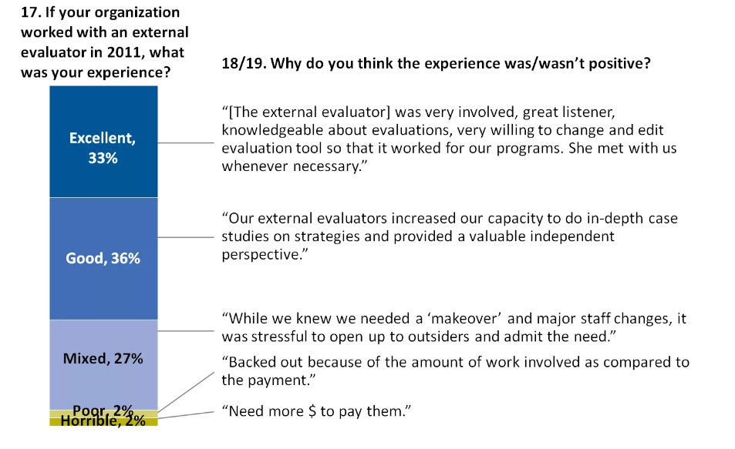
Others ways to display data
Open-ended survey data next to closed-ended data

Slide 22

Others ways to display data (2)
Word cloud
Notes:
This is a word cloud generated from comments during interviews with policymakers.
Word clouds for one-word descriptions
Ask, “What one word would you use to describe….”
Examples: “Hey Mr. Policymaker, what one word would you use to describe public opinion on poverty in the United States?” or “Hey Mrs. Principal, what one word would you use to describe the grant’s implementation during Year 1 in your charter school?”
The rest of the interview is obviously focused on long responses and fuller descriptions, as well as plenty of examples. However, for one or two moments during the conversation, it’s nice to pause and throw in a semi-qualitative short question.
Word clouds for before/after comparisons
Word clouds are also great for before/after comparisons, like these tweets describing breakups: “Does your study involve pre/post tests with a few open-ended questions?” “Do you interview participants at multiple intervals during the study?” You could adapt this technique for nearly any time series design.
Showcasing open-ended survey data beside closed-ended data
What’s better than quantitative data? Or better than qualitative data? Quantitative and qualitative data combined.
Use this technique when your survey has both closed-ended and open-ended questions. Tie the responses together in one chart to add much-needed context. In this example, a survey asked nonprofits to describe what it was like to work with an evaluator. Then, the survey asked them why their experiences were good or bad. Who cares if 33% of nonprofits had excellent experiences but we don’t have examples that describe why? Rather than simply listing out the open-ended responses in your appendix, showcase them beside your stacked bar chart.
Images and text from: http://annkemery.com/qual-dataviz/

Slide 23
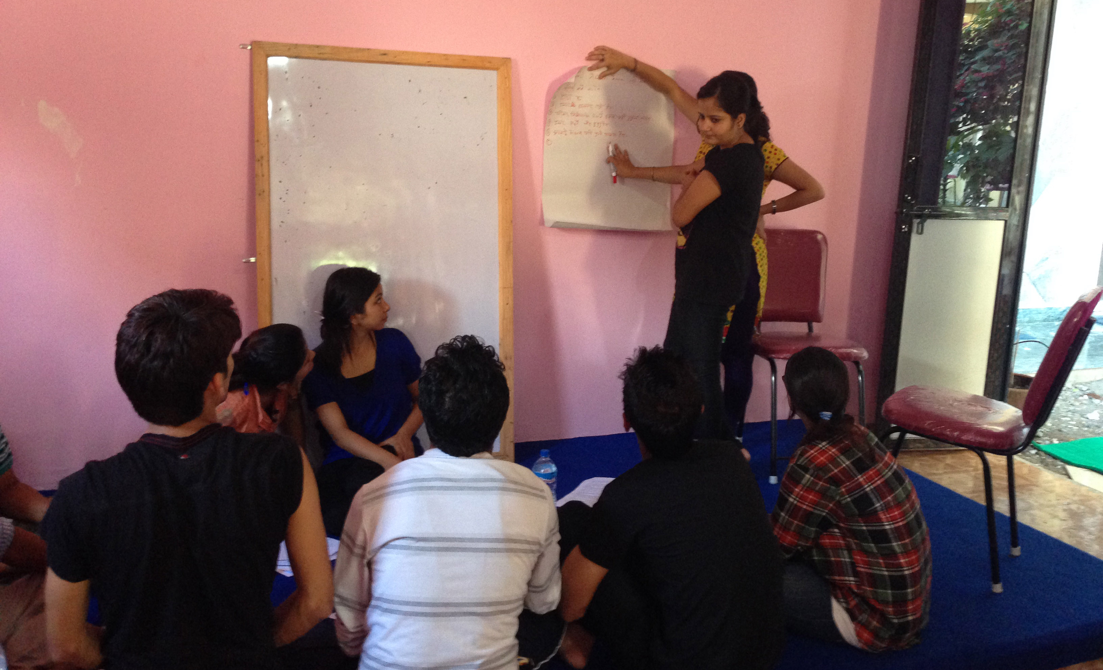
Evaluating reports

Slide 24
Domain 1: Evaluation team and reflexivity
About the team
Interviewer/facilitator
  Which author/s conducted the interview or focus group?
Credentials
  What were the evaluators’ credentials? (e.g., PhD, MD)
Occupation
  What was his/her occupation at the time of the study?
Gender
  Was the evaluator male or female?
Experience and training
  What experience or training did the evaluator have?
Notes:
There are different methods and tools to help make sure you have the necessary information to report qualitative results. The “Consolidated criteria for reporting qualitative evaluation (COREQ): a 32-item checklist for interviews and focus groups,” by Allison Tong, Peter Sainsbury, and Jonathan Craig, is a comprehensive and useful tool. This checklist can used for report writing to improve: the quality of reporting of evaluation, credibility, acceptability, and perception of the quality of the results.
Qualitative reports are often criticized for not including sufficient detail on the methods; this offers some suggestions to address this issue.
[Instructions: Review items from the COREQ checklist. Participants should have a copy of it.]

Slide 25
Domain 1: Evaluation team and reflexivity (2)
About the team
Established relationship
  Was a relationship established prior to study commencement?
Participant knowledge of the interviewer
  What did the participants know about the evaluator (e.g., personal goals, reasons for doing the evaluation)?
Interviewer characteristics
  What characteristics were reported about the interviewer/facilitator (e.g., bias, assumptions, reasons, and interests in the evaluation topic)?
Notes:
[Instructions: Continue to review items from the checklist.]

Slide 26
Domain 2: Study design
Theoretical framework
Methodological orientation and theory
  What methodological orientation was stated to underpin the study?
Sampling
  Why and how were participants selected?
  e.g., purposive, convenience, consecutive, snowball

Slide 27
Domain 2: Study design
Methods: Participant selection
Method of approach
  How were participants approached? (e.g., face-to-face, telephone, mail, email)
Sample size
  Why and how many participants were in
  the study?
Nonparticipation
  How many people refused to participate
  or dropped out? Reasons?
Notes:
When the results of the qualitative evaluation are presented, the following aspects must be very clear.

Slide 28
Domain 2: Study design
Methods: Setting
Setting of data collection
  Where was the data collected? (e.g., home, clinic, workplace)
Presence of non-participants
  Was anyone else present besides the participants and evaluators?
Description of sample
  What are the important characteristics
  of the sample?
Notes:
This slide shows what the methods section of a qualitative report should contain.
Setting: Evaluators should describe the context in which data are collected because it highlights the reason why participants responded in a particular way.
The presence of non-participants during interviews or focus groups should be reported because it can also affect the opinions expressed by participants. For example, parent interviewees might be reluctant to discuss sensitive subject if their children are present.
Participant characteristics, such as basic demographic data, should be reported, so readers can consider the relevance of the findings and interpretations of a given situation (Allison Tong, Peter Sainsbury, and Jonathan Craig, p. 356, ).

Slide 29
Domain 2: Study design
Methods: Data collection
Interview guide
  Were questions, prompts, guides provided by the authors? Was it pilot tested?
Repeated interviews
  Were repeated interviews carried out?
Audio/visual recording
  Did the evaluators use audio or visual recording to collect the data?
Field notes
  Were field notes made during and/or after
  the interview or focus group?
Notes:
Data collection: The questions and prompts used in data collection should enhance the readers’ understanding of the evaluator’s focus, and enable the readers to assess whether participants were encouraged to openly convey their viewpoints.
Evaluators should also report if repeated interviews were conducted, as this can influence the rapport developed between the evaluators and participants and therefore affect the richness of data obtained.
The method used to record the participants’ words should be reported. Generally, audio recording and transcription reflect the participants’ views more accurately than contemporaneous evaluator’s notes—more so, if participants checked their own transcript for accuracy.
Any reasons for not recording audio should be provided. In addition, field notes maintain contextual details and nonverbal expressions for data analysis and interpretation.
Duration of the interview or focus group should be reported, as this affects the amount of data obtained. Evaluators should also clarify whether participants were recruited until no new relevant knowledge was being obtained from new participants (data saturation).

Slide 30
Domain 2: Study design
Methods: Data collection
Duration
  What was the duration of the interviews
  or focus group?
Data saturation
  Was data saturation discussed?
Transcripts returned
  Were transcripts returned to participants
  for comment and/or correction?

Slide 31
Domain 3: Analysis and findings
Data analysis
Number of data coders
  How many data coders coded the data?
Description of the coding tree
  Did authors provide a description of the coding tree?
Derivation of themes
  Were themes identified in advance
  or derived from the data?
Notes:
Data analysis: Specifying the use of multiple coders or other methods of triangulation can indicate a broader and more complex understanding of what is being evaluated.
The credibility of the findings can be assessed if the process of coding (selecting significant sections from participant statements) and the derivation and identification of themes are made explicit. Descriptions of coding and memoing demonstrate how the evaluator perceived, examined, and developed their understanding of the data [17, 19].
Evaluators sometimes use software packages to assist with storage, searching, and coding of qualitative data.
In addition, obtaining feedback from participants on the evaluation findings adds validity to the evaluation’s interpretations by ensuring that the participants’ own meanings and perspectives are represented, and not curtailed by the evaluations’ own agenda and knowledge [23] (p. 356).

Slide 32
Domain 3: Analysis and findings (2)
Data analysis
Software
  What software, if applicable, was used
  to manage the data?
Participant checking
  Did participants provide feedback
  on the findings?
Notes:
Evaluators sometimes use software packages to assist with storage, search, and coding of qualitative data. In addition, obtaining feedback from participants on the evaluation findings adds validity to the evaluation’s interpretations by ensuring that the participants’ own meanings and perspectives are represented, and not curtailed by the evaluations’ own agenda and knowledge [23] (p. 356).

Slide 33
Domain 3: Analysis and findings
Reporting
Quotations presented
  Were participant quotations presented to illustrate
  the themes/findings? Was each quotation identified?
Data and findings consistent
  Was there consistency between the presented
  data and the findings?
Clarity of major themes
  Were major themes clearly presented in the findings?
Clarity of minor themes
  Is there a description of diverse cases, or discussion
  of minor themes?

Slide 34

Activity 1: Evaluate a Report (1)
Notes:
Now, we are going to review a report to put into practice what we have just discussed.

Slide 35
Activity 1: Evaluate a report (2)
In groups of four, review the report
Individually, answer these questions for your assigned domain (10 mins.):
  Is your assigned domain addressed?
  How are qualitative results presented, and what evidence supports them?
In your group, share opinions on answers
(10 mins.)
Plenary discussion (15 mins.)
  Central versus peripheral results
Notes:
[Activity (35 minutes):
Instructions. The full group will be divided into small groups of four. Each group will be asked to answer one “question,” i.e., will examine whether the report follows the checklist in one domain of the COREQ. Two teams may answer the same question if there are more than three teams.
They will be given 10 minutes to find the information individually (each person in the team will have a copy of the report).
Then they have 10 minutes to share answers within their groups on whether these domains are reported in the example provided.
In plenary, the full group will then discuss whether the qualitative reporting fulfills the requirements of each COREQ domain. If they do not, the group will suggest how the evaluation report could be revised to fulfill the missing requirements.]
[Wrap-up the activity by explaining central versus peripheral results as follows.]
One of the most complicated elements in qualitative evaluation is the selection of results to be presented in the report. Even if the evaluation has already cast findings and results, the qualitative report must include carefully and effectively selected findings to be reported. It is impossible to report all of the findings, since the resulting report would be too long.
The results to be presented can be divided into two types: central and peripheral (or not central). The central findings are those that clearly and directly answer the evaluation questions, supported by evidence from the subjects that participated in the evaluation; these results must be highlighted. Because they are central, the recommendations to the program will be built on them.
The peripheral (or not central) results are those notable results that—even if they were found in the field—do not directly answer the evaluation questions or lend themselves to a recommendation during the current period of evaluation. In some cases, these notable or peripheral results are reported and end up leading to major evaluation.
For example, in an evaluation of a program that fights poverty in elderly adults, abuse of authority toward them has been found in a notable way by one promoter of the program. This was an isolated case that attracted the evaluators’ attention because it seemed so rare compared to the data obtained in many other communities. The case was reported and it was suggested that the program explore the existence of other possible cases, but in no way was this case presented as a central finding of the program, because it occurred in an atypical way.
It is important not to confuse the central findings with what is found to be repeated most often. Rather, we look for the data that offers a profound and detailed explanation of the phenomenon.

Slide 36
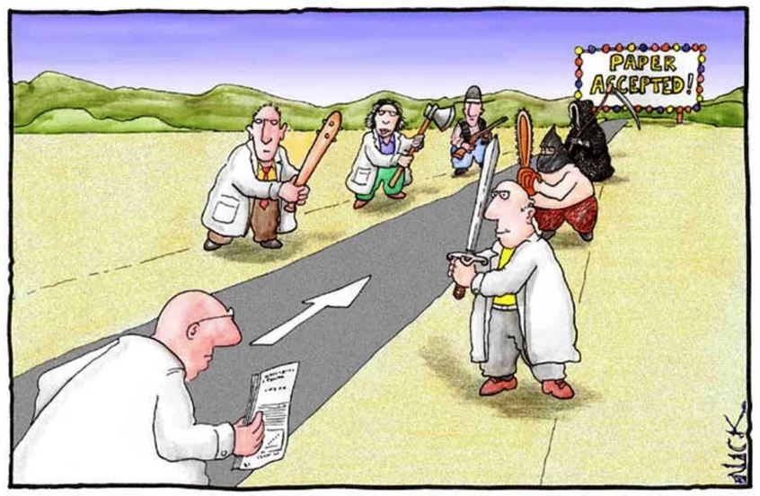
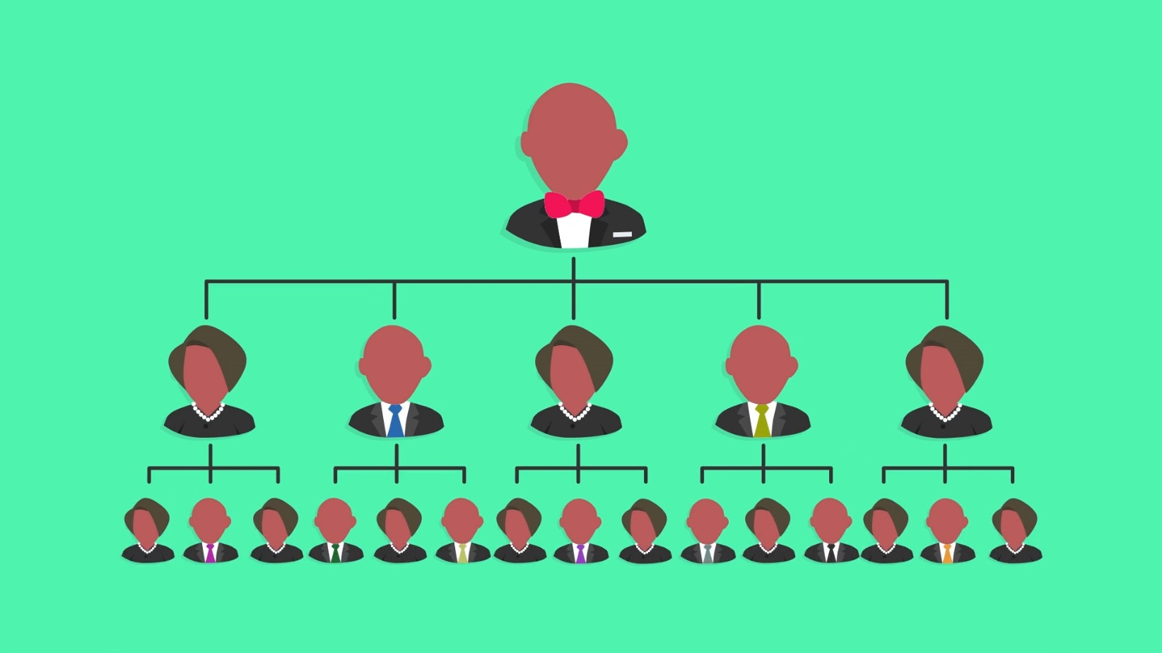
Report review and comments
Once the report is delivered to funders…
Notes:
Once the report is delivered to the funders, you expect that it is going to go through a grueling review process before it is accepted and disseminated.

Slide 37
Report revisions
Expect to make clarifications and changes based on external reviewers’ comments
Address aspects of internal and
external validity
  Internal validity (methods section)
  External validity (transferability: users)
When planning for review be sure to agree on:
  The number of revisions to be made
  Who will review
  Timelines for revisions
Notes:
Once the report has been delivered, it is very important to take into account that qualitative methodology will not use the same tools to demonstrate the internal and external validity as quantitative methods.
As was seen in previous sessions, it is important to sustain only the recommendations of the central findings of the evaluation.
One way to obtain external validity, or what Malterud (2001) calls transferability, is to present the users and program operators with the results and receive feedback from them. You addressed this in the trustworthiness session.
The reports delivered to financing agencies and governments are generally revised by the readers. Some of them have experience in the qualitative methods, but others do not. It is important to present the report in such a way that external evaluation agents can understand it. It is also important to document the changes made to the report.
It is recommended that expectations be established, from the beginning, on how comments will be made, where observations will be located in the report, and what modifications will be made in response to comments, in order to give the reviewer an exact answer.
From: Malterud, K. (2001). Qualitative Evaluation: standards, challenges, and guidelines. The Lancet; col. 358: 483–488.
Transferability. Metaphor = external validity. The range and limitations for application of the study findings, beyond the context in which the study was done. The findings from a qualitative study are not thought of as facts that are applicable to the population at large, but rather as descriptions, notions, or theories applicable within a specified setting.

Slide 38
Giving recommendations
Must be based on evidence from your data (not from literature)
Should be realistic and consider
the client
  Ideally, they must be actionable
Must be concrete and practical
Notes:
Recommendations must always be based on the evidence that has been collected in the study. They can also be supported by literature, but cannot be derived completely from the literature.
Recommendations must be realistic and related to the objective of the evaluation (be it design, implementation, results, impact, or cost-effectiveness).

Slide 39
Giving recommendations
“All operators must revisit their
use of power, and deepen
their understanding of their
internalized racism.”
(Recommendation to a
national infrastructure program
for an indigenous population)
Notes:
Presented here is an example of an unrealistic and unclear recommendation. The idea is to have operators reflect (a level is not specified) on their use of power (no circumstances have been given) and on “internalized racism.”
Even though this recommendation is very important and valuable, it is difficult to translate it into action and will likely not be taken into account by the program managers.

Slide 40
Giving recommendations
An example from the United States Centers for Disease Control and Prevention
Audience: Local provider immunization program
Purpose of evaluation: Improve program efforts
Recommendation: Thirty-five percent of
providers in Region 2 recalled the content of
the monthly provider newsletter. To meet the current objective of a 50% recall rate among
this population group, we recommend varying the media messages by specialty and increasing the number of messages targeted through journals for the targeted specialties.
Notes:
This is a much clearer recommendation and it is grounded in the data.

Slide 41
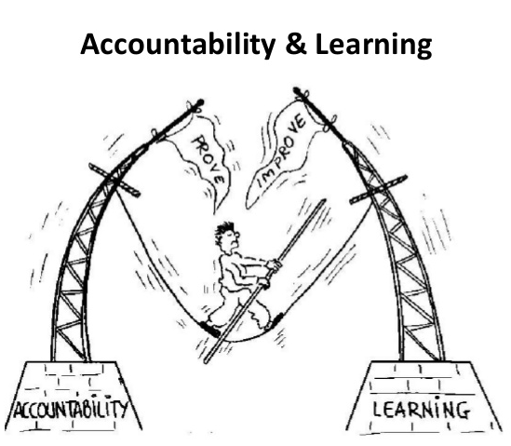
The most important step in an evaluation
Using the results!
Notes:
If the evaluations are not used to improve the program, they are not useful.
Results must be disseminated and made available for decision-makers, for program implementers, for policymakers, and for academics who may create new programs.
Presenting the evaluation results to each group in an appropriate way is very important.

Slide 42
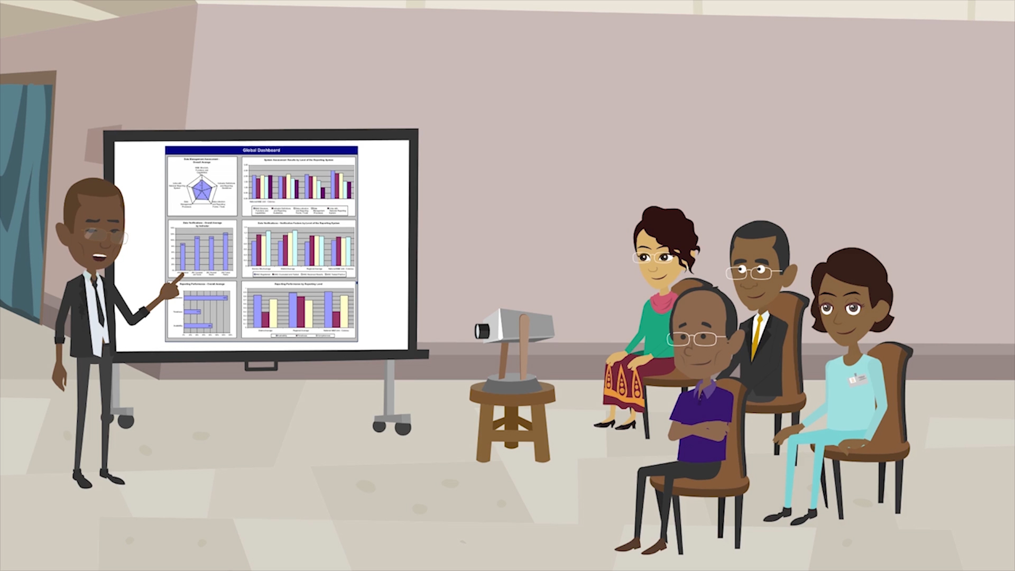
Communicating results for use
Data presentation for different audiences

Slide 43
Report and use of findings
Identify reporting requirements
  Communication plan
  Client reporting needs
Develop reporting format appropriate for users
  Written executive summaries
  Final reports
  Memos and emails
  Newsletters, bulletins, briefs, or brochures
  Website communications
You may develop a number of reports, in different formats, for different sets of stakeholders. Work with your primary users and stakeholders to determine when and in what form they want to receive evaluation reports. Also, determine who you will involve in reviewing drafts.
Notes:
Develop and present findings in ways that are useful for stakeholders, and support them in interpreting and using results.
Identify reporting requirements
Create a communication plan: Developing a plan that outlines the strategies which will be used to communicate the results of your evaluation
Reporting needs analysis: Working with your client to determine their reporting needs
Develop the correct reporting format
Written executive summaries: Including an executive summary, which is a shortened version of the full report
Final Reports: Ensuring they are readable, straight to the point, and use a writing style that promotes understanding regardless of who the target audience is
Memos and email: Maintaining ongoing communication among evaluation stakeholders through brief and specific messages about a particular issue.
News media communications: Sharing news relating to evaluation findings through press releases
Newsletters, bulletins, briefs, and brochures: Highlighting particular findings or angles on an evaluation using shorter communications such as bulletins, briefs, newsletters, blogs, and brochures
Website communications: Disseminating information (such as information coming from evaluations) via a range of web based tools
Source: BetterEvaluation (2013). Retrieved from http://betterevaluation.org/en/plan/reportandsupportuse/report

Slide 44

Why dissemination?
Effective dissemination of evaluation results will not only contribute to greater accountability, but also enable partners to learn more
about the program
Effective dissemination
is the only way to
ensure evaluation results are used.

Slide 45
How to disseminate results
Dissemination plans should be built into
the evaluation
  It must be in your TOR/budget
Who should see the results?
  Map key actors
Different ways to disseminate results
  Reports, scientific journals, conferences, talks and seminars, newspaper, radio, video, workshop
  All formats have a different impact
  and are directed to different audiences
Notes:
The dissemination plan must be included in the terms of reference (TOR) so it will get a budget.
There must be clarity about the key actors in the dissemination plan (this can be established through a mapping).

Slide 46
How to disseminate results
Presentations in scientific environments
Displays and exhibits
Flipcharts
Information contacts
Posters
PowerPoint
Teleconference
Verbal briefings
Video
Videoconference
Web-conference
Notes:
Presentations in a scientific conference: Discussing a set topic or theme with a large group of people at a set venue.
Displays and exhibits: Drawing attention to particular issues and assisting in community engagement.
Flipcharts: Providing a useful way of interacting with your audience, and therefore allowing you to present your own ideas and results—also, to immediately record input, feedback, and ideas from your audience.
Information contacts: Providing a contact person for all media and public enquiries about a project or program.
Posters: Presenting your evaluation findings in the form of a poster provides a good opportunity to get your message across in a clear way, while also providing opportunities for feedback.
PowerPoint: Organizing and communicating information coming from evaluations in the form of a slide show, which can be used at a meeting or conference.
Teleconference: Facilitating discussion of evaluation findings via telephone.
Verbal briefings: Providing specific information to an audience of interested participants, and allowing for a structured question and answer format based on that information.
Video: A highly flexible and immediate medium which allows you to make an emotionally meaningful connection with the audience.
Videoconference: Gathering data, communicating information about an evaluation, reporting findings, receiving feedback, and planning for utilization.
Web-conference: Brings people from around the world together to share and discuss findings using the internet.

Slide 47
How to disseminate results
Presenting your report in a creative manner may be the most relevant means to get your information across, if the context allows it. You may consider working with an artist or a graphic designer to produce creative displays.
Creative cartoons
Photography
Poetry
Picture reports
Theater
Notes:
Creative cartoons: Allows readers to see a point differently, adds humor, and breaks up large sections of prose.
Photographic reporting: Makes your report more appealing to readers, and also makes the key messages more memorable by including photographs.
Poetry: Communicating the experience of participants can be achieved by presenting some of the findings in the form of a poem.
Reporting in pictures: Presents information in an alternative way, and therefore increases understanding of your results.
Theatre: Communicates evaluation findings and engages intended users in responding to them.

Slide 48
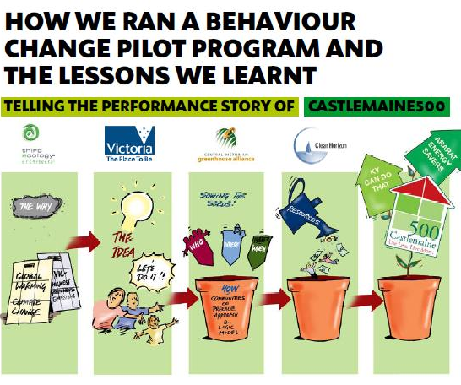
Effective dissemination
Source: Castlemain 500 Project. Evaluation Toolbox:
https://www.clearhorizon.com.au/f.ashx/C500eBook_Mar09.pdf
Notes:
Here is an example of the Castlemaine 500 Project, which developed a storybook to present their findings.

Slide 49
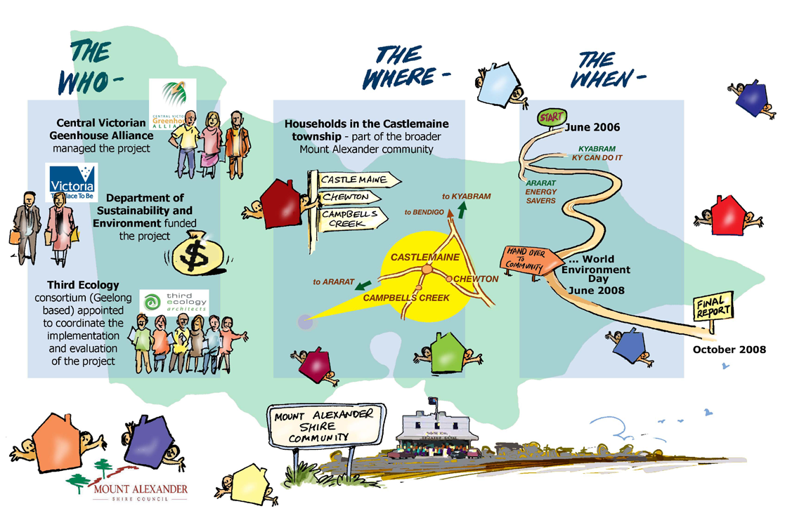
Effective dissemination
Who, where, when: In a cartoon
Source: https://www.clearhorizon.com.au/f.ashx/C500eBook_Mar09.pdf
Notes:
This slide shows who participated, where it happened, and when the project was delivered. However, images such as this one must be explained and grounded in the data.

Slide 50

Effective dissemination
Storytelling
Notes:
There are other ways to present your findings.

Slide 51

Notes:
[Instructions: Poster will be given as a handout
Note: The poster in the handout is not so visual as the ones that are shown in the slide, the objective of the handout is to see what the sections of a poster are, as well as what the qualitative information reported are.]
Scientific posters are one of the many options used to disseminate evaluation results.

Slide 52

Presenting results
Consider your audience
Choose appropriate results and evidence
Variations by audience:
    Academic forum versus civil society
    Policymakers versus academics
    Level of education
    Cultural context
    Language
Notes:
Different audiences have different languages, time schedules, and interests.
Sharing participant experiences may incorporate different events or results. Not all audiences need to receive the same information, not all audiences are able to understand the same language, and not all audiences need the same amount of time.
Academic forum vs civil society
Policymakers vs academics
[Instructions: Give handouts with Castlemaine story for dissemination.]
Language must be very precise, accurate, and technical (particularly with respect to methods) in an academic forum, something that is not as necessary for a general audience. For a general audience, the implications of results in terms of program changes are very relevant, and technical language should be avoided.

Slide 53
Presenting results
Qualitative evaluations add value:
  Give a face to a statistic
  Shed light on sensitive or controversial topics:
    Corruption, violence, abuse,
    illegality, negligence
  Provide individual voices with anonymity
  and confidentiality
  Qualitative data can make the difference when it is well-presented to policymakers
  and decision makers.
Notes:
One of the main tasks of the qualitative evaluation is to give a face to statistics. It is one thing to know that X% of women die giving birth, and quite another to hear about individual experiences describing the conditions of injustice and the structural barriers (poverty, marginalized, poor education, and violence) that led to maternal death.
Using results from qualitative evaluation, light can be shed on the causal mechanism of problems and controversial issues such as violence, corruption, poverty, drug use, and illegal migration.
The importance of qualitative information does not justify the careless pursuit of research subjects to obtain their story. This is why anonymity and confidence are key to the qualitative evaluation. Subjects should not be recognizable, but their direct voices and quotes should be used to show the experiences of many people (including those who were not interviewed).
Qualitative evaluation can reveal key behavior patterns, and, if accurately collected and analyzed, can be the “golden kernel” for decision-makers.

Slide 54
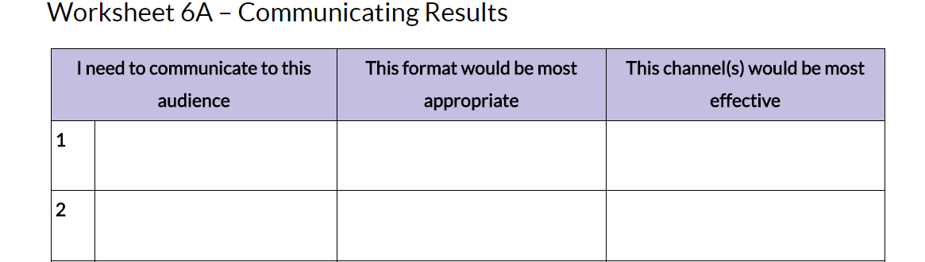
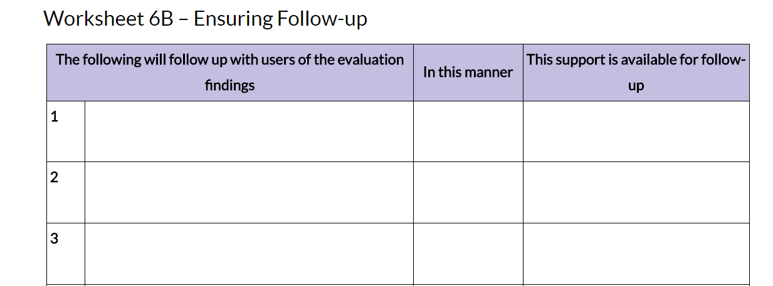
Communicating results
Notes:
Presented here is an example of a worksheet to guide you with communicating your results and providing follow-up.
Source: https://www.cdc.gov/eval/guide/step6/

Slide 55
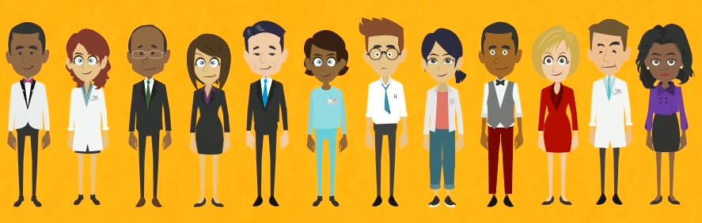
Learning the lingo: Activity 2
Doing it qualitatively
Group activity: Reach your audience
Notes:
As you gain confidence as an evaluation expert, you will expand your repertoire of evaluation techniques to best suit your particular evaluation problems and intended audiences.
When it all falls into place, you will develop the ability to exercise more freedom within any chosen design while remaining true to the principles of the chosen approach.
There is not one way to conduct qualitative evaluation. You can always innovate, learn, explore, and become more skilled at reaching the intended audiences of your evaluation project.
Source: Bazeley, 2013; Campbell, Quincy, Osserman, & Pedersen, 2013; Chenail, 2012; Denzin & Lincoln, 2011; Eberle, 2014; Flick, 2014a&b; Huberman, 2014; Schurink et al., 2013; Willig, 2014a.

Slide 56
Learning the lingo: Activity 2
Doing it qualitatively
Split group into teams of four to five
Write an introductory paragraph on trustworthiness; craft the language for your assigned audience/clients/funders
      15 mins.
Present your paragraph to the group.
      5 mins.
  Have a group discussion
      Combined 35 mins., after all groups present
Notes:
The purpose of this activity is to illustrate that although establishing trustworthiness is always important, the manner in which it is conveyed should be determined by the audience.
[Note to facilitator: The next four slides provide the information for this group activity—Learning the Lingo.
This slide provides the overall structure and time allocation for the activity
The next slide provides the evaluation topic on which the groups are working (note, the topic is the same for all groups)
The following slide provides the context of the evaluation, and imagery of the landscape and participants
The final slide shows the three different possible audiences (each group is assigned one of these audiences)]

Slide 57
Learning the lingo: Activity 2
Evaluation topic
Your team of evaluators has just completed a qualitative evaluation on the impact of
a violence against women (VAW) intervention in Tanzania.
Notes:
[Instructions: Display evaluation topic.]
This program is the case study provided in the Participants’ Guide.

Slide 58

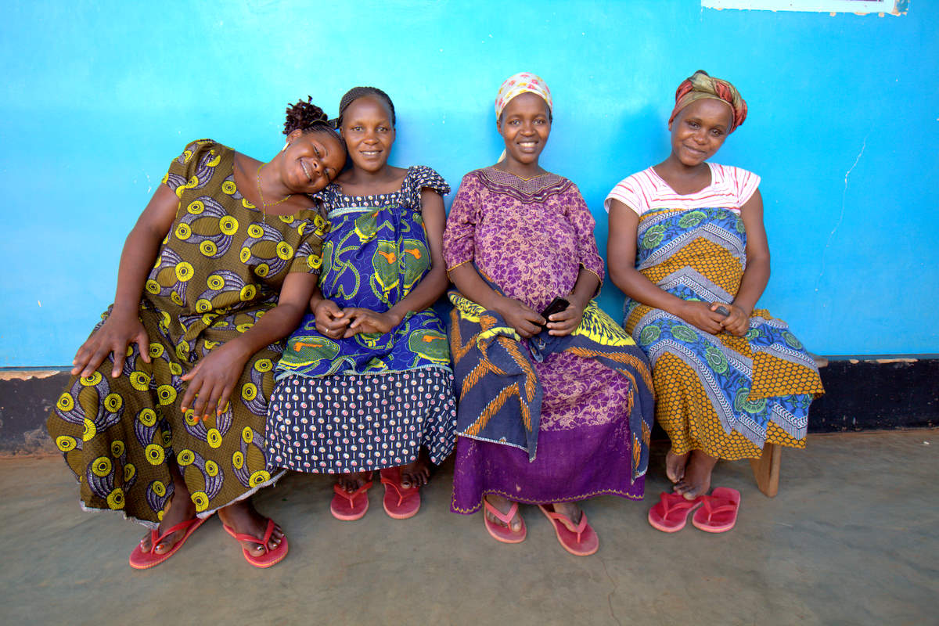
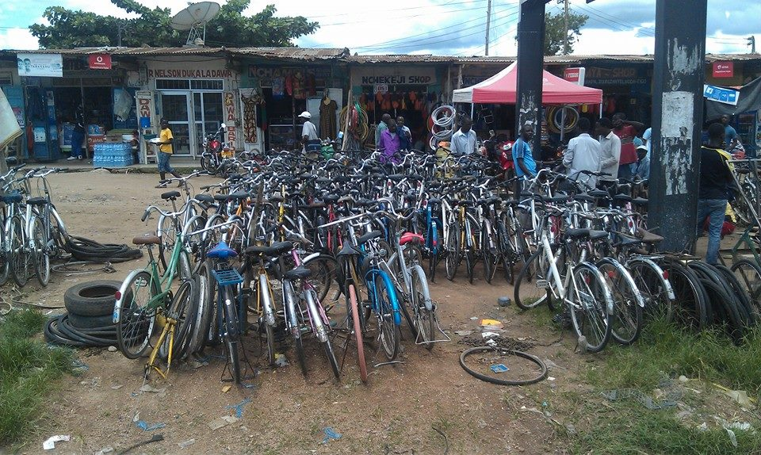
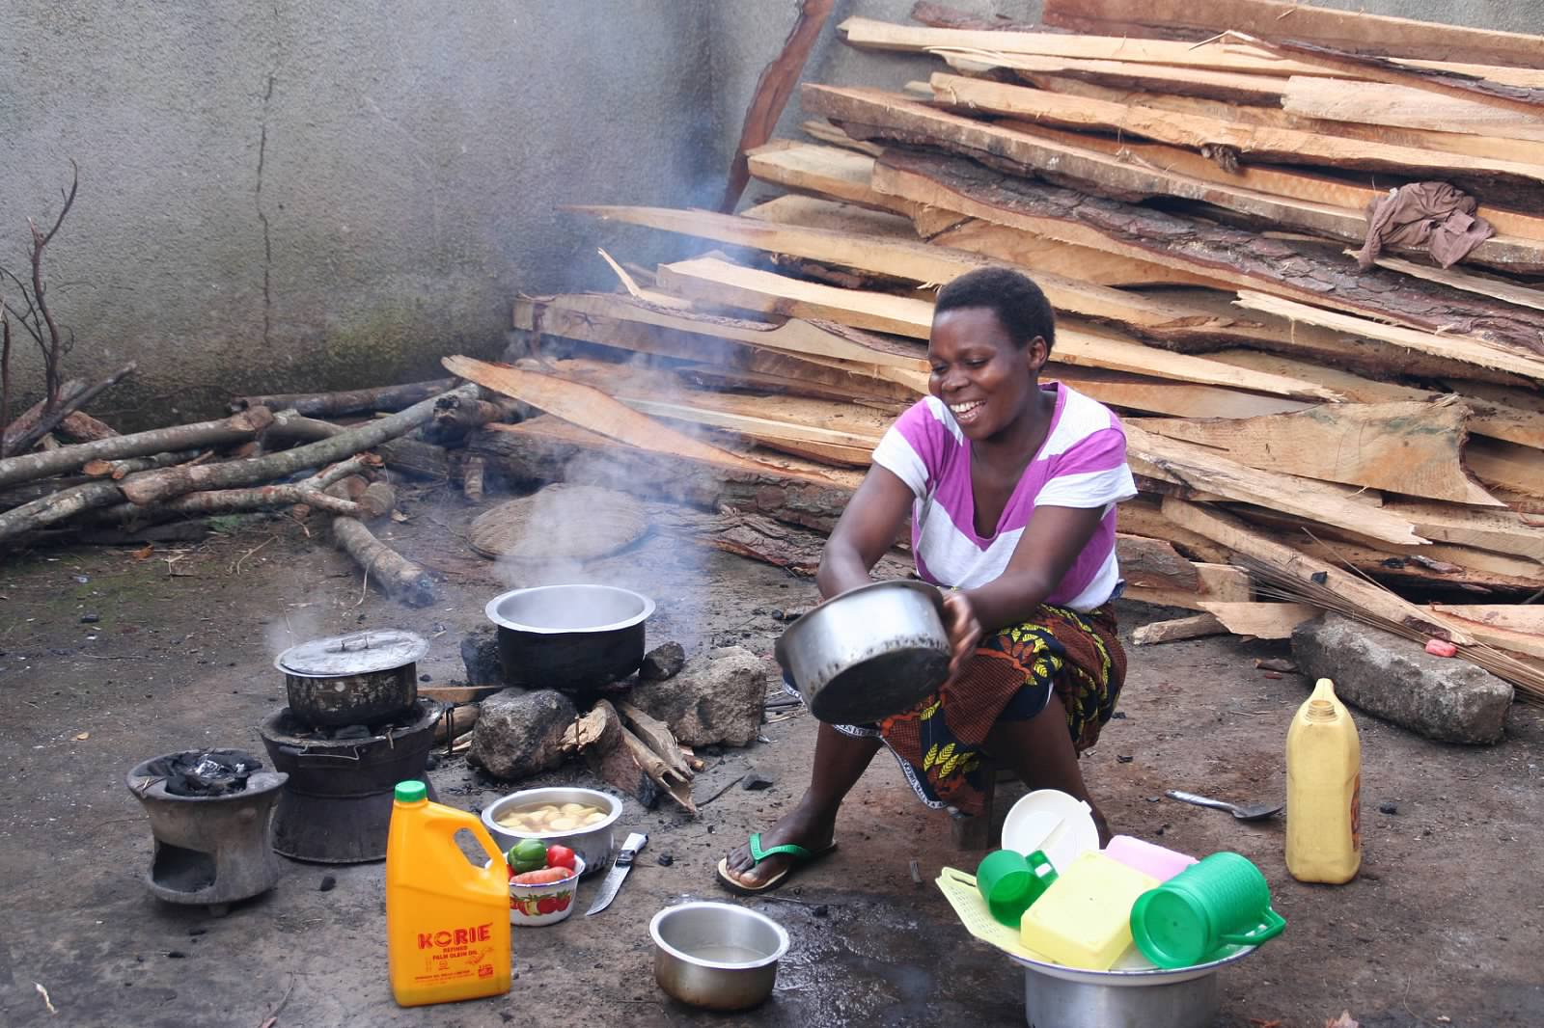
Learning the lingo: Activity 2
Setting the scene
Notes:
Setting the scene: The population is relatively young (42% were 25 years of age or younger) and dominated by one tribal ethnic group. The community is culturally diverse, representing five different tribal groups and at least as many languages. Approximately 30% of the men and almost 60% of the women had not completed schooling beyond primary education. The median income was low; many respondents were self-employed. Almost two-thirds of the community members identify as Christian, while about 25% consider themselves Muslim. Patriarchy—the concentration of both individual and institutional power in the hands of men—is a dominant aspect of the sociocultural context. Men are widely considered to be the heads of the households, and women are usually expected to be subservient.

Slide 59
Learning the lingo: Activity 2
Audiences
The local community
Cambridge University
World Health Organization
Notes:
Possible Audiences: The same audience can be given to multiple groups, so you will only have three different audiences, irrespective of the number of groups:
Participants
Academic
Funder: Aid organization
With the participants (imagine standing under a tree speaking to a group of people), terminology like trustworthiness would not be used. And yet, buy-in would be required for participation and for putting weight in the evaluation. Buy-in might be obtained by:
Providing feedback separately to males and females
Gaining permission for entry from tribal authorities
Establishing a clear method (oral) of collecting information, a clear timeframe, etc.
On the other hand, academics (imagine participating in a colloquium on malaria interventions in Africa) would require a description of the context, terminology, detailed methodology, sampling, instruments, etc.
Funders (imagine addressing a boardroom of funders at the WHO headquarters attempting to acquire funding) would be interested in the methodology, but also the purpose of the evaluation and appropriateness for the participants (credentials of the evaluators, audit trails, etc.).

Slide 60
Comments and questions
Was there something new
or surprising in this session?
Do you have anything to add?
Notes:
[Instructions: Facilitator displays the two questions on this slide to start discussion about this session.]

Slide 61
Summary
Qualitative reports should tell a story: Consider your audience, answer main evaluation questions and TORs, and support practical recommendations with evidence
Consider creative methods of data presentation (pictures, word clouds, participatory techniques), where appropriate for your research question and audience
Remember domains in the COREQ checklist for qualitative reporting: (1) evaluation team and reflexivity; (2) study design; (3) analysis and findings

Slide 62
Online resources
CDC. (2013). Developing an effective evaluation report: Setting the course for effective program evaluation. Atlanta, Georgia: Centers for Disease Control and Prevention, National Center for Chronic Disease Prevention and Health Promotion, Office on Smoking and Health, Division of Nutrition, Physical Activity and Obesity.
Cohen and Crabtree. (2008). Evaluative Criteria for Qualitative Evaluation in Health Care: Controversies and Recommendations.
Ann Fam Med; 6:331–339.
Malterud, K. (2001). Qualitative Evaluation: standards, challenges, and guidelines. The Lancet; Col 358:483–488.
Spencer, J.R., Lewis, J., & Dillon, L. (2003). Qualitative Evaluation: A framework for assessing evaluation evidence. United Kingdom: National Centre for Social Evaluation. ISBN: 07715-04465-8. Government Chief Social Evaluation's Office Crown, Copyright 2003.
Tong, et al. (2007). Consolidated criteria for reporting qualitative Evaluation (COREQ): a 32-item checklist for interviews and focus groups. International Journal for Quality in Health Care; 19(6):349–14.
Notes:
Presented here are online resources mentioned in this presentation that may be useful for disseminating your findings.

