Slide 1
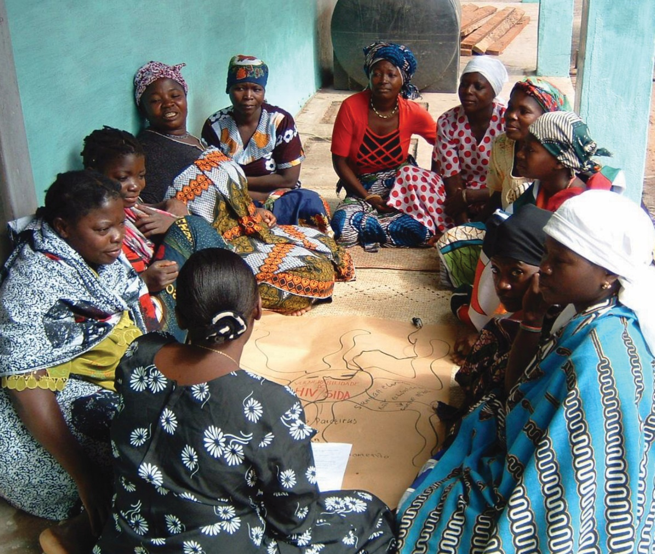
Creating and Conceptualizing
Qualitative Evaluation Questions
[insert date]
Qualitative Methods
in Evaluation of Public Health Programs
Session 2
Notes:
[Facilitator notes: This power point contains material to be used for the practical session as well. The session is structured so that after some inputs the participants can work in small groups to create evaluation questions for the case study that has been introduced to the group.]

Slide 2
Learning objectives
At the end of the session, participants
will be able to:
Use the program theory of change
to identify key questions that can
be answered using different types
of qualitative evaluation
Conceptualize key components
of evaluation questions

Slide 3
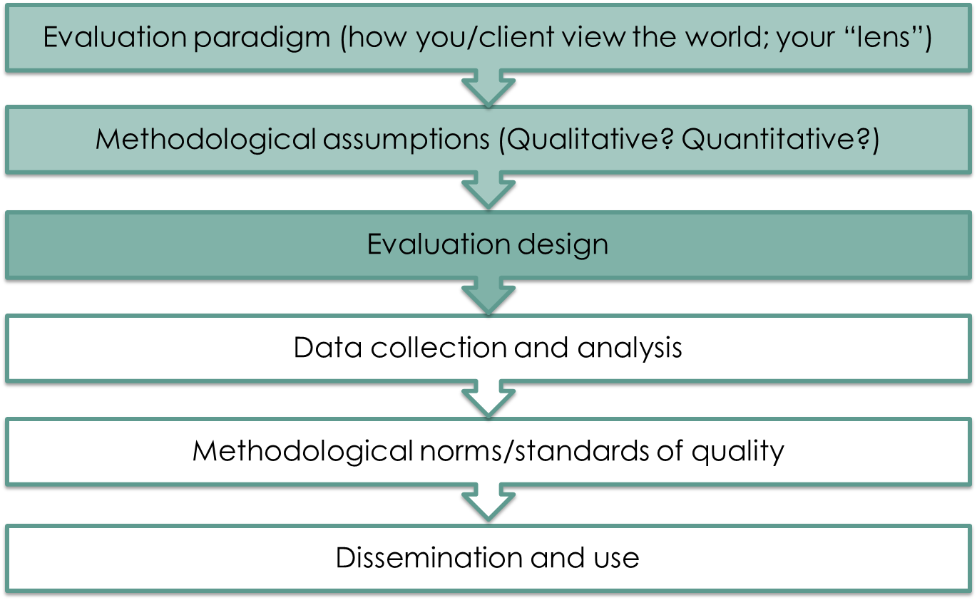
The evaluation process
Notes:
[The purpose of this slide to help participants situate the session within the overall evaluation process. The facilitator needs to remind the participants briefly about the overall evaluation process and point to the particular phase into which this session fits in (shaded darker blue/green).]

Slide 4

It starts with a question
What do we
need to know?
Notes:
[Ask participants to discuss the following] Why do we need to have evaluation questions? What purpose do they serve? [Possible answers: to frame the evaluation, to engage program stakeholders, for logistical reasons such as funding and evaluation proposals, etc.]
Qualitative evaluation starts with an evaluation question, which informs the rest of the evaluation and evaluation design. Evaluation questions may already be determined by the program’s monitoring and evaluation plan, or the funders may have specific goals that need to be addressed by an evaluation. Framing your evaluation with a good question will allow everyone to understand the goals and objectives.
Evaluation questions are the high-level questions that an evaluation is designed to answer—not specific questions that are asked during interviews or focus group discussions. Having an agreed-upon set of key questions at the onset of an evaluation will make it easier to decide what data to collect, how to analyze and how to report findings. We’ll cover planning for this in subsequent sessions, but it’s important to frame our evaluation questions by recognizing how they effect overall study design.
We must also keep in mind that questions may evolve over time as the evaluation design becomes fully formed. Patton said, “First the question, then the methods, then the question” —because as we move to the more practical aspects of the answering the question, the question may evolve or sharpen. A good question clearly lays out what we will find out through the evaluation, and will likely be clarified further as we formulate a plan for data collection.

Slide 5

Qualitative Evaluation
Questions
Are open-ended
Address the how and why
of a program’s processes,
outcomes, or impacts
Can be answered using
qualitative methods and
data analysis
Generate complex understanding of interactions with program participants or communities
Notes:
[Discuss the following points with participants.]

Slide 6
Formulating questions
When formulating questions:
Clarify the evaluation purpose (formative, process, output, outcome)
Notes:
[The next section of slides will take you through the process of designing appropriate evaluation questions. When formulating questions, one of the first steps should be to clarify the evaluation purpose—are we planning to conduct a formative, process, output, or outcome evaluation? There are key difference between these types of evaluations that will help in creating evaluation questions. The next few slides will go through these four evaluation types in greater detail.]

Slide 7
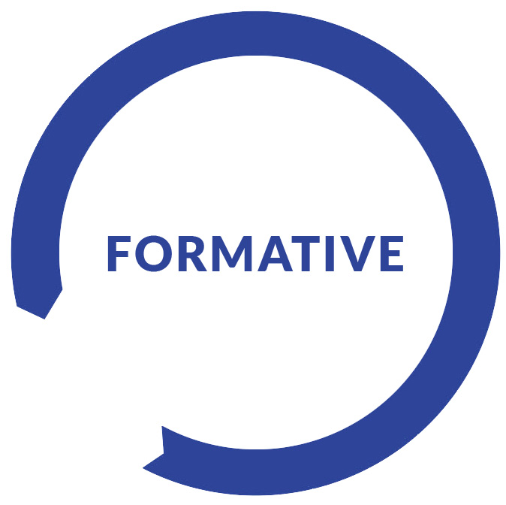
Types of evaluation
Type | Purpose | Key types of questions
Formative evaluation | Ensures that a program or program activity is feasible, appropriate, and acceptable before it is fully implemented Incorporates interventions and outputs from program theory of change | How well are program elements accepted and understood by program beneficiaries? How should the program be modified or adapted?
Notes:
A formative evaluation usually evaluates a program or part of the program at an early or pilot stage, to determine if it is feasible, appropriate, and acceptable before being fully implemented. You may want to know what changes or adjustments should be made before implementing the program more widely. Evaluation questions here should focus on interventions and outputs from the program theory of change. Questions should focus on the acceptability of the program to beneficiaries and/or program implementers, and ask how well elements of the program are accepted or understood
by participants.
The main purpose here is to improve your programming so you may focus on finding out which materials have been most useful, if parts of the program have not been well received. For example, maybe you are implementing a small-scale nutrition and breastfeeding education program for new moms and you conduct a formative assessment before expanding the program. A formative assessment might find out that while moms like the information they are receiving, they are uncomfortable with the male educator conducting the session on breastfeeding. This information will help you adjust when planning for scale up.

Slide 8

Types of evaluation (2)
Type | Purpose | Key types of questions
Process evaluation | Address program operations, activities, and outputs, and if activities are occurring as expected Help understand how an intervention’s outcomes or impact were achieved | How well is the program being implemented? How satisfied are program beneficiaries? How have program activities been carried out in innovative ways?
Notes:
A process evaluation will focus on the program operations, activities, and outputs. This will allow us to assess whether the program is occurring as expected. A process evaluation may identify program areas that need improvement to be able to reach expected outcomes. It may also identify program activities that have been done or implemented in an innovative way, and capture lessons learned during program implementation.
Process evaluation is usually implemented while a program is still ongoing, as results can inform the program’s future course.
Through a process evaluation, you might find out about barriers or facilitators to successful implementation, or innovative ways in which a program has been implemented. Let’s say we have scaled up in the example of our nutrition and breastfeeding education program, and we want to the know if the program is being implemented as we intended. We might find out that yes it is, and we might also find out that educators have been able to target moms when they bring their kids in for immunizations, and that this has increased the success of service delivery to beneficiaries in this case.
The information obtained form a process evaluation should be complementary to, but not take the place of, routine program monitoring. For example, program monitoring may tell you how many moms are participating in the breastfeeding program and what the retention rate is for program participation, but may not tell you why moms are dropping out. Information obtained from the process evaluation may help you to make modifications for the program
as it progresses.

Slide 9

Types of evaluation (3)
Type | Purpose | Key types of questions
Outcome evaluation | Concerned with the effects of program delivery and operations in the target population Incorporates key outcome components of the theory of change | How have program activities and materials been received by program beneficiaries? How have knowledge and perceptions changed as a result of program activities or materials?
Notes:
Outcome evaluations assess the effectiveness of a program in producing change and focus on the effects of program delivery in the target population. Outcome evaluation questions incorporate key outcome components of the theory of change to ask what changes there were and how much of a difference the program made for participants.
Outcome evaluations determine the effects of the program by producing evidence of the program’s contributions toward the intended outcomes. Continuing with our nutrition for moms program, we now want to know how moms’ knowledge and attitudes toward breastfeeding and complementary feeding practices have changed (if at all) as a result of the program.

Slide 10

Types of evaluation (4)
Type | Purpose | Types of questions
Impact evaluation | Concerned with long-term impacts of the program as outlined by theory of change | How well did the program work? How has context contributed to the intended outcomes? How have other factors contributed to impact?
Notes:
Impact evaluations are concerned with long-term expected goals of the program. These should align with overall program objectives, and are conducted to understand if the program succeeded, if it was more successful in certain groups of people than others, and what aspects of the program had the greatest benefit.
For example, in a moms’ nutrition program, we now want to know if the long-term impact has been achieved. So, if the long-term goal of our program was to improve breastfeeding and complementary feeding practice as prescribed by our program, we’d want to evaluate the long term impact there.

Slide 11
Formulating questions (2)
Clarify the evaluation purpose (formative, process, output, outcome)
Refer to the program’s theory
of change and other
program materials

Slide 12
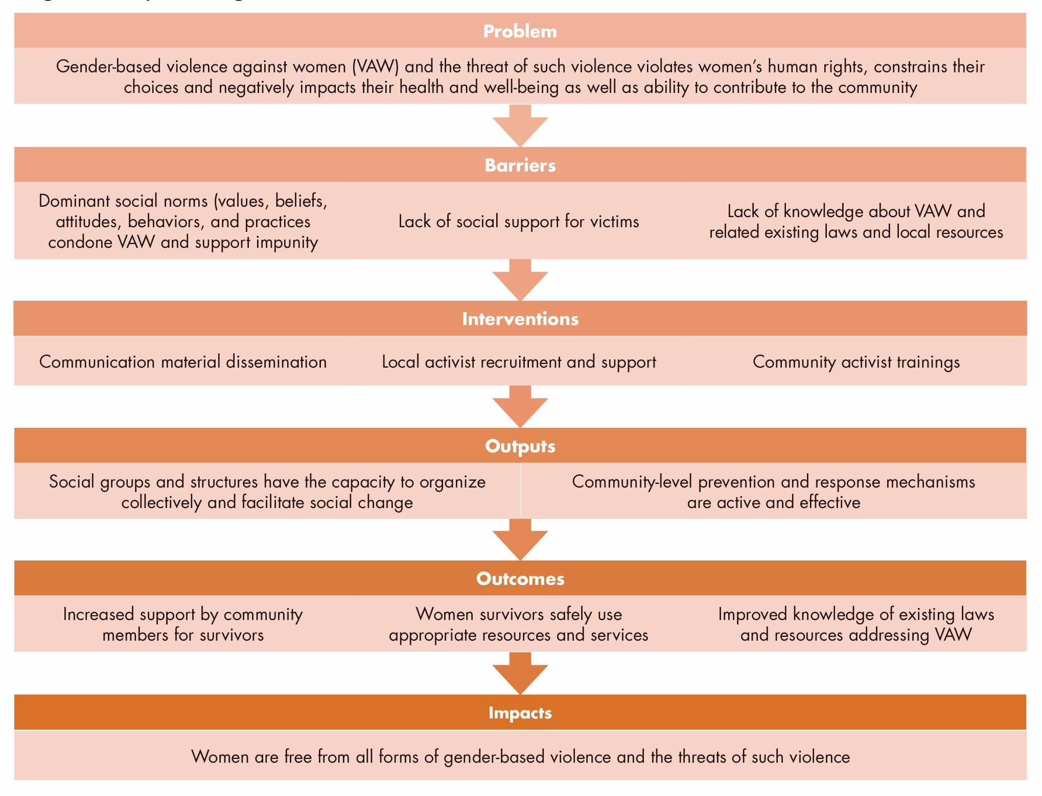
Communities United Program:
Theory of change
Notes:
Once we have identified the type of evaluation we will carry out, we should refer to the program’s theory of change
(or logic model) to understand what the program intended to achieve, what the key strategies were for achieving the objectives, and what the intended outcomes and impacts were. We will also want to review the program’s goals and objectives, and any relevant program material such as workplans or program training materials. This will inform our overall evaluation questions and ensure that our evaluation questions align with the goals and objectives of the program.
This is the theory of change for our case study program—Communities United. (Participants should have a copy of the theory of change.) Starting with the problem, we see that violence against women (VAW) violates women’s human rights, constrains their choices, and negatively impacts their health and well-being and ability to contribute to the community
in general. Barriers to addressing this problem, as we’ve identified, are dominant social norms, lack of social supports
for survivors of violence, and lack of knowledge about the laws and resources available.
The interventions describe what our program is doing to mitigate these barriers – the outputs follow the interventions. The outcome describe what we are hoping to accomplish with our interventions in the short-term, what changes do we expect to see as a result of the program. The impact is the long-term result we expect to see if our program is successful, which addresses the problem with which we started.
It is possible your program will use a logic model, which is fine – or that they won’t have a theory of change at all, in which case you as the evaluator will have to work with them to create one.

Slide 13
Formulating questions (3)
Clarify the evaluation purpose (formative, process, output, outcome)
Refer to the program’s theory of change and other program materials
Use open-ended questions to guide your evaluation
Less is more!
Avoid hypothesis testing or predictions
Notes:
Once we’ve clarified the evaluation purpose and reviewed program materials, we’ll want to think about forming the actual evaluation questions. Some general guidelines when forming our question appear below.
Use open-ended questions: These questions lend themselves well to qualitative methods and exploring the how, why,
and complex relationships and pathways from program to beneficiaries.
Less is more: You want to avoid a laundry list of questions. In general, the more questions you have, the more difficult your evaluation will be to undertake and design. Having a core group of evaluation questions should frame the evaluation for everyone—evaluators and stakeholders—should be high-level, and should remain general while still capturing a complete picture of the program.
Avoid hypothesis testing or predictions in the questions: Hypothesis testing is typically a quantitative approach and lends itself to quantitative data. Qualitative questions are not well-suited to test hypothesis, instead the qualitative strength here
is the ability to explore a question and the topics of interest.

Slide 14

Formulating questions (4)
Outcome evaluation
Outcome: Decreased tolerance for violence against women (VAW) within communities within social, political,
and cultural circumstances.
Question: Do community
members accept use of
violence against partners?
What problems do you see with this question?
Notes:
So, we have taken a moment to look at our program theory of change. Let’s say we are planning for an outcome evaluation. One of the program elements we will want to focus on is the community perceptions of the use of violence against partners.
[Ask participants]: Do you see any potential issues with this question?
[Possible responses]:
This question is dichotomous. Qualitative data may not provide the most appropriate answer to this evaluation question. In addition: what could we be missing out on by using this question to frame our outcome evaluation? We may miss out on why women are accessing services or why they don’t access services, how they go about accessing services (secretly, with the support of friends or family, etc.) and what their experiences are if they do access such services. This question is also not an evaluation question, and doesn’t do a great job of framing what we really want to know as the result of an outcome evaluation. It doesn’t ask about the intervention or changes resulting from the intervention.
Using open-ended qualitative evaluation questions will allow us to better frame our thinking, our data collection, and provide a more complete picture of how the Communities United (CU) program operates in this particular community.
[Ask participants]: Take two minutes to discuss with the person next to you: What would be a better way to ask this question? (An example is provided on the next slide.)

Slide 15

Formulating questions (5)
Outcome evaluation
A better question: How has the
program affected community perceptions of violence?
Notes:
This is an example of a better way to ask this question. It better frames what we actually want to know, links it to the intervention, and avoids the dichotomous phrasing.

Slide 16
Formulating questions (6)
Clarify the evaluation purpose (formative, process, output, outcome)
Refer to the program’s theory of change and other program materials
Use open-ended questions to guide your evaluation
Less is more!
Avoid hypothesis testing or predictions
Engage stakeholders
Notes:
Another step you’ll want to be sure to take in this process is to engage stakeholders.
[Ask participants]: Who do we mean by stakeholders in this case?

Slide 17

Engage stakeholders
Increase buy-in to evaluation
process and findings
Determine what stakeholders
need from the evaluation
  Some stakeholders may prefer different types of evidence—funder and evaluators should agree on qualitative information
In choosing stakeholders, be sure to engage minority or marginalized groups
Notes:
Now that we have identified the type of evaluation we want to do and we have referred to the logic model, it is a good time to engage stakeholders in the question development.
One way to make sure an evaluation is relevant and useful is to develop a set of key questions that reflect the perspectives, experiences, and insights of individuals, communities, and relevant groups who have been engaged with or affected by the project.
Stakeholder input is essential to establishing the focus, input, and direction of an evaluation—findings will be more relevant, credible, and useful, and recommendations may be more acceptable by a broader constituency, and more fully and with less resistance.
Preparing for stakeholder engagement involves collecting information about the program being evaluated—who’s been involved, how it came into being, etc. Through the use of qualitative methods, we have the opportunity to understand
the “how” and the “why,” and we want to be sure we capture all relevant perspectives.
Be sure to engage women and men, and minority or marginalized groups in the process. All groups potentially affected, positively or negatively, by the program, need to be represented. For example, in evaluation of a program that is trying
to engage men in antenatal care, women’s groups also need to be represented as stakeholders, as they are affected by men participating more heavily in antenatal care.

Slide 18
Formulating questions (7)
Clarify the evaluation purpose (formative, process, output, outcome)
Refer to the program’s theory of change and other program materials
Use open-ended questions to guide your evaluation
Less is more!
Avoid hypothesis testing or predictions
Engage stakeholders
Allow questions to evolve or sharpen
as methods take shape

Slide 19

Conceptualizing questions
What exactly do you mean?
Conceptualize what you intend to evaluate by providing a working definition of a concept.
  Make sure everyone is on the same page.
  Are your concepts measurable through qualitative methods?
Notes:
As part of developing our research questions, it is important to establish a common understanding of what we want to measure. Conceptualizing the terms of our research question involves establishing a definition. Operationalizing then provides criteria by which to measure this concept.

Slide 20

Conceptualizing questions (2)
What we want to know
How does the community experience the Communities United (CU) program?
Notes:
For example, in the case of the Communities United program, I may want to know how women are reacting to the program materials—the community meetings and the discussion session we have trained our community advocates
to lead.
I could start by asking the question: How do women like the program? This might be what I want to know, but it will likely need some further clarification before we are able to go about measuring this.
[Ask participants]: What concepts am I going to have to explain further to be able to understand this research question?

Slide 21
Conceptualizing questions (3)
What we want to know
How does the community experience
the CU program?
Key concepts:
Community
  Married men and women in the target community who have attended CU programming
  Others in the community who have heard of the program
Experience: What are their reactions and feelings; what parts do they dislike or like; what are perceived changes for attendees and/or broader community perceptions of those who have attended, etc.
Program: Community group meetings and discussions organized by community volunteers, program material, specific period
Notes:
The key concepts here are women, feel, and program.
What women are we talking about? Whose perspective do we want to get? What women will we be able to reach?
Experiences: What are we interested to know about the women’s feelings? Their initial reactions, positive, negative, what parts resonate and which might fall flat.
Program: What, specifically, do we want to know from community women? How they received the community discussion talks led by CU-trained community activists.
[*Make very clear that this is just one potential way to conceptualize your questions for an outcome evaluation.]

Slide 22

Sub-questions
Assist in further identifying the questions we want to ask and concepts we want to ask about
Can be added to and adapted over time as findings and concepts emerge in the evaluation process
Notes:
We mentioned that our main research questions should be broad and overarching. The purpose of broad research questions is to allow for flexibility in your approach as your research unfolds. You may come across concepts you hadn’t considered. Subquestions allow you to add new and emerging questions to your research design as you go, while still staying true to the original research design.
This is especially helpful if your evaluation plan must be approved ahead of time, or if you need IRB approval for
your research.

Slide 23
Evaluation questions
Practice: outcome evaluation
Program: Smoking cessation for adolescents
in China
Question: Did adolescents stop smoking?
How did the program affect adolescent smoking in this area
of China?
Notes:
Let’s take a few minutes to look at potential qualitative evaluation research questions and critique them. This will give an opportunity to think critically about research question strengths and weaknesses.
[Click on the next arrow to add the pop-up to show a better way to frame this question.]
How did the program affect adolescent smoking in this area of China?

Slide 24
Evaluation questions (2)
Practice: outcome evaluation
Program: Nutrition education for moms and kids in Uganda
Question: How have moms’ feeding practices changed following participation in the program?
Notes:
Let’s take a few minutes to look at potential qualitative evaluation research questions and critique them. This will give an opportunity to think critically about research question strengths and weaknesses.

Slide 25
Evaluation questions (3)
Practice: outcome evaluation
Program: Increasing condom use among sex workers in India
Question: Do more sex workers
use condoms?
How have sex workers’ attitudes about condoms changed, if at all, after participation in the program?
Notes:
Let’s take few minutes to look at potential qualitative evaluation research questions and critique them. This will give an opportunity to think critically about research question strengths and weaknesses.
How have sex worker’s attitudes about condoms changed after participation in the program? [Use of condoms, knowledge, etc.]

Slide 26
Evaluation questions (4)
Practice: process evaluation
Program: Family planning education
for married couples in Egypt
Question: Did the program implement according to plan?
How satisfied were the program participants with the services?
How was the program implemented?
Notes:
Let’s take a few minutes to look at potential qualitative evaluation research questions and critique them. This will give an opportunity to think critically about research question strengths and weaknesses.
How satisfied were the program participants with services? How was the program implemented?

Slide 27
Group work
Each group takes one type of evaluation and writes evaluation questions (15 minutes); identify and describe key concepts; 10 minutes to share.
Evaluation type | Evaluation questions (2–3) | Identify and describe key concepts
Formative
Process
Outcome
Impact
Notes:
Facilitator notes
[Participants will work in their groups to write out the evaluation questions based on the CU case study background and theory of change in the participants’ guide.] Each group will be assigned a type of evaluation and will design 2–3 research questions appropriate for this type of evaluation.
Groups should identify the purpose of the questions they want to ask and identify the type of question—is it to understand experiences, values, feelings, or knowledge?
Groups should then identify key concepts central to the research question.

Slide 28
Summary
Different types of evaluations (formative, process, output, outcome) have different purposes. Think carefully about your research question to choose the most appropriate
type of evaluation.
Refer to the program’s theory of change
and other program materials to develop a research question. Remember that these
should be open-ended, and that “less is more”
Conceptualize what you intend to evaluate by providing a working definition of concepts, and ensure that your concepts are measurable using qualitative methods

