Slide 1
Why is This happening in the Program?
Options for Further Investigation & Information Flow
Session 5
Notes:
Read Slide.

Slide 2
Session Overview
Comparison of research approaches
Qualitative research methods
Choosing the appropriate qualitative method
Introduce the Informative Mapping Tool
Notes:
This presentation will give you a brief introduction to the research options available to you when you have identified a data gap.
READ SLIDE

Slide 3
What are quantitative methods?
Identify variables and specific units of analysis
Specify a relationship between 2+ variables
  Association
  Predict causal relationship
Measure variable using a structured survey, validated index or scale, or structured observation
Probability Sampling - each individual has an equal chance of being chosen (randomly selected).
Notes:
When you want to conduct further research, you may think a quantitative research method will give you the answers you seek.
Before you decide, it is important to consider some aspects to a quantitative approach to research:
1) You need to identify a variable, indicator, or set of indicators. This is something that will be measured like sex or age. A variable is something that varies.
2) These variables have specific values or units of analysis for who or what will be described like male, female, or number of years.
3) You then develop an hypothesis that specifies the relationship between 2 or more of these variables. This hypothesis is supported by a theory, empirical data, or both.
- In this hypothesis you are trying to determine if there is an association between these variables such that a change in one variable leads to some kind of change in another.
- By eliminating any other uncontrolled variables (often using statistics), you may even be able to predict that a change in one variable actually causes a change in another variable.
4) These variables are measured using an structured survey, validated index or scale, or a structured observation.
5) Often you need a certain sample size and you use a sampling technique called probability sampling. The idea behind this type of sampling technique is that all cases are randomly selected. All eligible cases, or individuals, have the same chance of being chosen for a study.
The reason we randomly choose participants in a study is because it is too expensive to survey an entire population. If we randomly select a small group of individuals within a population for our survey, we can often say that the results of our survey represent that larger population. Also, if survey respondents are chosen randomly, it may also be possible to generalize or infer our survey results to other population groups, points in time, or settings.
For example, if I randomly chose students at one university, and my sample size was large enough to make a precise estimate, I may be able to say that my findings describe typical students at any university in the country.

Slide 4
What are qualitative methods?
In-depth interviews:
  Unstructured, Semi-structured
Observations
Focus Group Discussions
Systematic methods
  Free listing, pile sorting, ranking
Participatory methods
  Mapping, Transect walks
Notes:
Qualitative methods include…(Read slide).
What all of these methods have in common is that their purpose is to establish a relationship with the subject or informant. Then the investigator can get in the words of the informant descriptive data of the issues and perspectives within a given context (social, cultural, political, and physical environment).
An investigator using qualitative methods values a natural setting to conduct their research. They are critically self-aware of their role as a researcher, and are driven to portray data only in the words of the informant.
You most likely will speak to different types of people to gain a more complete picture.
You may use different methods to explore the topic from various vantage points (i.e. observations and interviews)
Each step of data collection and analysis using qualitative methods informs the next step of data collection. For example, you often have multiple contacts with one person and revisit topics with that person. You may follow up on points made by one informant with another informant. You may also revisit an idea multiple times in one interview to get a more complete understanding.
Qualitative research requires flexibility from the investigator to: modify data collection plans during the study, explore emerging themes, and drop themes when you reach data “saturation”.
These qualitative methods use a non-probability sampling technique, that is subjects are NOT randomly selected.

Slide 5
Useful Distinctions between Qualitative and Quantitative Research
Qualitative:
Inductive
Primary data
Exploratory
Interview/ Observation
Small sample
No Systematic Sample
Words
Quantitative:
Deductive
Secondary data
Confirmatory
Survey
Large Sample
Systematic/Random
Numbers
      Viewed more as a continuum than a separation
Source: Randall Teal UNC the North Carolina Translational & Clinical Sciences Institute
Notes:
At one end of this continuum is textbook quantitative research marked by sharply defined and delineated populations, cases, and variables, and well-specified theories and hypotheses. At the opposite end of this continuum is social research that eschews notions of populations, cases, and variables altogether and rejects the possibility of hypothesis testing. In between these two extremes are many different research strategies including many hybrid and combined strategies.

Slide 6
Qualitative vs. Quantitative
Qualitative
  Answers the how, what, & why questions
  Used to generate understanding of issues from the perspective and in the language of the informants
  Ideally suited to explore sensitive topics in depth with small numbers of informants
Quantitative
  Useful for determining the size and scope of problem
  Often use to prove the existence of relationships
Notes:
When do we use these two different methods? (Read slide)

Slide 7
When to use qualitative research
When events are unknown or need to be explored
When events change quickly
When we lack good ways to measure things
When we need to know what real life is like
When the numbers and statistics do not “add up”
Notes:
Note to facilitator – read slide
In a qualitative research approach you often use Non-probability Sampling. This technique is used when you are not able to randomly select your survey participants.
For example, you want to look at the behavior of Men who have Sex with Men, but this population is not easy to find or quantify. Without being able to clearly define your population of interest, it will be challenging to randomly sample from it. The only way to find survey participants maybe for the investigator to non-randomly select them.
Another example is that you want to investigate client satisfaction with a particular service but do not have the funds to conduct a large scale survey.
Other reasons to use Non-probability Sampling is that you want to do an exploratory or formative study to direct future research, you don’t want to apply your findings to other populations, or there are very few cases to investigate within a population. In these cases, you would use Non-probability Sampling methods such as availability or convenience sampling, purposive sampling, quota sampling, or snowball sampling.
The principal difference between Probability and Non-probability sampling is random selection. If you do not choose your sample participants randomly, then there is potential for what is called sample bias, or sample selection bias. This term means that the chances of selecting any case, or survey respondent, are not known. We therefore cannot say with certainty that the individuals within a survey, and the information they provide, represents the characteristics of a larger population.

Slide 8
When not to use qualitative research
  Is not good when:
    Understanding is already complete
    To test hypotheses that are fully bought into
    To generate measures of statistical significance and generalization
Notes:
Note to facilitator – read slide.

Slide 9
Complementary methods
Survey methods tell us about the scope of a problem (i.e., what proportion of men consistently use condoms with regular partners)
Qualitative methods can help us answer questions about why only 15% of men report consistently using condoms with regular patterns.
Notes:
Of course, the best of both worlds is mixed-methods research, where an investigator uses multiple research methods and sampling techniques to learn about a specific phenomenon.
Multiple methods can ensure data quality, enhance credibility, and validate findings. Although this is ideal, it can be expensive to apply both methods.
Here is an example of how both research approaches can complement one another (read slide).
SAY:
Quantitative methods could then be used to measure barriers to condom use as well, however to be meaningful the barriers we ask about must be ones that have been derived from men’s subjective experience.
What you often see is qualitative methods being used to develop more meaningful quantitative measures.

Slide 10
Qualitative Research Methods
Interviews
Observations
Focus groups
Document Reviews
Systematic & Participatory Methods
Notes:
There are many different kinds of qualitative research methods. These are the most common types of qualitative data collection methods. There are others, but these are the ones you may be most likely to use. Other types would be covered in a more comprehensive qualitative methods course.

Slide 11
Key Informant Interviews
Often semi-structured
Can interview different participant groups
Useful for sensitive topics
Can explore responses in depth
Notes:
Key informant interviews is the most versatile method, meaning interviews can be used to provide a vast array of information. You are really only limited by the number of people you can interview and the amount of time you can devote to data analysis and synthesis. Good data will depend in part on the type of rapport you are able to establish with participants.
Most importantly, key informant interviews are typically the quickest way to find out what actually happens within a program or service, which is what you will most likely be interested in when you want to know more than what your routine data source is telling you. Although other methods do require additional skills, many of the techniques used for in-depth interviews can be applied across the various qualitative methods.
Key informant interviews can also be used for:
Process Evaluation
Formative research
Case Studies
Your data sources tend to be interview notes, transcripts, and audio/visual recordings.

Slide 12
Observation
    Structured or Participatory
    Builds rapport with subjects
    Ask better interview questions
    Explain other data
    Identify new routines
Notes:
Observations can either be highly structured like a checklist. This is often done to understand how something happens. They can also help with assessing clinic conditions, wait times, commodities in stock, presentation of public health materials, and other important information.
A structured approach will often NOT lend itself to understanding how people, other than the researchers, perceive what is happening in a program or service.
If you want to really understand how a program or service is perceived by a participant, then you often need to conduct more unstructured and participatory observations whereby the researcher actually experiences what other people are going through. This approach to observation is much more interactive.
Observation methods are often used in the formative stages of research to:
Build rapport with a community
Ask better questions during an interview or survey
Help explain findings from other data.
Identify routines that are unconscious to members of the culture or routines that they are unwilling to discuss
Your data sources tend to be field notes, transcripts, audio/video recordings, or maps.
Observations require the minimum amount of financial resources of all of the qualitative methods. You mainly need to plan time for designing how the observations take place, data collection and reporting, and what amount of time is needed to get the information you want.

Slide 13

Focus Groups
  Topic good for open discussion & interactions
  6-10 people
  Shared experiences
  Want a range of ideas
  Understand differences
  between groups
  Only 1-2 topics
Notes:
A focus group discussion typically involves a semi-structured discussion with 6-10 individuals who share a common characteristics or experiences, that is they are homogeneous. A moderator guides the discussion, and often there is a note-taker who also facilitates logistics of the meeting.
This approach is often good with topics that can be openly discussed. You are looking for a range of ideas and feelings from your subjects. It is also good to have multiple focus groups when you want to understand the differences between groups.
You are looking for an interaction among focus group members that provokes thinking about a particular topic. Example topics might be to understand more about existing data, review educational materials, or test a social marketing campaign. Highly sensitive, personnel, or individualized topics are not recommended with this approach.
For most focus groups, you cannot examine more than 1 or 2 topics a session. Also you need to consider your logistical capacity to identify a location, time, and resources. Resources include possible incentives for participants, venue and transport, as well as recording, transcription, and analysis of data.
Your data sources tend to be moderator notes, transcripts, and audio/visual recordings.

Slide 14
Document Review
  Work with existing documents
  Site visit reports, quarterly reports, past evaluations, etc.
  Window on past events or ideas
  Often combined with other methods
Notes:
This approach relies significantly on inductive, logical reasoning. A researcher works with whatever is at hand: diaries, photographs, letters, newspapers, or other artifacts. They use any documents that can provide a window on past events or ideas.
Archival research ranges in structure and size driven by particular study and research question
A Document Review:
Uses existing documents so no need for additional data collection
Makes use of rich, often under-utilized data
Examples include site visit reports, technical reports, quarterly reports, meeting minutes

Slide 15
Systematic & Participatory Methods
  Part of a Social Assessment
    Community action priorities
    Resources/Strengths
    Stakeholder commitment
    ‘Readiness’ for change
  Knowledge/Practices on a health topic
  Identify potential interventions or other assistance
Notes:
Systematic methods often involve a group of community members listing and ranking there issues, resources, and strengths.
Participatory methods involve walking or driving through a community to observe different aspects, and/or involving the community in creating a map of the important locations in the community. These can be public assets like a community resource or outreach center. Or they can reflect priority problems within a community such as areas of popular open defecation.
Both methods are often used as part of a social assessment to determine a community’s expressed developmental needs or health priorities, and whether those needs are being met. A social assessment is used to:
inform a new intervention,
decide on the type of existing evidence-based interventions that are most appropriate for the community,
or other kinds of assistance.
They are also often used to determine the level of commitment among various stakeholders in the community and identify specific areas where there is a ‘readiness’ for change.
This method can also be used to measure health knowledge, perceptions, attitudes, motivations, or practices of individuals or groups for a particular health topic. However the terms used need to be in the language of the participants.
The resource commitment depends on the size of your coverage area and number of different communities living within that area that access your services. Each community may have different points of view and use different terminology. Also, the definition of community could include a group of people based on a variety of social units such as a locality, interest, identification or patterned social interaction, culture, activity, or collective political power.
There are some limitations to the data you collect using this method:
1) The key informants you really need to hear from may not speak up at your community meeting or they do not attend all together.
2) There maybe health or developmental needs that those participating in this research are not aware of or do not perceive, even though there are real costs to community. For example, poor eating habits may be a determinant of poor health and be a major causal factor in growing long-term health costs. However a community may not perceive poor eating habits as priority or even a problem.

Slide 16
Which Method?
Method | Best Use
Interviews | Sensitive information, require in-depth responses from each interviewee.
Observations | Want to observe actual setting or experience a service
Focus Group | Non-sensitive information, group discussion/interaction, limited time.
Document Review | Low budget, existing materials with information available.
Systematic & Participatory | Learn more about the needs of the community
Notes:
Which qualitative research method you choose to apply really depends on how you want to use the data.
It is important to look at how you identified a gap in the data, what were the research questions that you could not find answers to?
Then think about the different method(s) and strategically decide on which one might give you the best answers.
Often available resources also dictate which research method you apply.
READ SLIDE…
Do you have any questions?

Slide 17
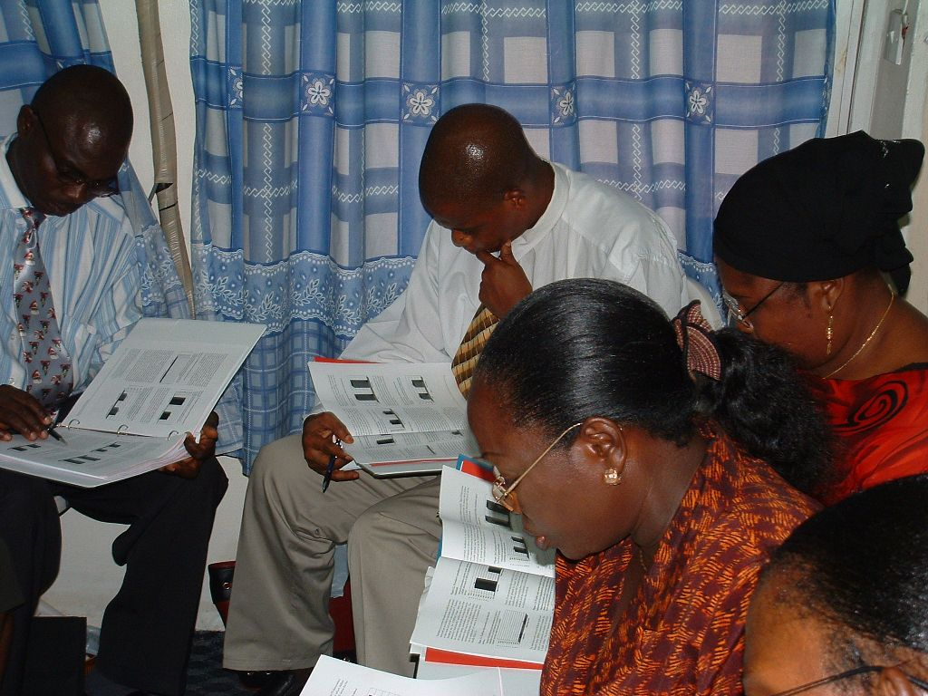
Information Use Mapping
Notes:
It may be the case that your data gap exists because of problems in the flow of information in the health system. Information flow is the collection of data from the client at the health facility or hospital, the collation of that data by data analysts, the use of that data by decision-makers, and finally how information derived from that data is disseminated back to the staff at health facilities and their clients.
In order to assess the information flow in a health system, I would like to briefly introduce to you the Data Demand and Use Tool: Information Use Mapping.

Slide 18
Information Use Mapping
Data Use Problem:
  Information is collected, but not shared and interpreted by those who can use it.
Data Use Solution:
  Assess how data is translated into useful information within a health system.
  Determine how that information can be used by all actors in the health system to improve health service delivery.
Notes:
The Information Use Mapping tool was primarily created in response to a problem commonly encountered in health services. Data is often collected and reported, but it never seems to be used, especially at the local level where services are delivered.
So the idea behind the tool was to help those at the service delivery level, who may collect and report data, to visually see how this data can be translated into information that can be used to improve their operations.
It helps all stakeholder groups that collect data on health service delivery understand how that data is eventually interpreted and used to make changes to the healthcare system.
Health facilities that collect data can then:
Identify ways they can use the information to improve their own service delivery efforts and,
Highlight missed opportunities for feedback from other stakeholder groups who conduct data analysis and interpretation.

Slide 19
Information Use Mapping
Goals:
  Find opportunities to increase who translates data into useful information
  Bring local expertise into data interpretation and increase use of data to inform programmatic decisions.
  Identify ways that information can be presented as feedback to others in the health service system
Notes:
The information Use Map documents the process of when data is collected, to when it is reported and used.
The goal of this exercise is to:
Find opportunities to increase the number of stakeholder groups who translate data into useful information.
Bring in those with experience delivering health services, use their insight to interpret data, and increase their use of this interpretation to make decisions about their health programs.
Identify ways that different actors can use information to provide constructive feedback to others in the health system.
The achievement of these 3 goals will contribute greatly to improving both quality and production of data throughout the health service system.

Slide 20
How to do an Information Use Map?
Scope of program(s) to assess
Identify key data users and data producers
How is information collected: desk reviews, interviews, and validation workshops
Adapt tool:
  Involve those active in the program area of interest
  Detail of assessment matches their specific needs
Notes:
The main steps to implementing an Information Use Map assessment are:
1.) Decide the scope of the assessment. For example, do you want to assess data flow throughout a national heath service system or do you want to look at just one health facility? Should the assessment include community-based data, specific surveys, or just routine data?
2.) Identify a CORE GROUP of data users and producers who are able to describe how data is created and used in the existing health service system. A data user can be a health professional, policy maker or other key health decision maker who uses data to inform the design, implementation, monitoring, or improvement of health programs. Data producers are professionals who acquire and analyze health data, and prepare them for distribution to audiences of users. These include monitoring and evaluation (M&E) specialists, data clerks, or researchers.
3.) This CORE GROUP of data users and producers will then find out how information is collected, analyzed, and reported.
This is done through a desk review of official procedures for data collection and reporting, which involves looking at plans, national policies, guidelines, M&E frameworks, or implementation plans.
An additional option is to interview about 10 to 12 key informants who represent a few typical health facilities for each stakeholder group involved in data collection and dissemination. If you access the Information Use Mapping Tool on the MEASURE Evaluation website, you will find a series of questions to help guide the development of key informant questionnaires. These questions are also useful for the CORE GROUP as well, if key informant interviews are not feasible.
Finally a validation workshop is held, with key stakeholders who have a vested interest in how information is used and can monitor any purposed changes to information flow. In this workshop, participants review the findings from the CORE GROUP, map how they expect information to be used in the future, and prioritize activities or interventions to improve data use and feedback mechanisms.
4.) Lastly, as you think about using the Information Mapping Tool, it is important to involve those organizations and government sectors relevant to the program area or context you are interested in. The detail of information described in the Mapping Tool should reflect their specific needs.

Slide 21
Notes:
This is a blank template of the Information Use Map. This map is used to describe the existing flow of information for a specific program area.
As I said before, the information used to complete this map can be gathered from desk reviews, interviews, or at a workshop with all relevant stakeholders together.
In this template, you can see that each row is represented by a specific stakeholder group. The scope of the information use assessment in this example begins at the health service delivery level with private clinics, NGOs, and government facilities, and continues all the way up to include the district, regional, and national levels.
This template is just an example. The kind of assessment that is best for your team may not include all of these stakeholder groups. You may just want to look at a group of health clinics within a district or a specific catchment area. In this case, you would change the stakeholder groups so that they reflect the scope of your assessment.
When deciding which stakeholder groups to include, it helps to start the first row with a group that collects data. As you list more groups in each subsequent row, you should include more groups who are involved in the aggregation of the data that is collected.
Now let’s look at the columns. These columns represent a specific stage in the information life cycle.
The term data collection refers to the transferring of data from records to reports.
Compilation is aggregating these reports.
Storage refers to keeping the data in a re-usable form such as data entry into a computer.
Analysis involves making inferences from the data.
Reporting transmits the data to other stakeholder groups.
And finally data use involves making information a core part of the day-to-day management of health system planning and delivery. The difference between reporting and use is important here. The term “use” in the Information Use Mapping Tool means to leverage data to support or inform a decision or activity.
Each stakeholder group agrees on how they are currently contributing to this information life cycle. Some may only collect, others might collect, compile, and store data.
As data is transferred to each stage of the information life cycle, it is important to indicate this transfer with a line or arrow [CLICK ANIMATION]. However, it may not always be the case that information is transferred to another stage in the life cycle or to another stakeholder group.

Slide 22
Notes:
This example was adapted from a 2006 Strategic Information Assessment in Swaziland that was facilitated by MEASURE Evaluation. Our stakeholder groups have now indicated in the Information Use Map how information flows through the existing health service structure.
In this case, the first column indicates that data is collected at the health service delivery level by private clinics, NGOs, and government facilities.
The second column tells us that data is compiled, or aggregated, only from government facilities. This government facility data is compiled again at the district, again at the regional, and then stored, together with raw data from NGOs and private clinics at the national level.
The only time all of this data is analyzed and reported on is at the national level. And then the only time all this information is actually used is when there is a need for another national 5-year strategic plan.
When information flow is mapped visually, deficiencies quickly become apparent. The large, empty expanses of the chart tells the story. In this map, it is clear that insights from high-level reports are not shared back with lower levels, and information is being used only to file reports, not to support evidence-based decisions for program improvements.

Slide 23
Notes:
This map highlights the many potential improvements to the M&E system, including points where feedback mechanisms can be developed and opportunities for increased data use can be identified.
The mapping process shows how each level of service delivery can improve their use of the data for local decision making, as indicated by the added red squares. Also, the map shows how the data collected at the facility level contributes to national data systems and the decision-making process.
As an example, additional steps were identified at the government facility [CLICK ANIMATION] where client data could be stored and used to conduct client-level as well as facility-level analysis [CLICK ANIMATION]. This client data could then be routinely reviewed at facility management meetings and used for program planning and improvements [CLICK ANIMATION].
The arrows along the left-hand side show how data are shared back with those who collect the data to improve the feedback and monitoring of services delivered. So in our example, not only is the government facility receiving feedback from the district, but is also providing feedback to both the NGOs and the private clinics.
Now in this example, because we applied a broad scope that ranged from the service delivery level to the national level you might think that this tool is only useful for data use planning at the national level. However you can also use the Information Use Map with stakeholders groups involved with a specific health program or geographic area.
The comparison between the existing information flow and this future vision of how information can flow in a health system is mainly designed to help health professionals identify new ways that data can be used by a specific stakeholder group, and how a variety of stakeholder groups can work together to tackle different aspects of the information life cycle.
It may be the case that in order to achieve this vision, other more fundamental data use constraints need to be addressed. In this case the Assessment of Data Use Constraints Tool found on the MEASURE Evaluation website can be used by the a stakeholder group to dig deeper into the challenges of using data to inform their day-to-day programmatic decisions.
The ideal vision of information use is when:
Any step along the information life cycle can be done by any stakeholder group member.
Each stakeholder group identifies some use for the information generated.

Slide 24
Planning Matrix Template
Barrier or Problem Identified in Map | Proposed Intervention | Steps Involved | Person(s) Responsible | Other Stakeholders | General Timeline
Notes:
Now establishing a vision of how data can be used by all stakeholder groups is just the beginning. Enacting this vision may take time and management skills.
In order to manage the transition, this Planning Matrix template can be used to outline and track a sequence of steps to improve information flow based on the previous analysis.
The first column lists the barrier to information flow or problem identified in the Information Use Map such as no method of storing data at the private clinic. Then the relevant stakeholders propose how they plan to change this aspect of data flow, list the steps involved, those responsible for making sure it gets done along with other stakeholders that may be involved, and finally a general timeline for when the change will occur.
It may help to prioritize the barriers to information flow that are 1) most changeable and 2) have the greatest impact on improving data use in decision making.
This Planning Matrix should be considered a guiding work plan , representing steps and best practices for improving Information flow and use, and should not be considered a strict prescription.

Slide 25
Information Use Mapping Resources
Tool is available on the MEASURE Evaluation website: www.measureevaluation.org/ddu-toolkit
  Instructions for use
  Key informant interview guides
  Planning matrix template
  Implementation checklist
Other Field Applications are described in the Information Use Map tool on MEASURE Evaluation website.
Notes:
You can access the information mapping tool on the MEASURE Evaluation website.
Are there any questions?

Slide 26
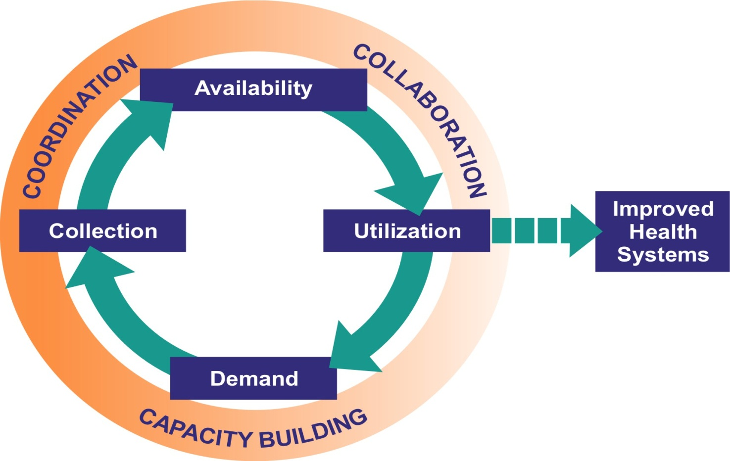
Data-informed Decision Making Process
Notes:
In order to understand the factors that inhibit or encourage data-informed decision making, we need to review the entire process that leads to evidenced-based decisions and eventually to improved health outcomes. There are many other contributing factors that affect data use.
The visual process depicted here illustrates the entire cycle of evidence-based decision making. This approach is the ideal.
The inner circle are the activities that take place: demand for data leads to collection and making it available for use to improve health systems.
The outer circle explains how these activities get done.
It starts with basic Monitoring & Evaluation systems, and securing the technical and human capacity to manage and analyze the data.
There is coordination to ensure that the information is available, in a format that is easily understood by all relevant stakeholders, and can be interpreted and used to improve policies and programs.
And finally there is collaboration among data users, data producers, management systems, and other organizational supports that facilitate data informed decision making.
The cycle supports the assumption that the more positive experiences a decision maker has in using information to support a decision, the stronger the commitment will be to improving data collection systems and continuing to use the information they generate.
ENGAGE PARTICIPANTS: Ask the participants, “This raises the question—is this what we are experiencing in our own work environments?” Allow time for a brief open discussion and summarize the points made by the group.
26

Slide 27
MEASURE Evaluation is a MEASURE project funded by the
U.S. Agency for International Development and implemented by
the Carolina Population Center at the University of North Carolina
at Chapel Hill in partnership with Futures Group International,
ICF Macro, John Snow, Inc., Management Sciences for Health,
and Tulane University. Views expressed in this presentation do not
necessarily reflect the views of USAID or the U.S. Government.
MEASURE Evaluation is the USAID Global Health Bureau's
primary vehicle for supporting improvements in monitoring and
evaluation in population, health and nutrition worldwide.

